Slide 1
An automated design of the thermostable
multiple-point mutants
Miloš Musil

Slide 2
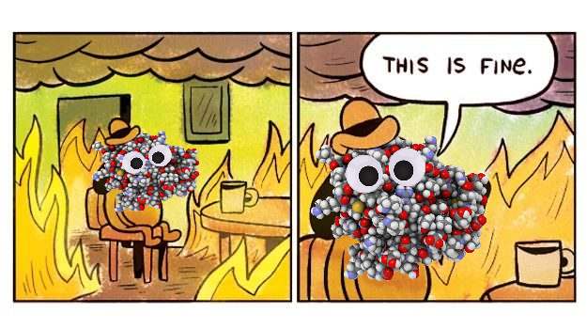
Protein stability
Ability to withstand higher temperatures
Evolved mostly in mild conditions
Applicable for industry, medicine, ...
Single-point mutants
Easier to design
Low stability

Slide 3
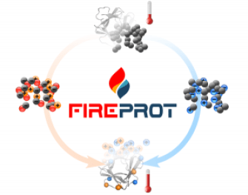
FireProt
Design of thermostable multiple-point mutants
Only PDB structure required
Antagonistic effect prediction
Hybrid method:
Energy approach
Evolution approach
Web service

Slide 4
Workflow

Slide 5
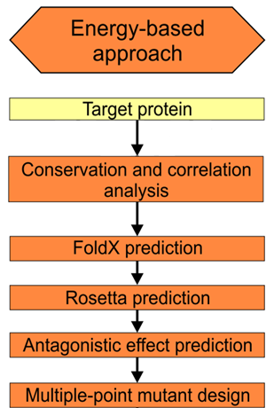
Energy-based approach
MSA constructed by ClustalΩ
Conservation calculated by Jensen-Shannon entropy
7 tools for correlation analysis

Slide 6
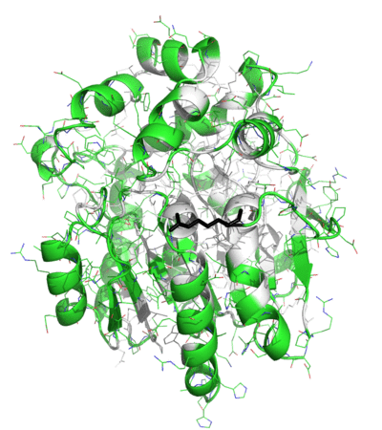
Energy-based approach
Hundreds of stable mutations

Slide 7
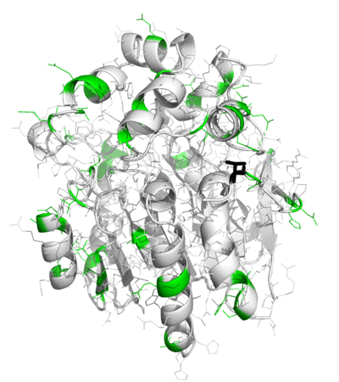
Energy-based approach
Dozens of stable mutations

Slide 8
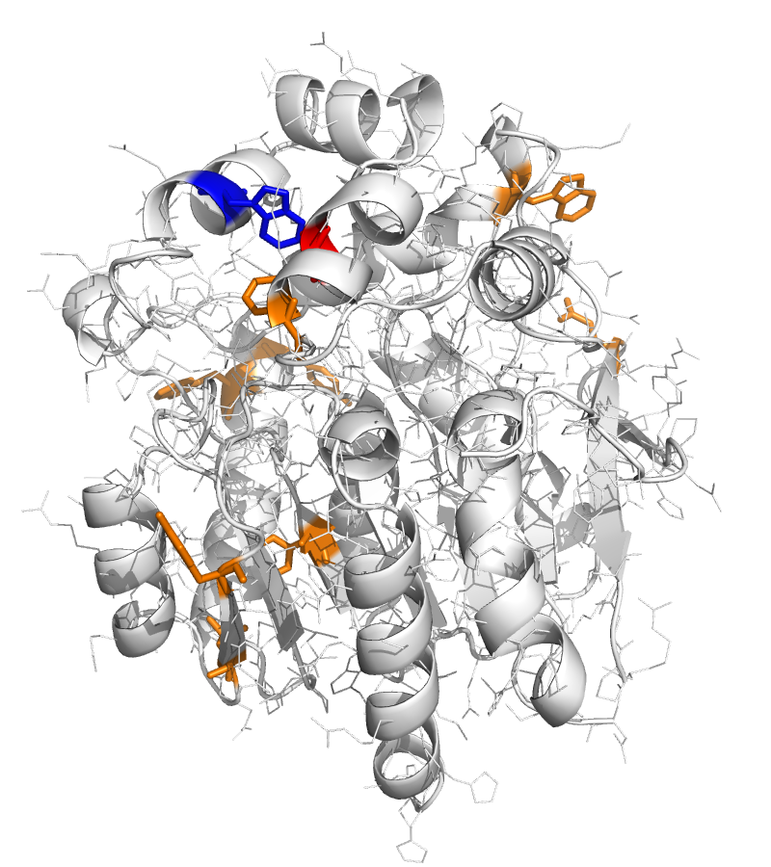
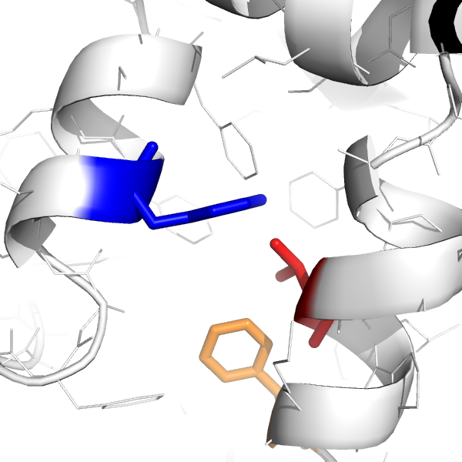
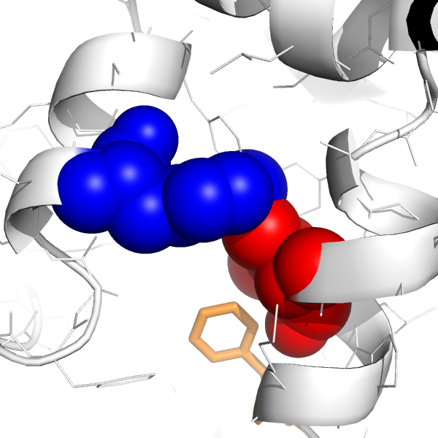
Energy-based approach
Single -> multi-point mutations

Slide 9
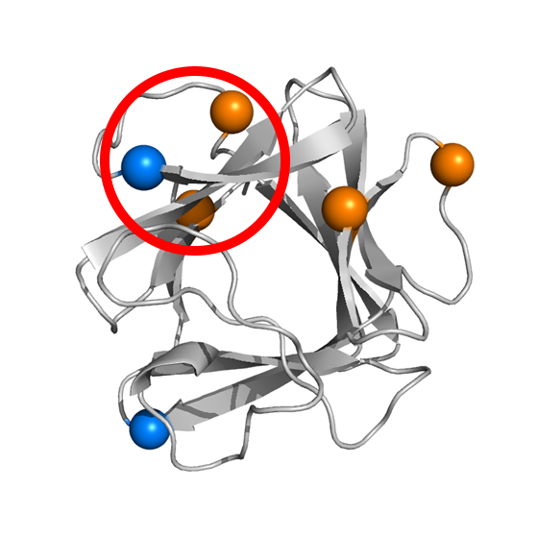
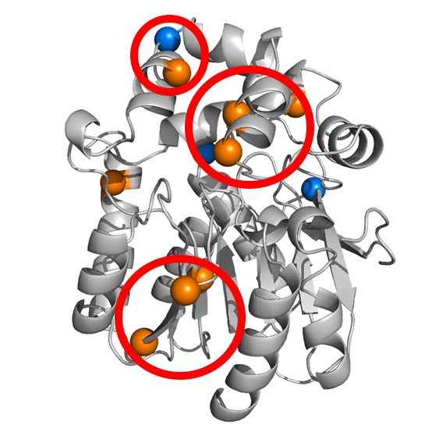
Antagonistic effect
High time complexity: O(n²)
~ 30 – 40 minutes per calculation
Not all pairs have to be analyzed
~ additive for distant mutations

Slide 10
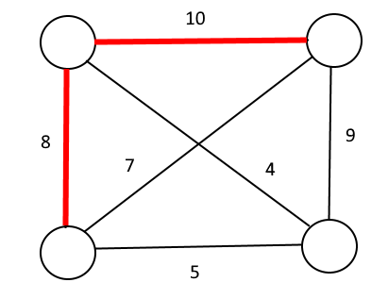
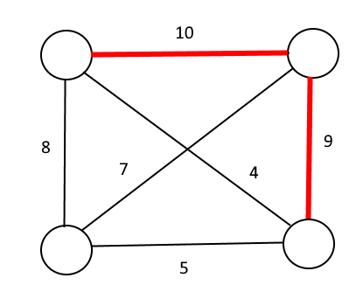
Antagonistic effect
What mutations to select?
Graph algorithms:
Pairs of mutations
Construction of the complete graph

Slide 11
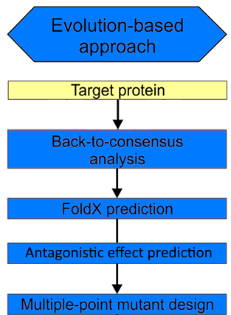
Evolution-based approach
Frequency and ratio approach
Reverting back to consensus

Slide 12
Time demands
Highly time demanding
FoldX & Rosetta calculations
Optimized protocols
Multiple-point mutant construction
Utilization of MetaCentrum
2-3 weeks -> 1-2 days

Slide 13
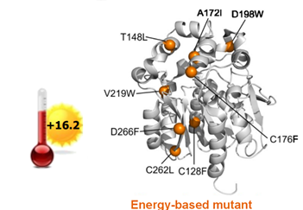
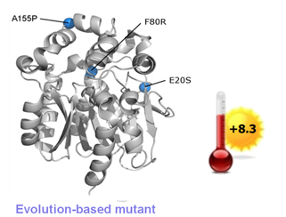
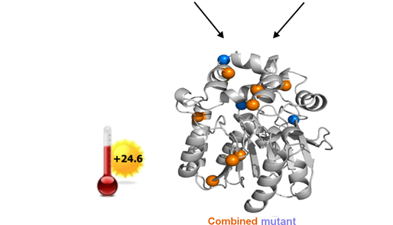
Results

Slide 14
Web server - input

Slide 15
Web server - settings

Slide 16
Web server - results

Slide 17
Web server - results

Slide 18
Summary
Automated design of stable multiple-point mutants
Energy & evolution based approaches
Antagonistic effect prediction
Easy-to-use interface
Web server available at:
https://loschmidt.chemi.muni.cz/fireprot/
Musil, M., et al., 2017: FireProt: Web Server for Automated Design of Thermostable Proteins, Nucleic Acids Research, 45(W1).

Slide 19
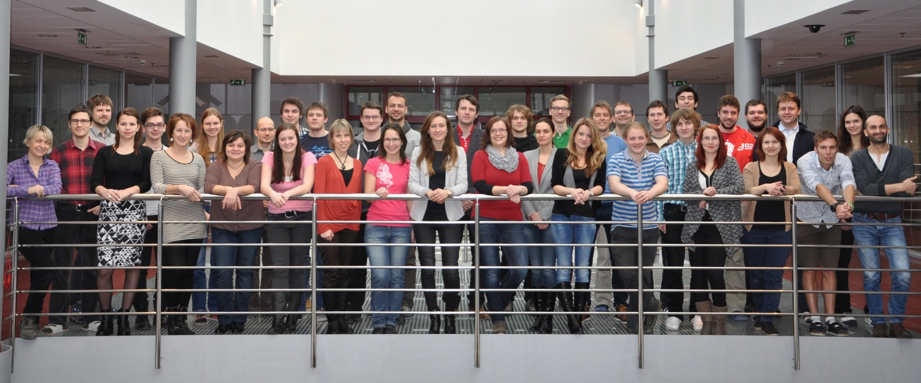
Acknowledgement

