Slide 1
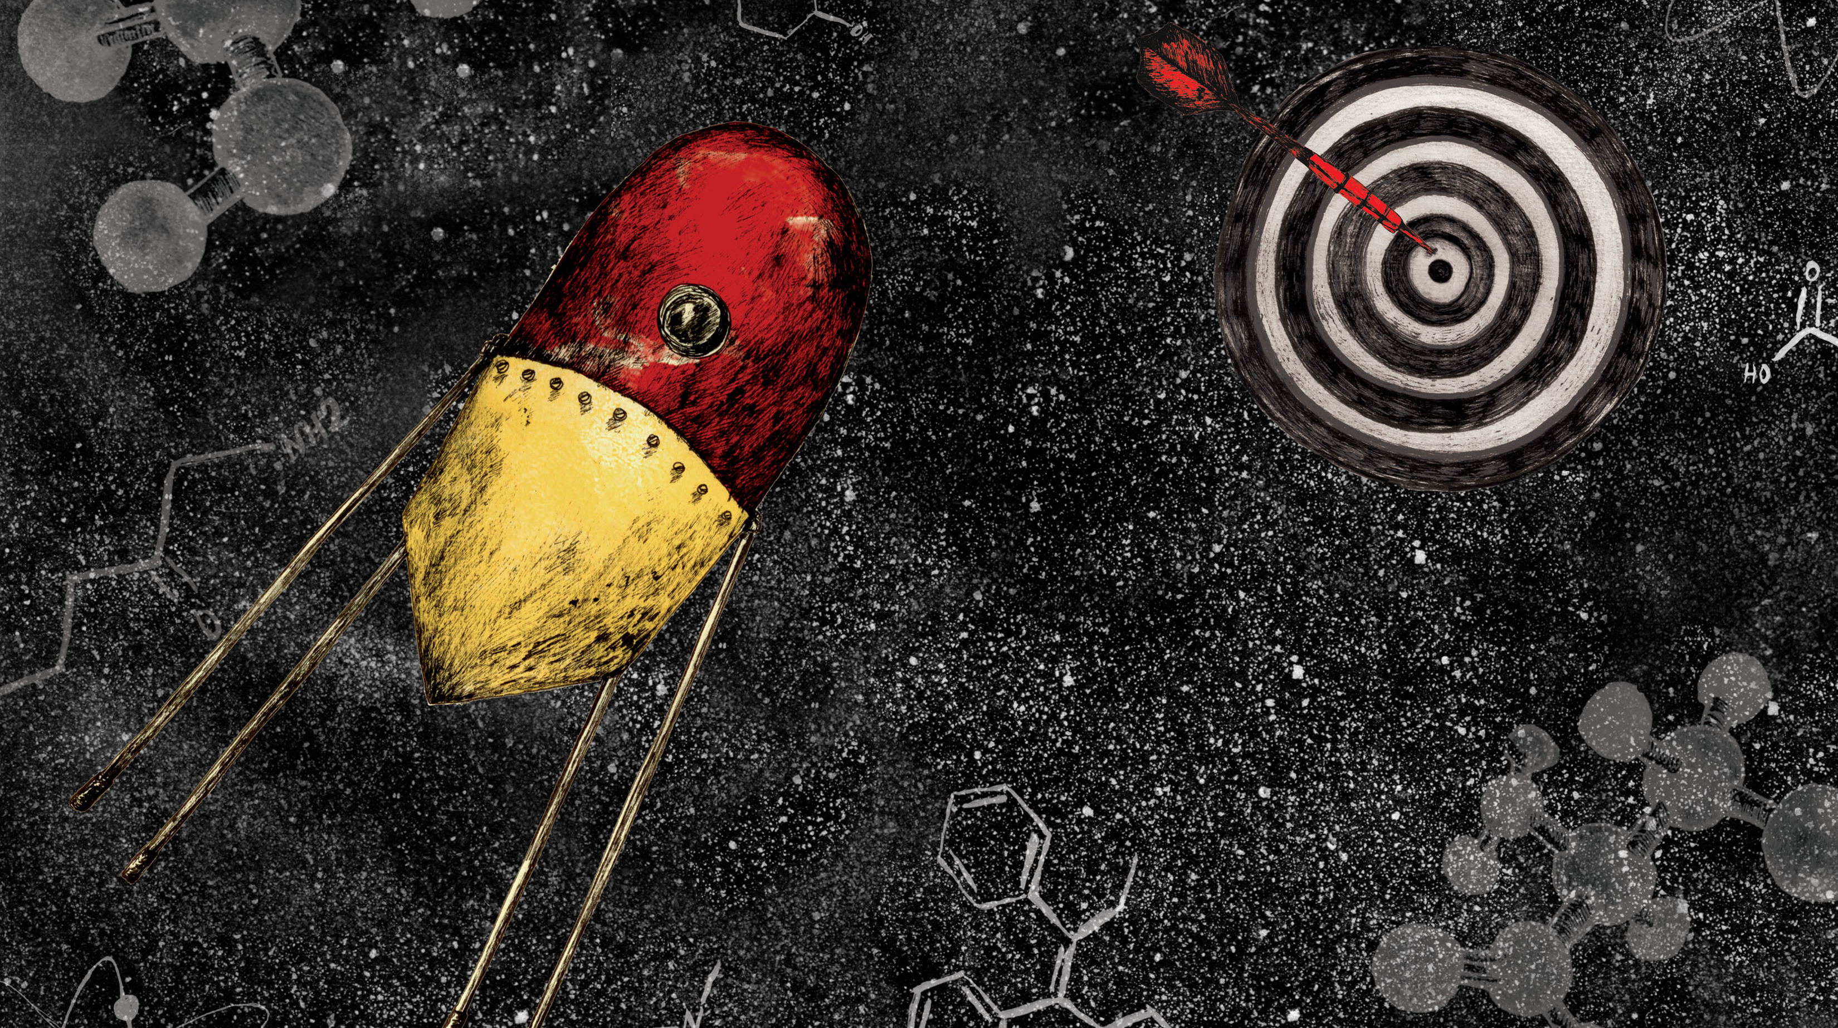
Probes & Drugs portal
An interactive open data approach
for chemical biology
Ctibor Škuta
UCT Prague

Slide 2
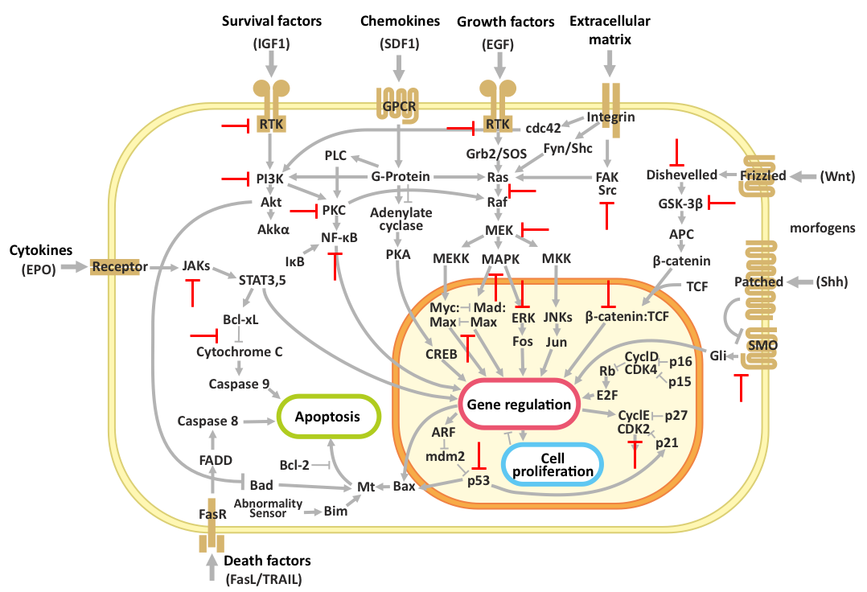
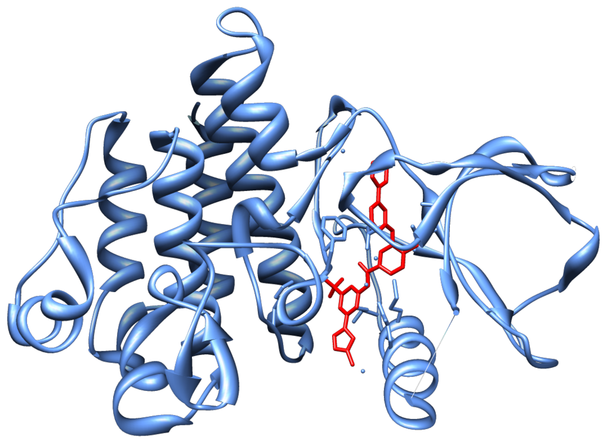
What are chemical tools for?
Abl
Nilotinib

Slide 3
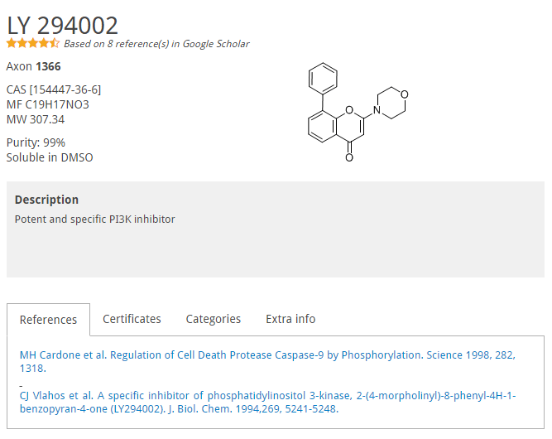
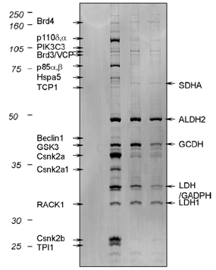
LY-294002
a selective inhibitor of PI3 kinase, originally described in 1994
10 years ago known inhibition of many other proteins at the concentrations used to inhibit PI3 kinase
Gharbi SI, Zvelebil MJ, Shuttleworth SJ, Hancox T, Saghir N, Timms JF, Waterfield MD: Exploring the specificity of the PI3K family inhibitor LY294002. Biochem J 2007, 404(1):15-21.

Slide 4
Staurosporine most potent Protein Kinase C (PKC) inhibitor known
Binds to almost 400 targets (most of them in concentrations < 100nM)
Many others: Quercetin, Curcumin, Sunitinib etc.
Wang et al., Evidence-based and quantitative prioritization of tool compounds in phenotypic drug discovery Cell Chem. Biol. 23, 862-874 (2016).

Slide 5
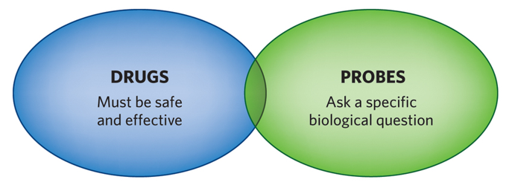
Drugs vs. Probes
Possibly unknown Mechanism-of-action (MOA)
Bioavailable
Defined MOA
Potent
Selective
Modified from: Arrowsmith, C.H., et al., The promise and peril of chemical probes. Nat Chem Biol, 2015. 11(8): p. 536-41.

Slide 6
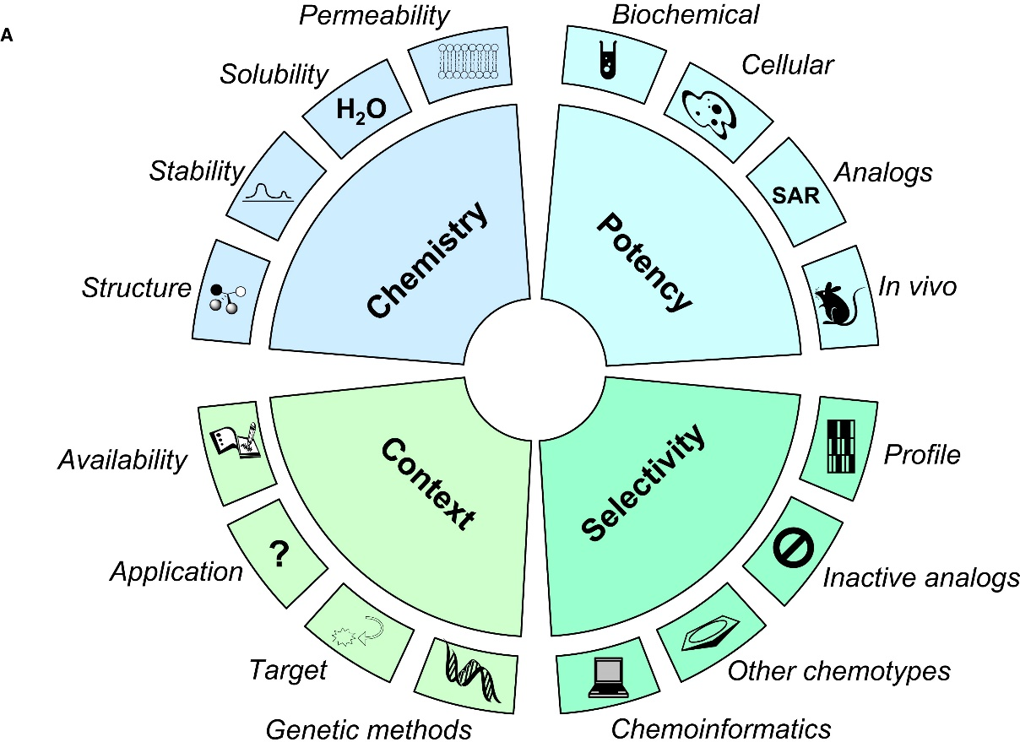
What is a chemical probe?
“A chemical probe is simply a reagent—a selective small-molecule modulator of a protein’s function—that allows the user to ask mechanistic and phenotypic questions about its molecular target in cell-based or animal studies.” http://www.chemicalprobes.org
Criteria | Biochemical assays | Cell-based assays
Potency | <100nM | <1 – 10μM
Selectivity | >10 – 100 fold | >10 – 100 fold
Workman P, Collins I: Probing the probes: fitness factors for small molecule tools. Chem Biol 2010, 17(6):561-577.

Slide 7
Current state of chemical probes (tools)
Informer set
Probes
Probes
PKIS
NPC Screening

Slide 8
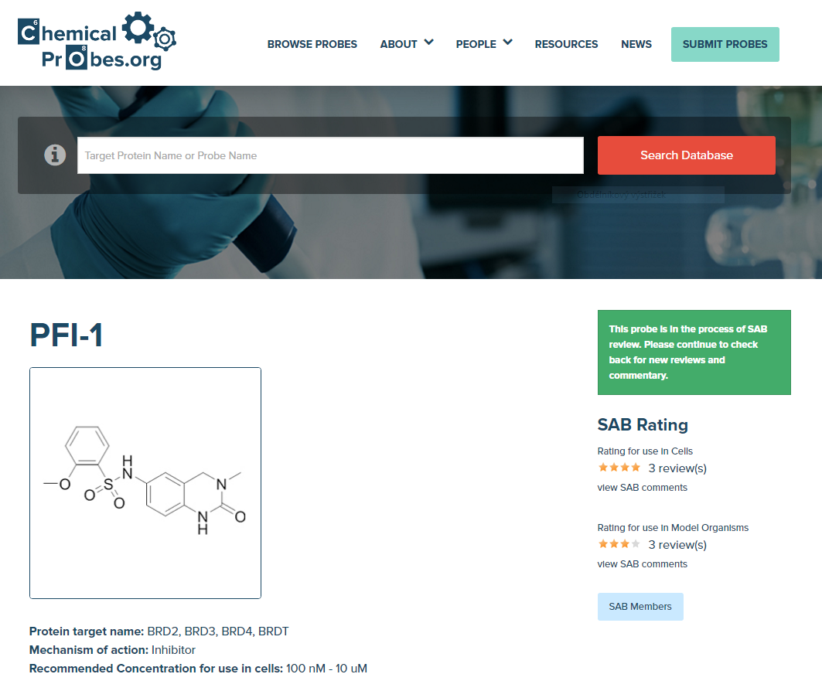
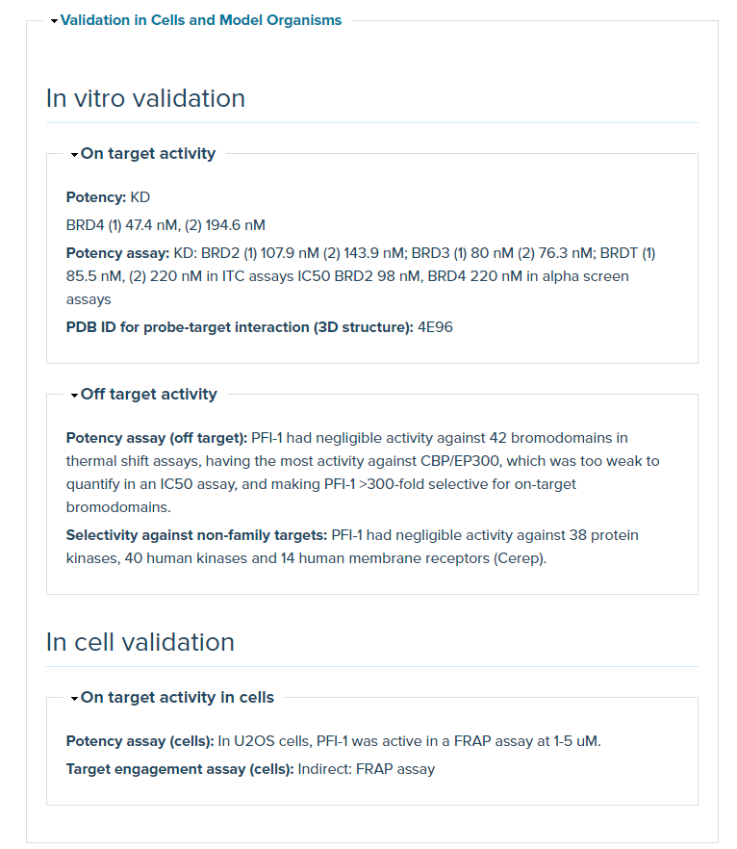
Chemical Probes.org
Arrowsmith, C.H., et al., The promise and peril of chemical probes. Nat Chem Biol, 2015. 11(8): p. 536-41.

Slide 9
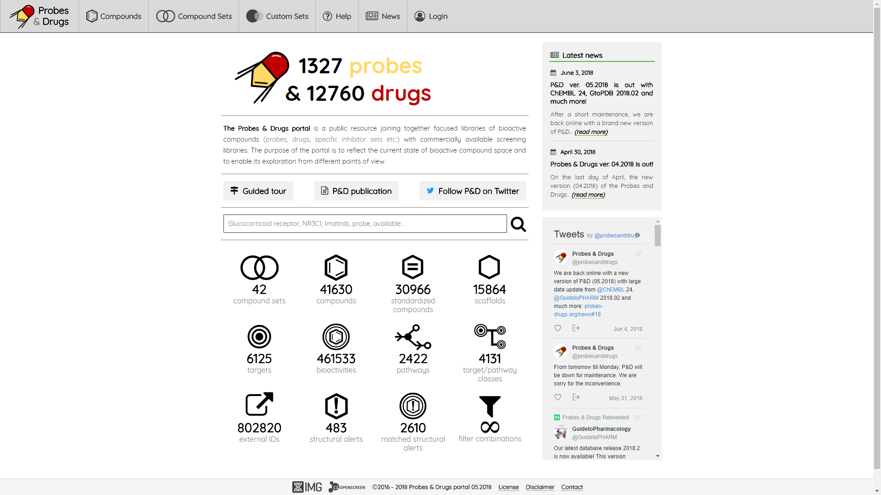

Slide 10
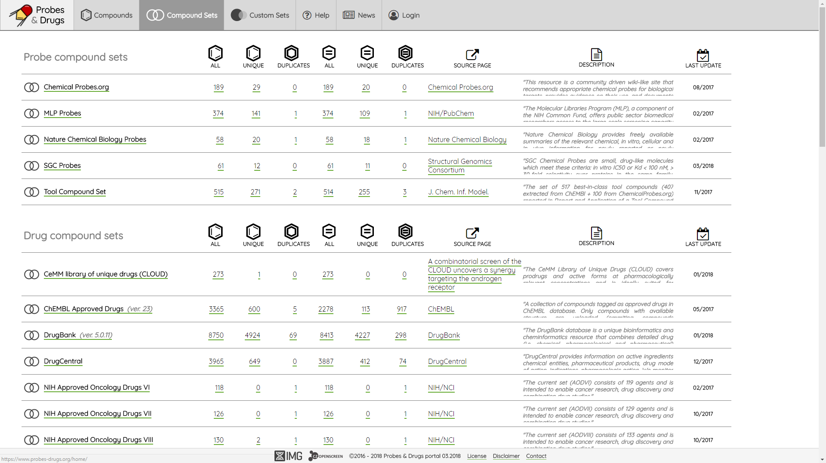

Slide 11
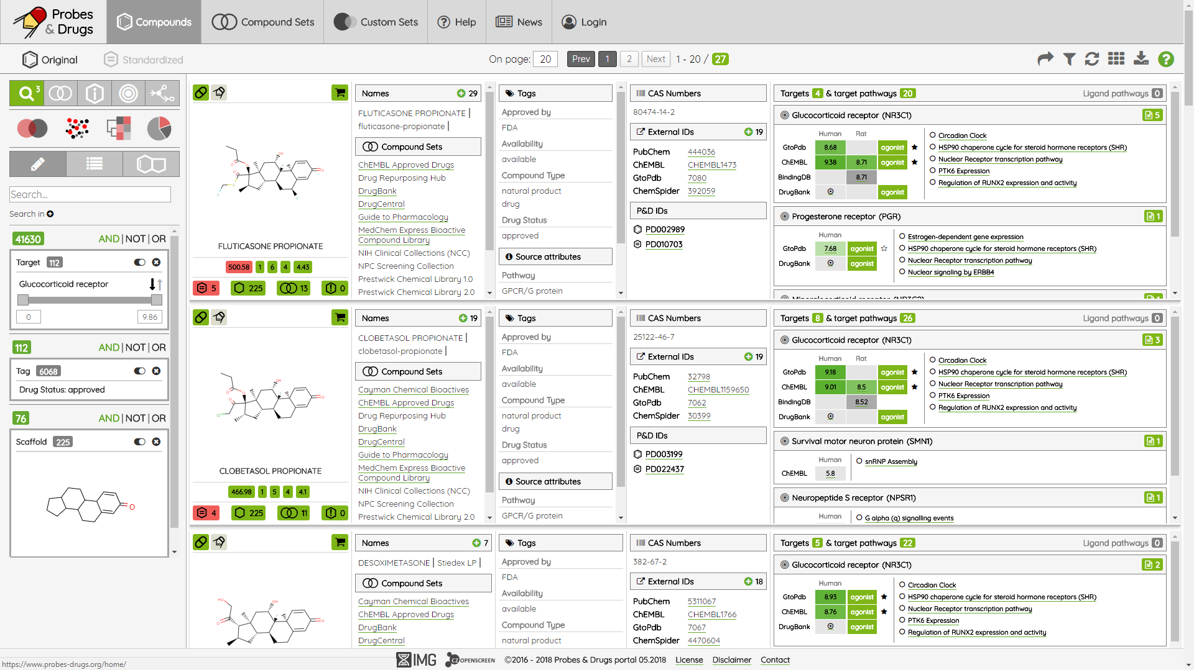

Slide 12
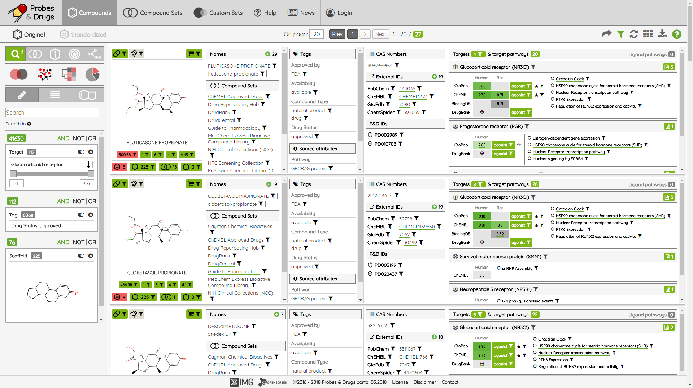

Slide 13
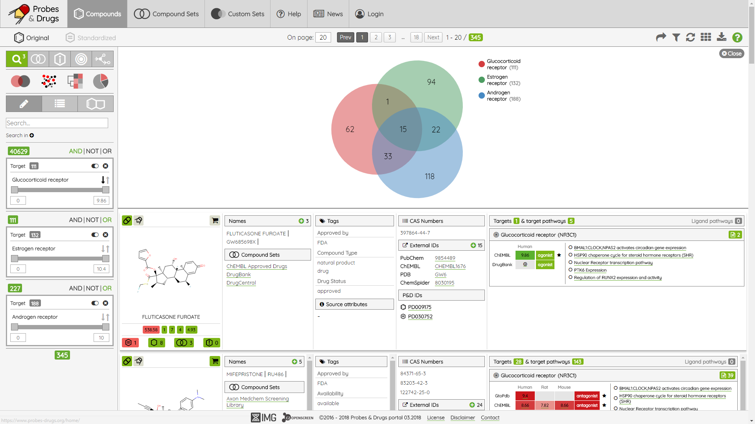

Slide 14
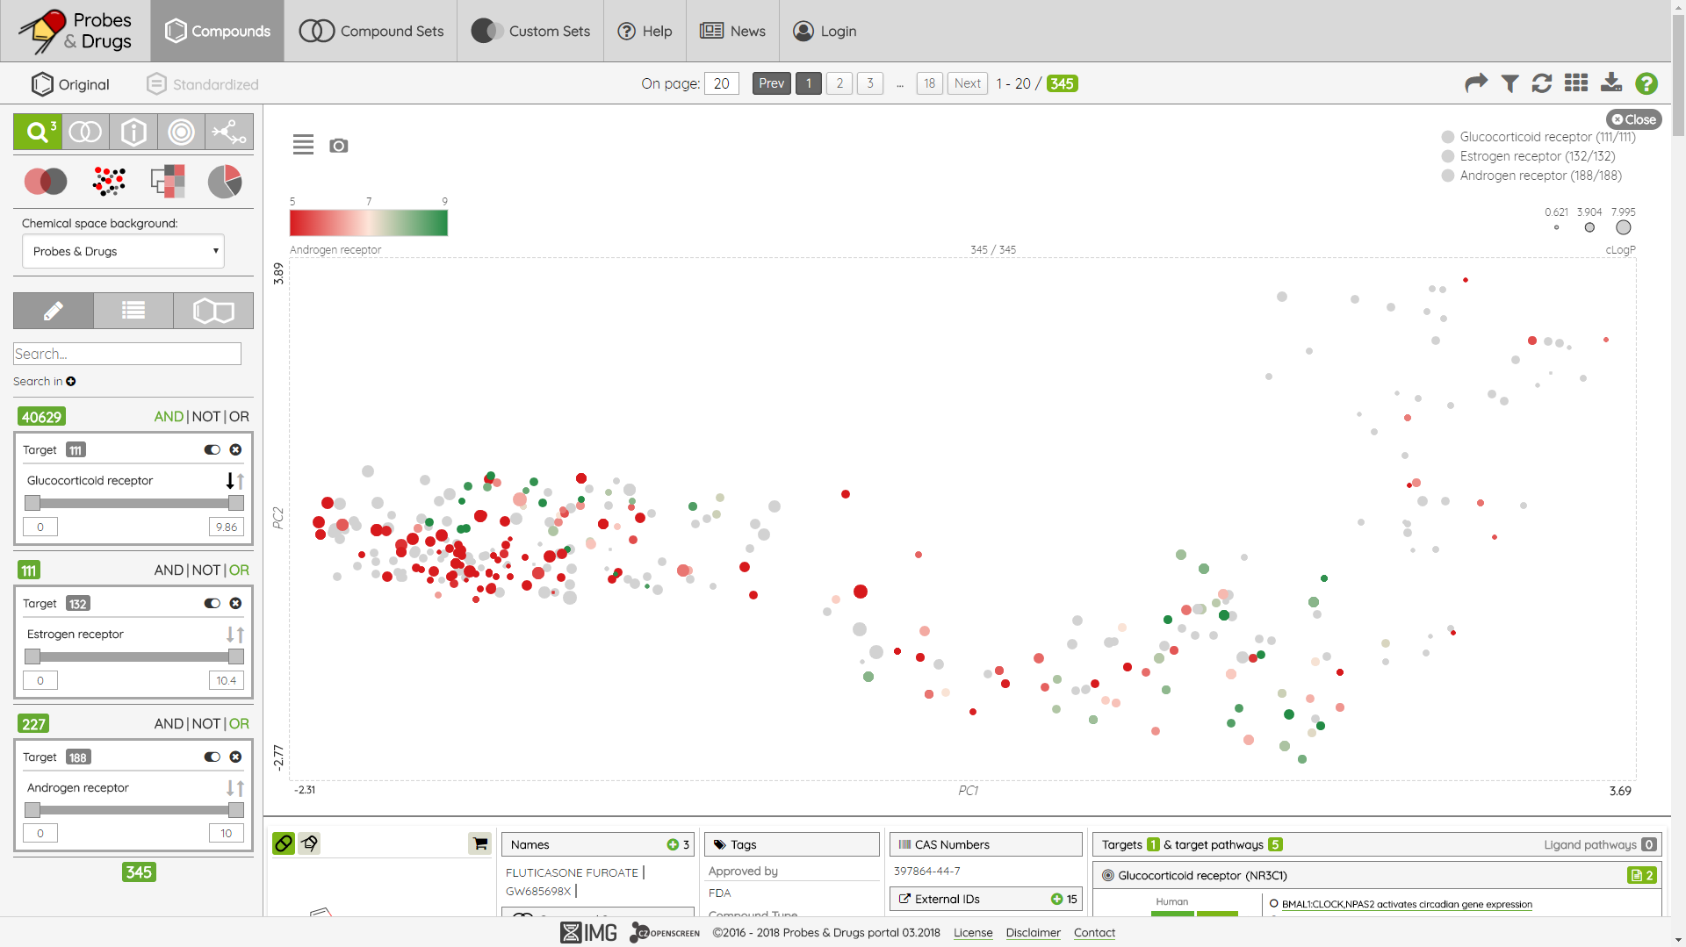

Slide 15
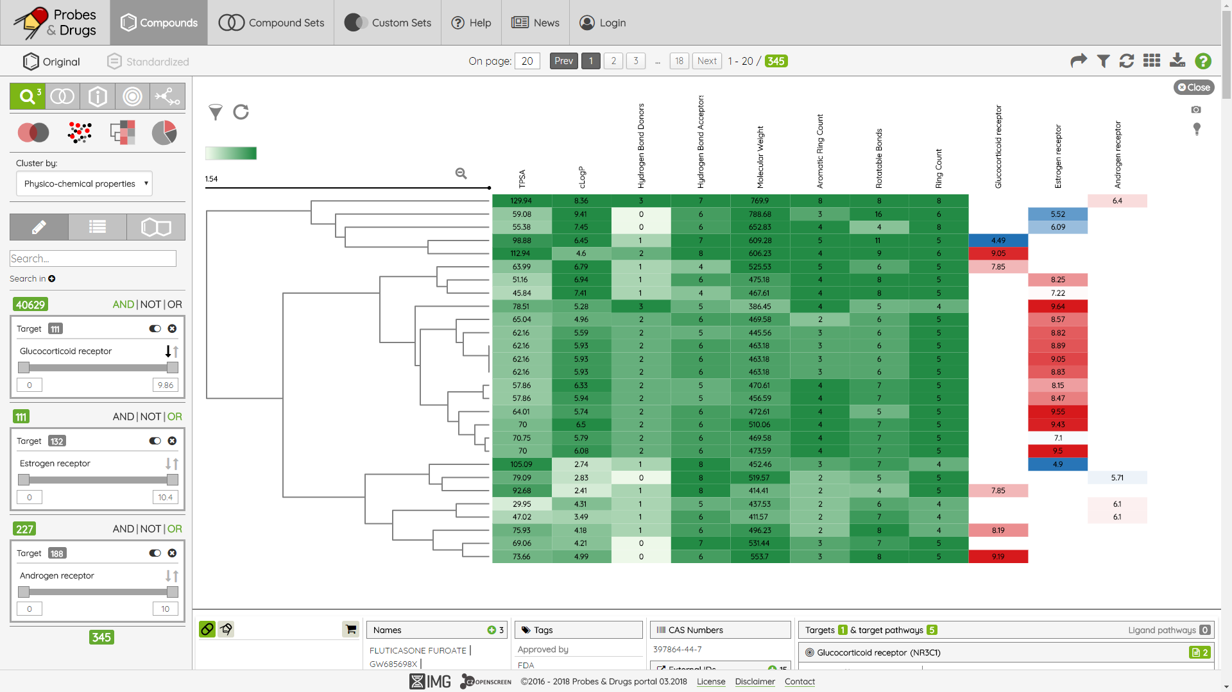

Slide 16
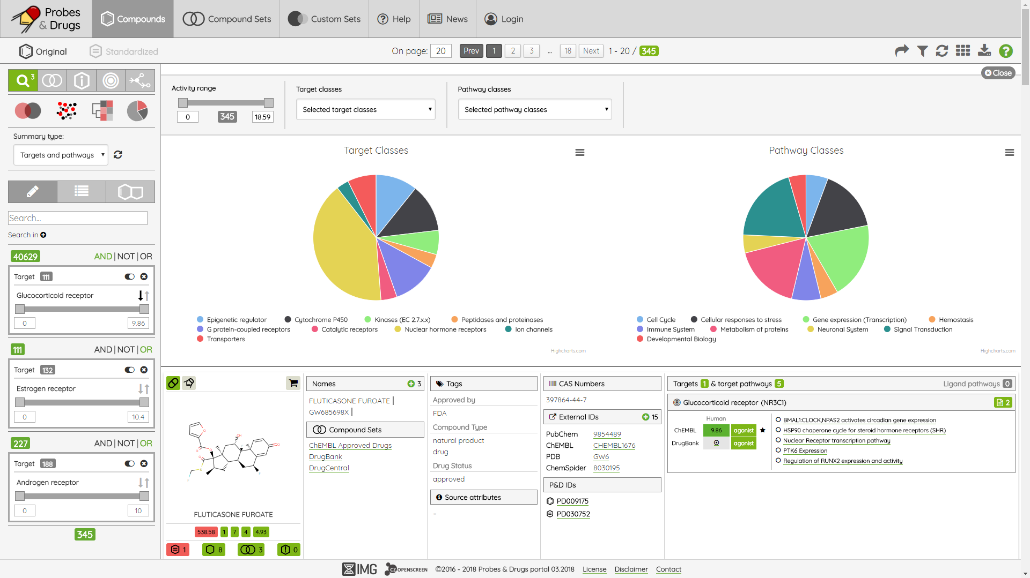

Slide 17
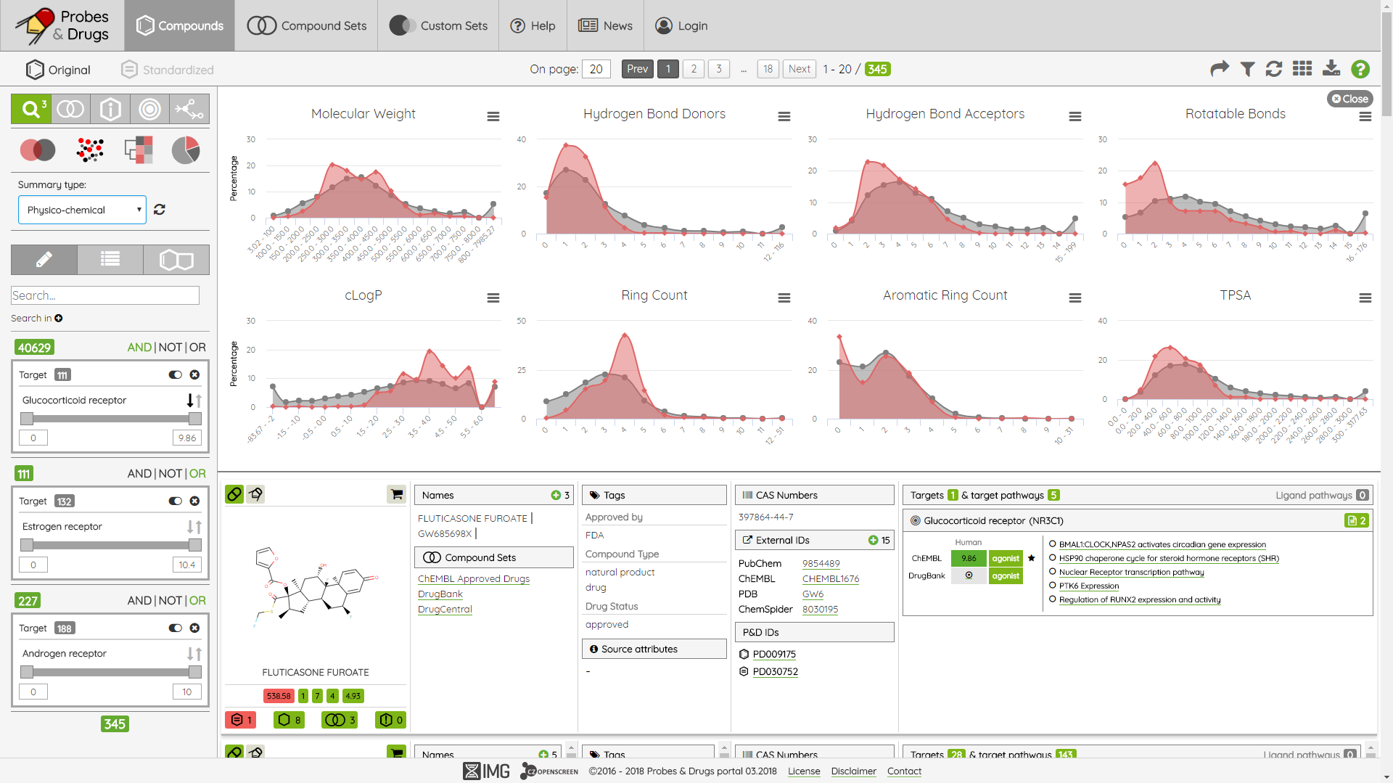

Slide 18
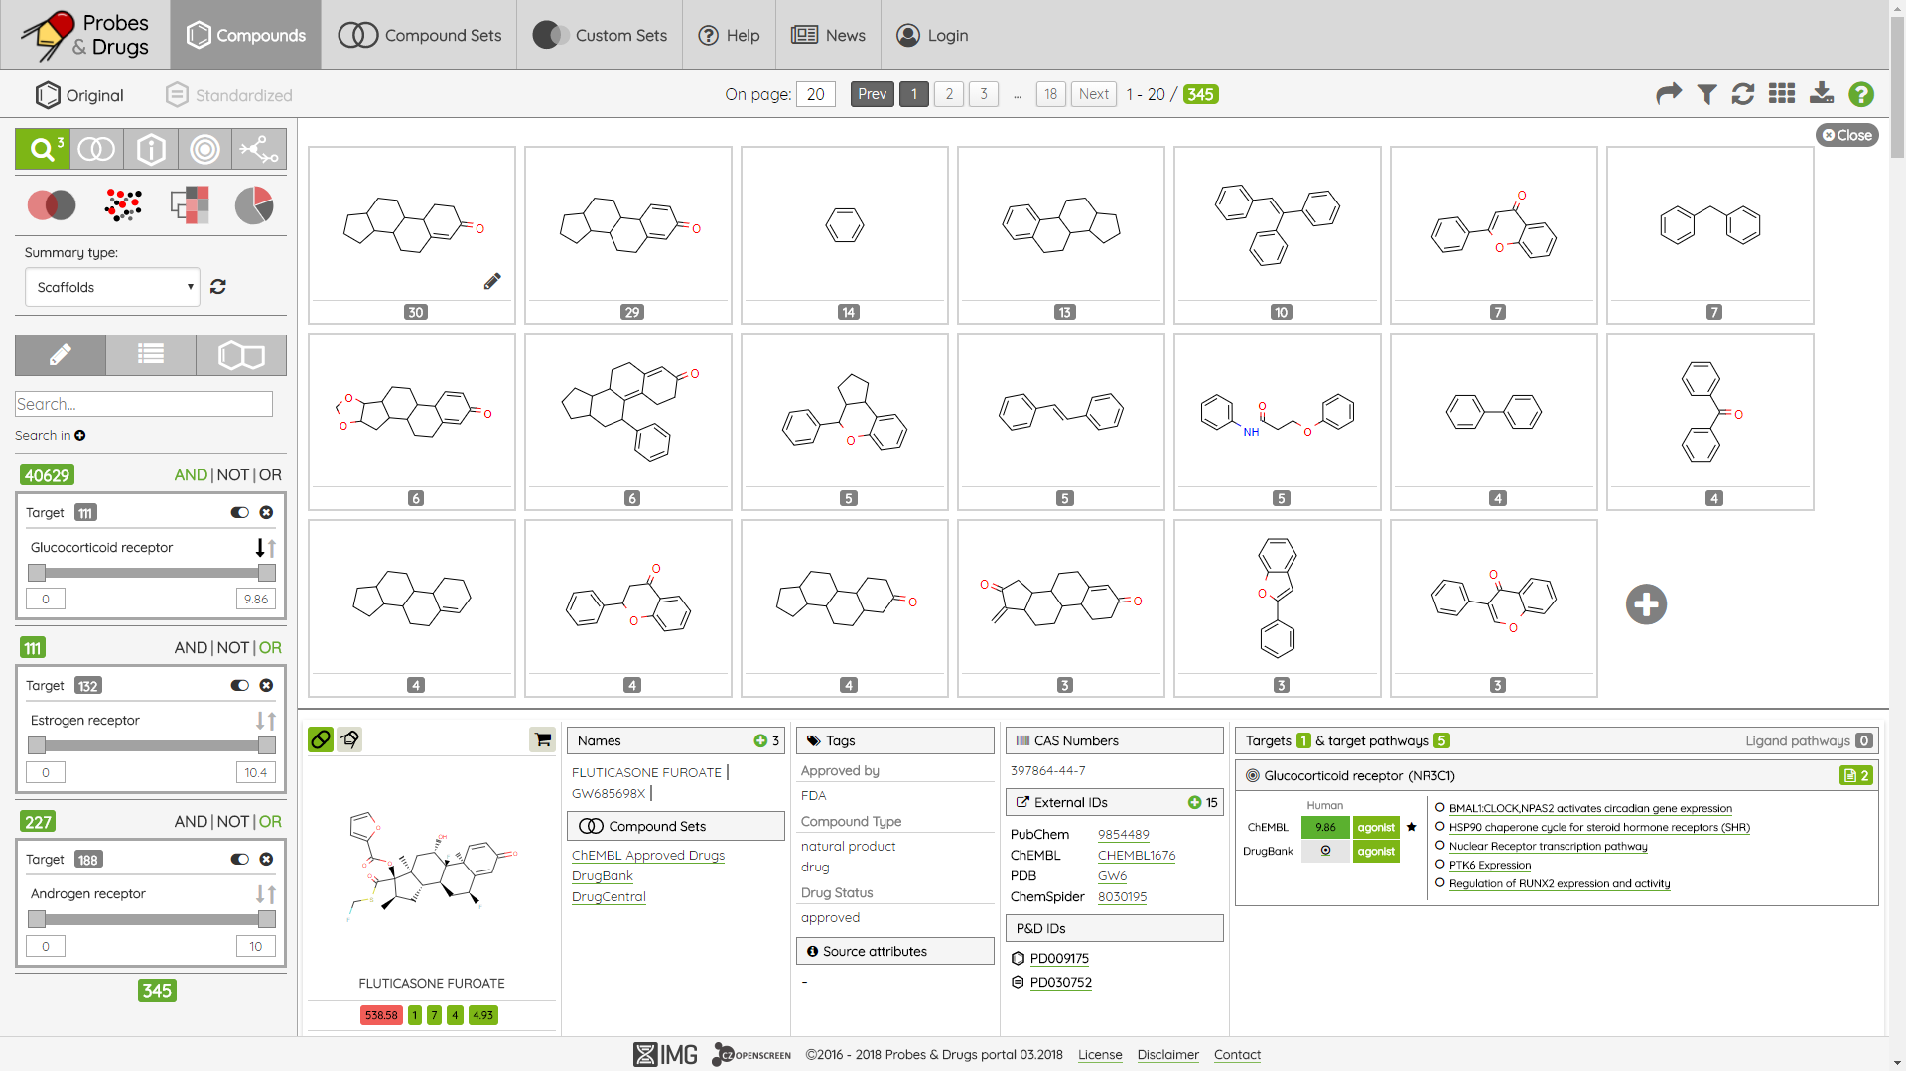

Slide 19
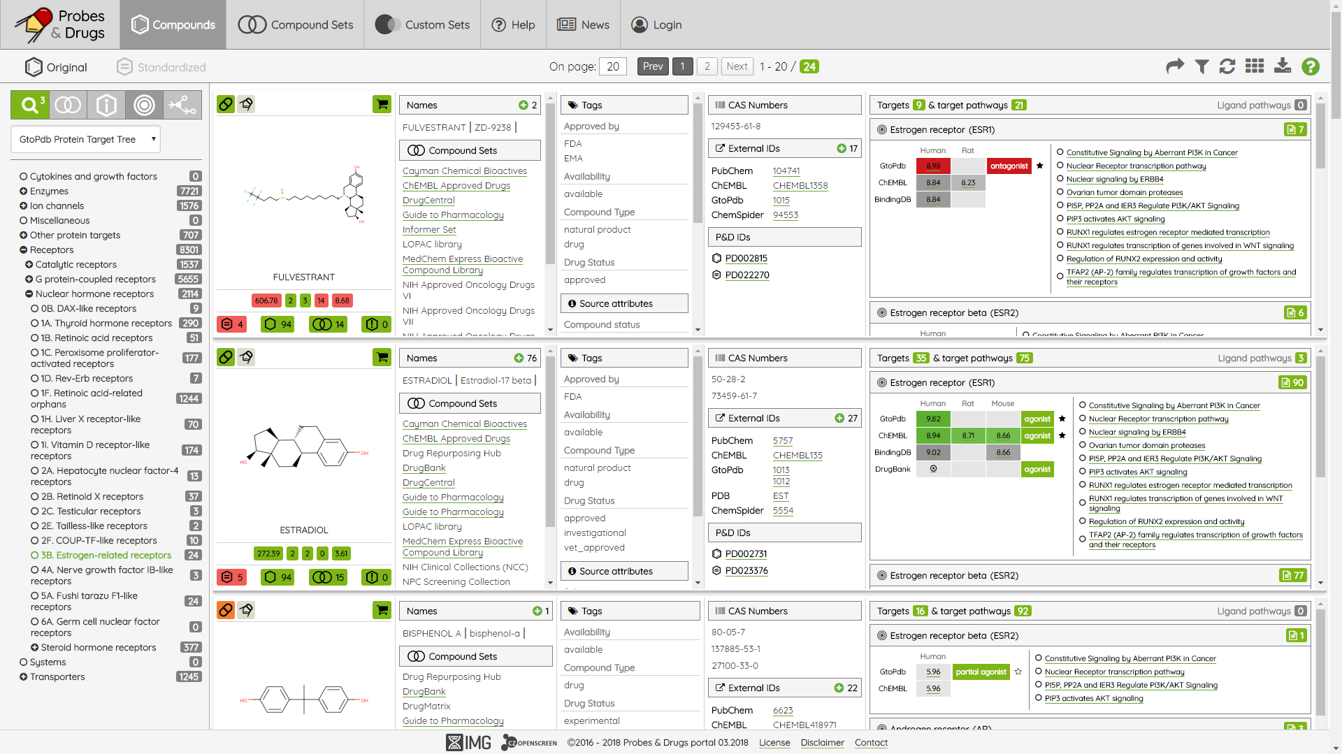

Slide 20
Conclusions
public resource for chemical biology that simplifies the well-informed selection of high quality chemical tools
the most comprehensive source of compounds labelled as chemical probes and also compounds labelled as approved drugs (their active ingredients respectively)
currently, one of the three main sources in the field of chemical probes (Chemical Probes.org, Probe Miner)

Slide 21
Future plans
Quantification of a ligand‘s probe-likeness for a given target
Integration of more diverse biological data
Data browse and filtering from different points of view
Targets, diseases etc.
Advanced analysis and visualization techniques
Enrichment analysis (targets, pathways), chemical space networks etc.

Slide 22
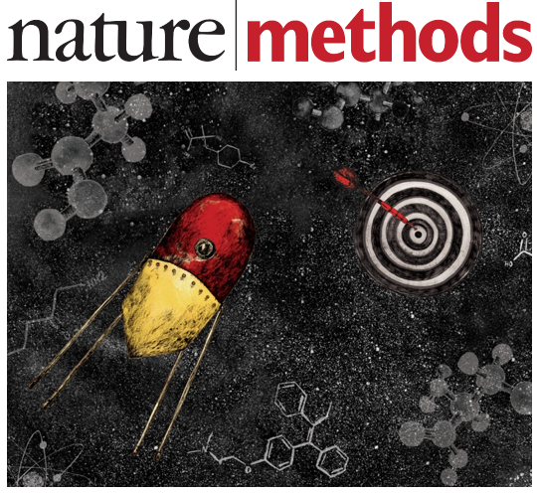
Acknowledgements
Petr Bartůněk
CZ-OPENSCREEN (IMG)
Daniel Svozil
Laboratory of informatics and chemistry (UCT)
Skuta, C.; Popr, M.; Muller, T.; Jindrich, J.; Kahle, M.; Sedlak, D.; Svozil, D.; Bartunek, P., Probes & Drugs portal: an interactive, open data resource for chemical biology. Nat methods 2017, 14 (8), 759-760.
https://probes-drugs.org

Slide 23
Thanks for your attention!
Q&A

