Slide 1
NanoLuc luciferase may not be as “nano” as previously thought
ENBIK2022, June 13-15
Jana Horáčková, Michal Nemergut, Daniel Pluskal, Sérgio Marques, Veronika Blechová, Jan Tulis, Jiří Damborský, Zbyněk Prokop, Yves L. Janin, Martin Marek, and David Bednář

Slide 2
NanoLuc
small bioluminescent enzyme
originally from deep-sea shrimp
utilizes furimazine (FMZ)

Slide 3
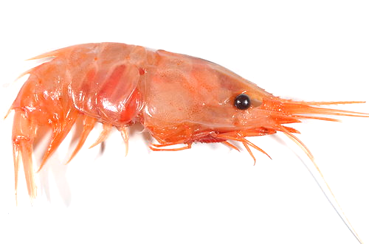
NanoLuc
small bioluminescent enzyme
originally from deep-sea shrimp
utilizes furimazine (FMZ)

Slide 4
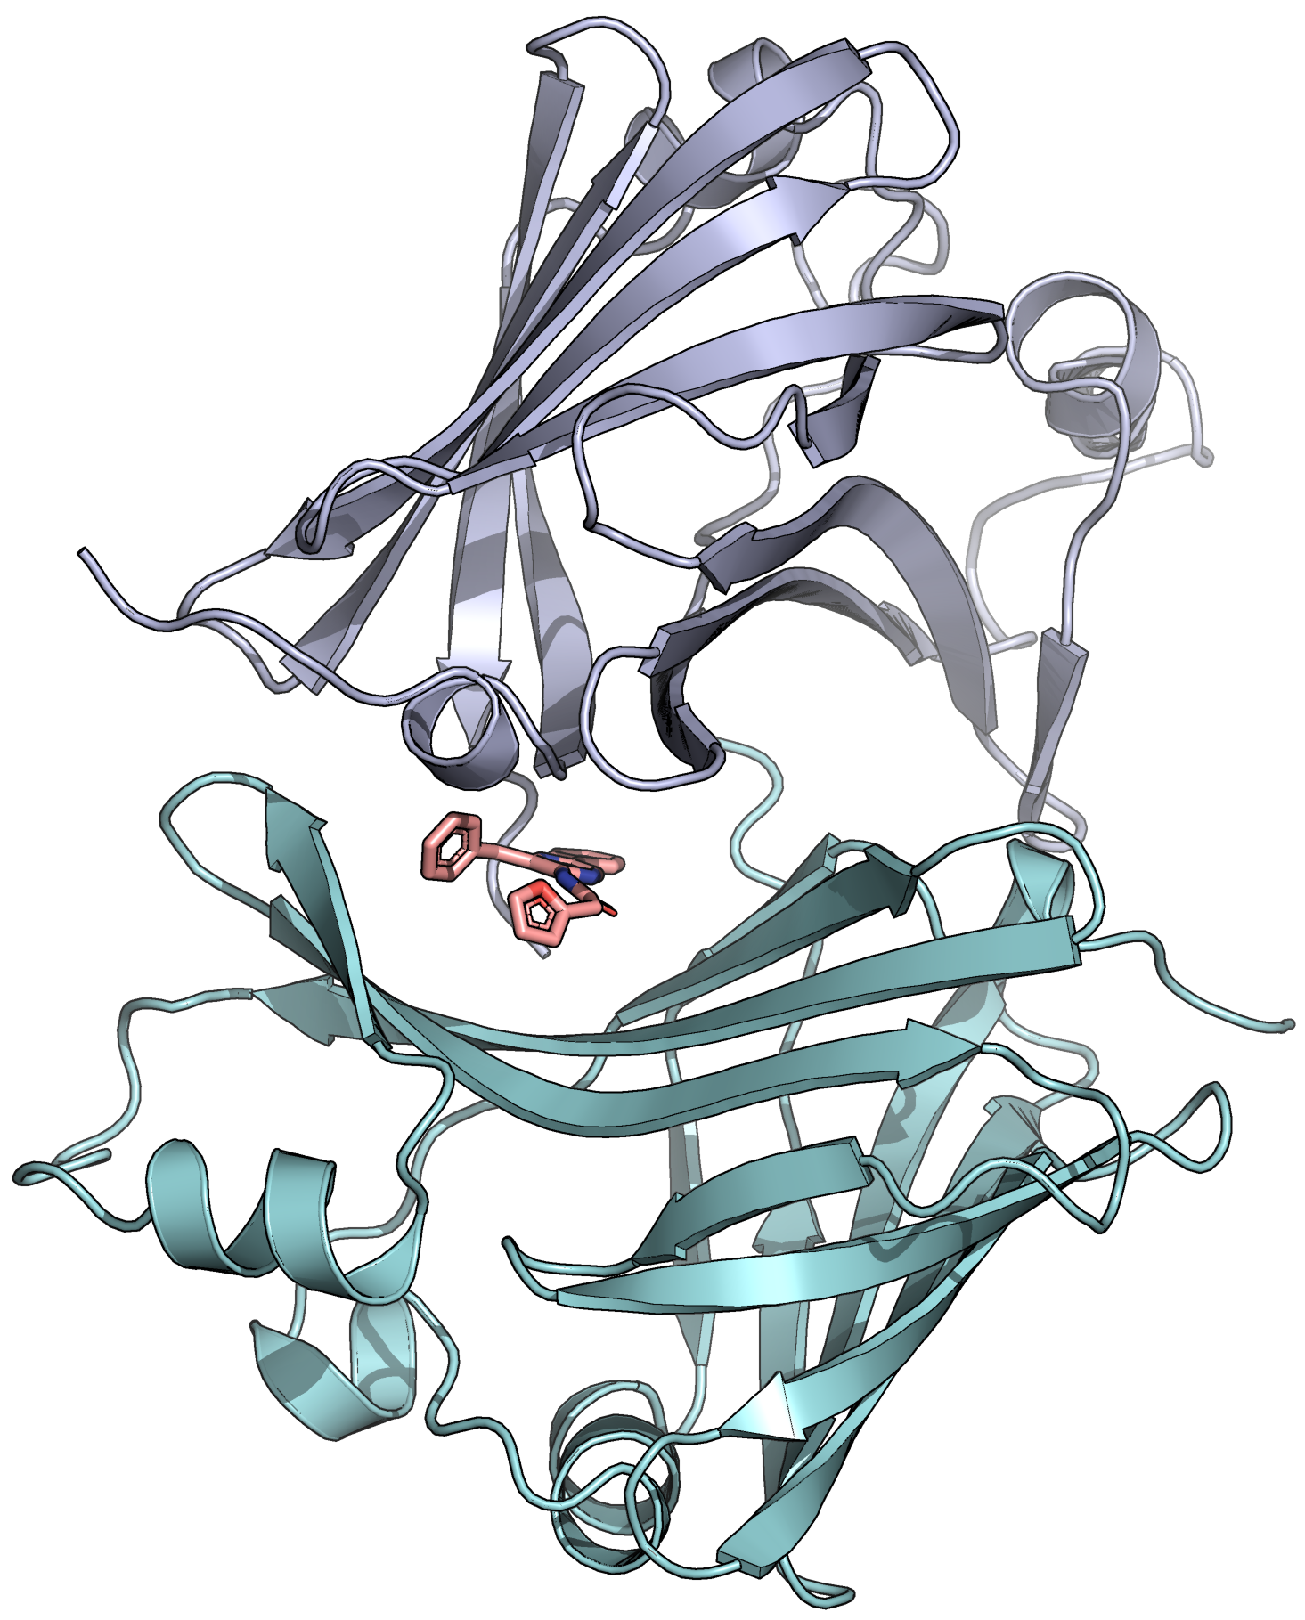
NanoLuc
small bioluminescent enzyme
originally from deep-sea shrimp
utilizes furimazine (FMZ)

Slide 5
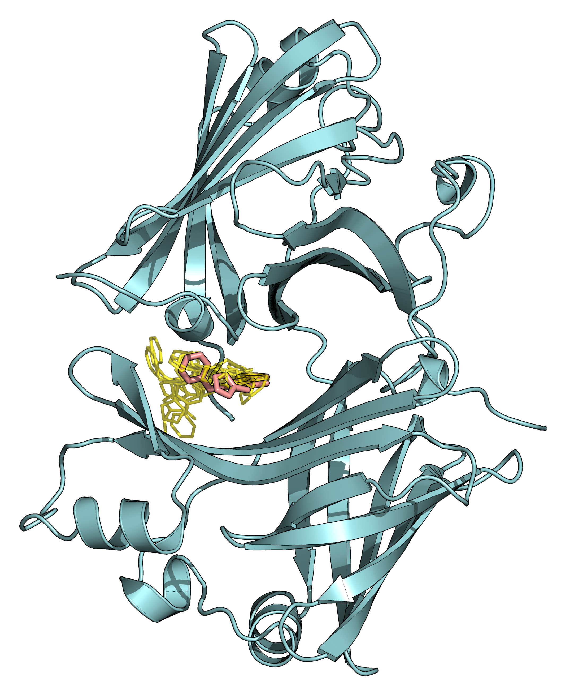
MOLECULAR DOCKING
crystallographic pose
10 best docking poses

Slide 6
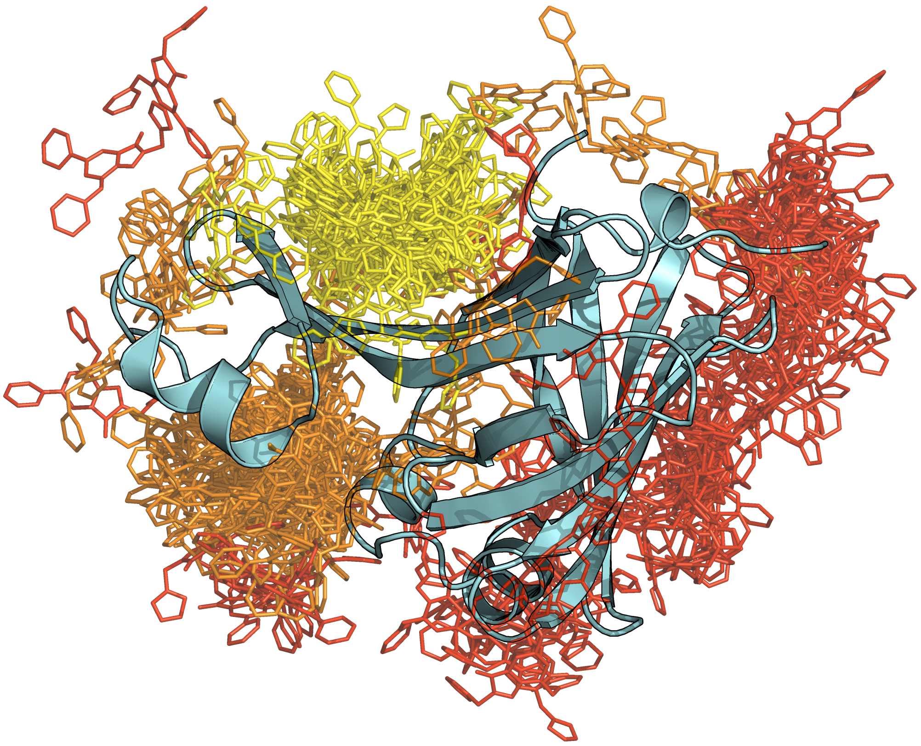
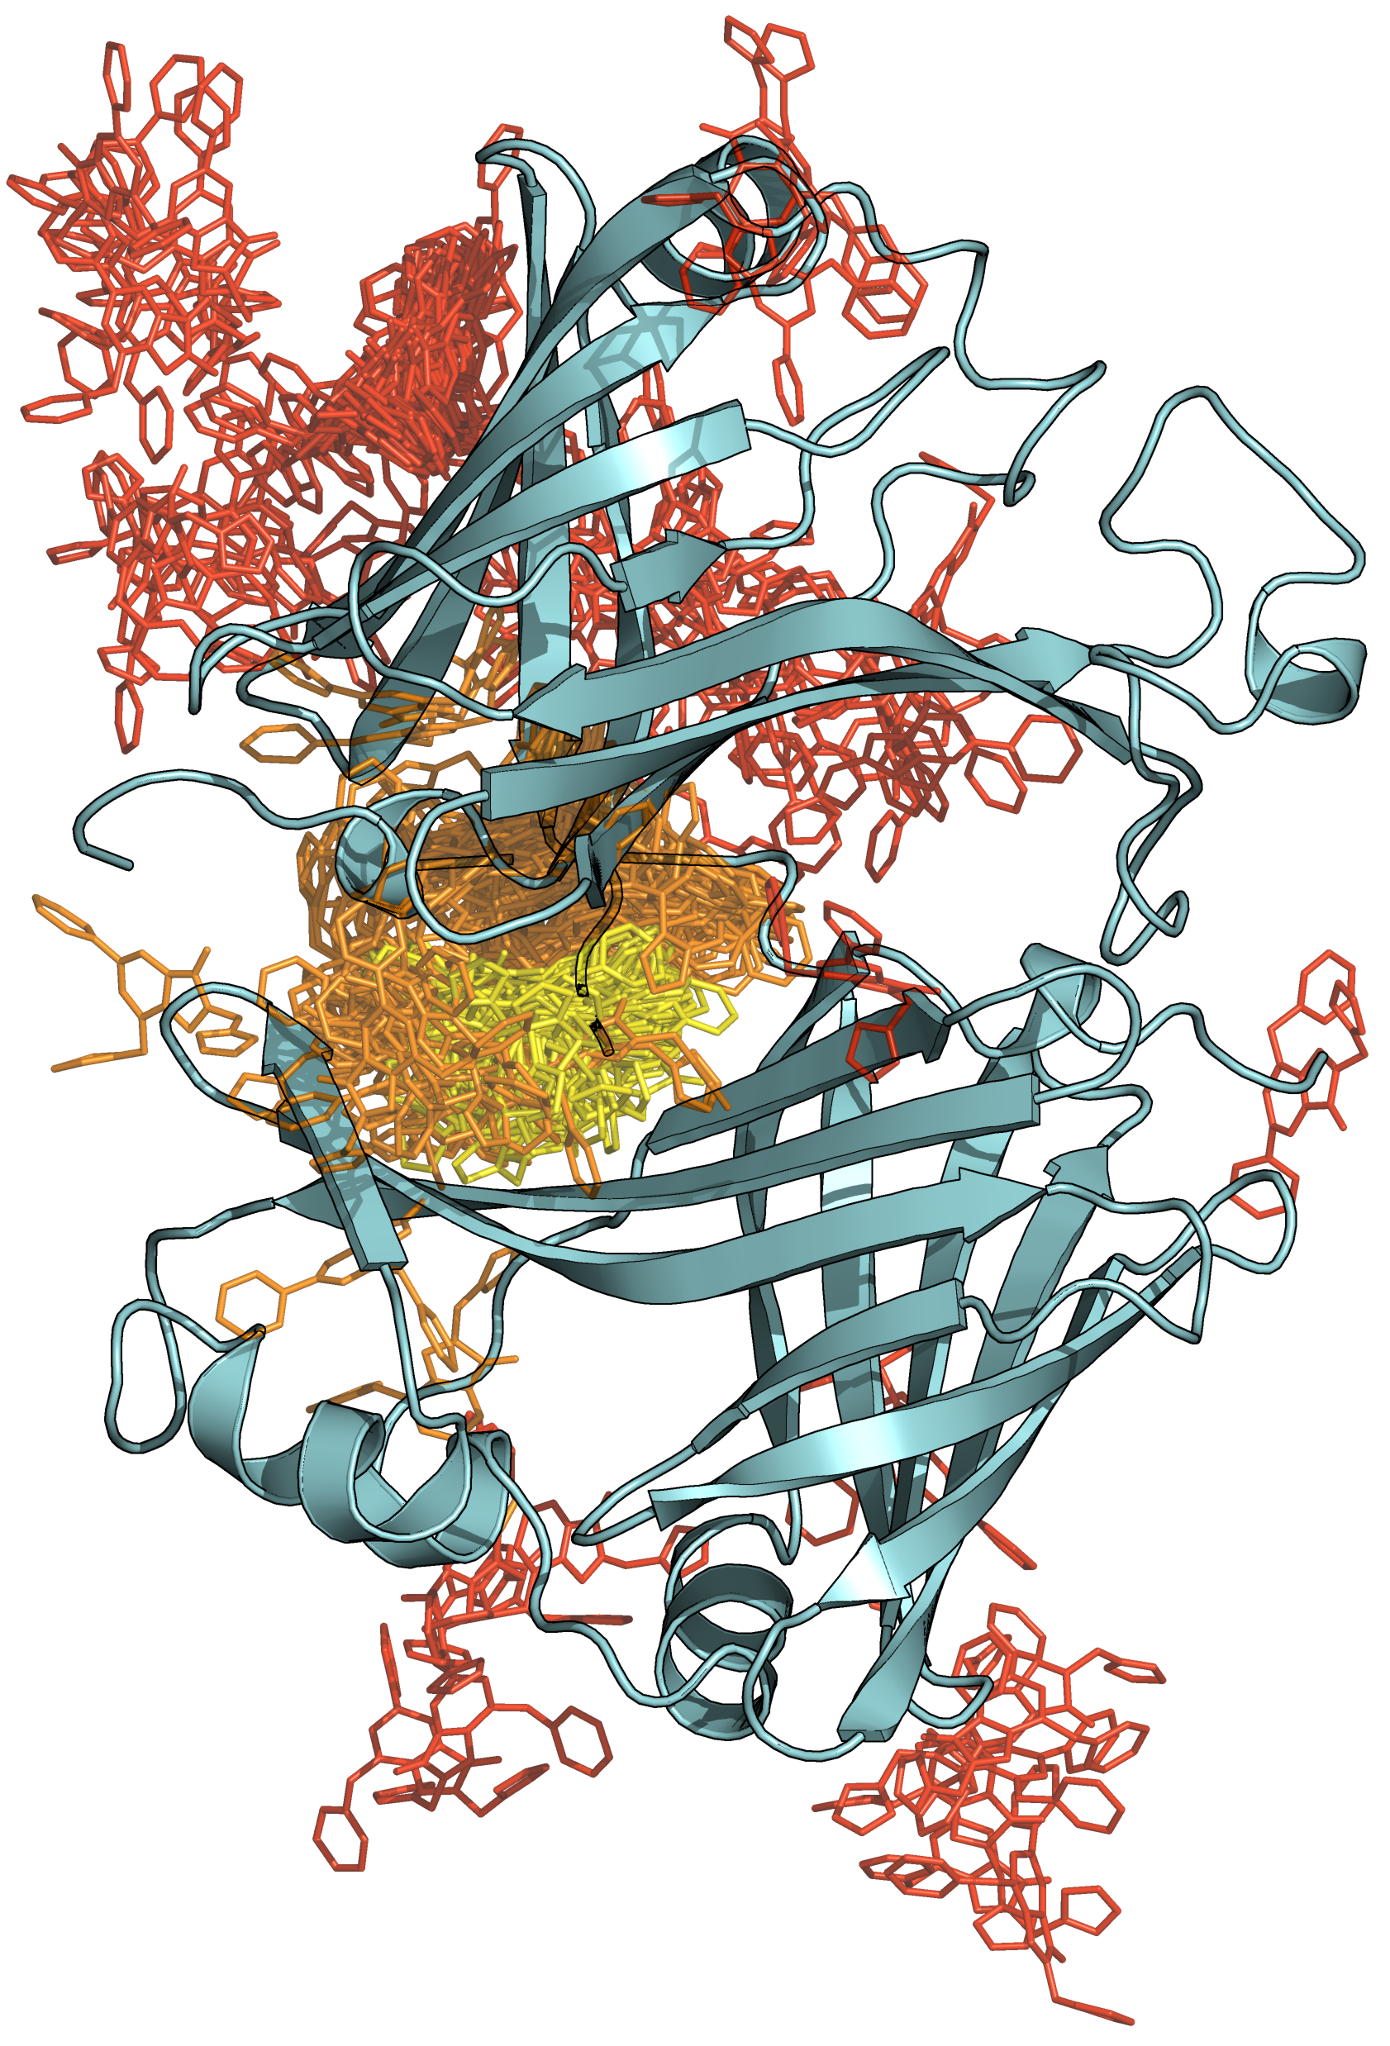
ADAPTIVE SAMPLING
Furimazine unbinding

Slide 7
ADAPTIVE SAMPLING
Dimer dissociation
associated
dissociated

Slide 8
ADAPTIVE STEERED MD
Dimer dissociation

Slide 9
CONCLUSIONS
dimeric NanoLuc might be the functional unit

Slide 10
CONCLUSIONS
dimeric NanoLuc might be the functional unit
1

Slide 11
CONCLUSIONS
dimeric NanoLuc might be the functional unit
furimazine stabilizes the NanoLuc dimer
1

