Slide 1
Using ChIP-nexus to decipher the architecture of transcription factor complexes
Martin Převorovský
Laboratory of Microbial Genomics
www.GenoMik.cz
Department of Cell Biology, Faculty of Science,
Charles University, Prague, Czechia

Slide 2
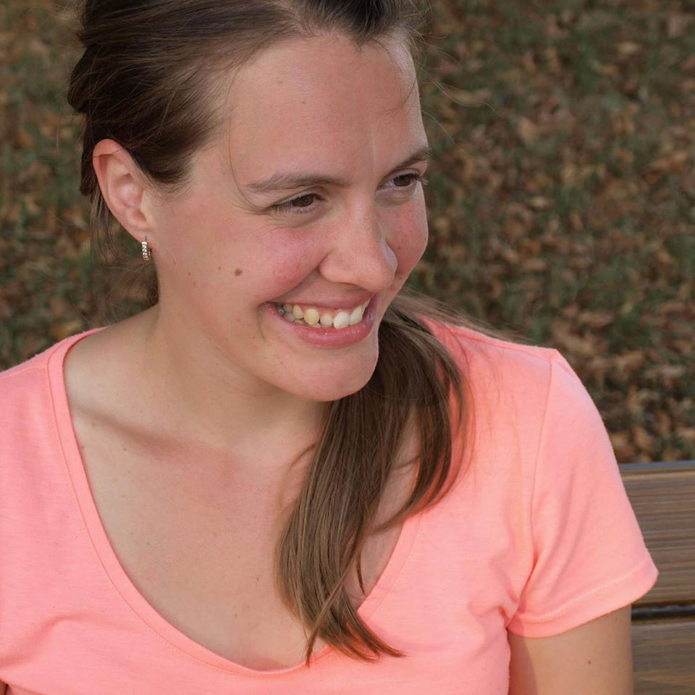
Acknowledgements I
Anna Marešová (Jordáková)

Slide 3
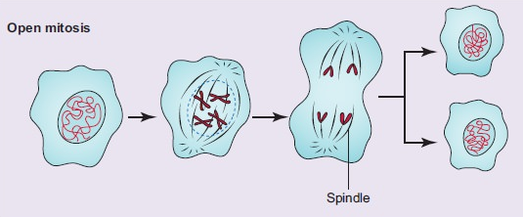
Intro - Mitosis (nuclear division)
https://www.brainkart.com/article/Cell-Division_33014/
Notes:
open mitosis in our cells

Slide 4
Intro - Mitosis (nuclear division)
https://www.brainkart.com/article/Cell-Division_33014/
Notes:
closed mitosis in fungi, yeast

Slide 5
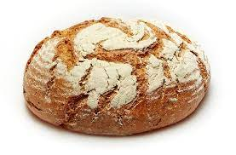
Intro - Mitosis (nuclear division)
https://www.brainkart.com/article/Cell-Division_33014/
Notes:
closed mitosis in fungi, yeast

Slide 6
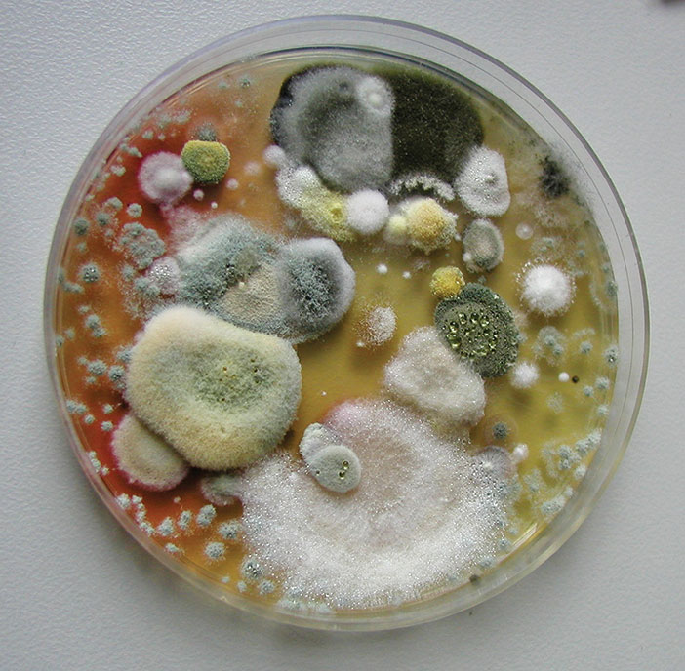
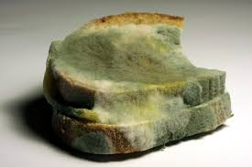
Intro - Mitosis (nuclear division)
https://www.brainkart.com/article/Cell-Division_33014/
Notes:
closed mitosis in fungi, yeast

Slide 7
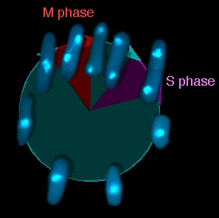
Intro - Fission yeast Schizosaccharomyces pombe
microtubules
chromatin
Patrik Hohoš

Slide 8
Intro - Fission yeast Schizosaccharomyces pombe
microtubules
chromatin
Patrik Hohoš

Slide 9
Intro - Fission yeast Schizosaccharomyces pombe
microtubules
chromatin
membrane phospholipids
needed to prevent

Slide 10
Intro - Lipid transcription factors in S. pombe
Cbf11
Mga2
~50%
~50%
cut6, ole1, lcf1, lcf2, vht1…

Slide 11
Intro - The question
Mga2
Cbf11
Cbf11
Mga2
?
Cbf11
Mga2
Notes:
hoping to discover something novel and cool (and to get PhD)

Slide 12
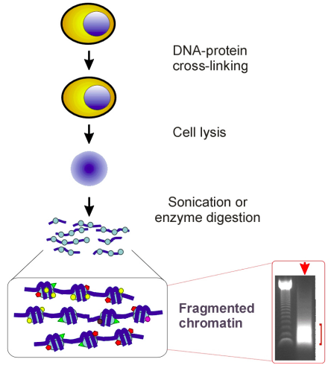
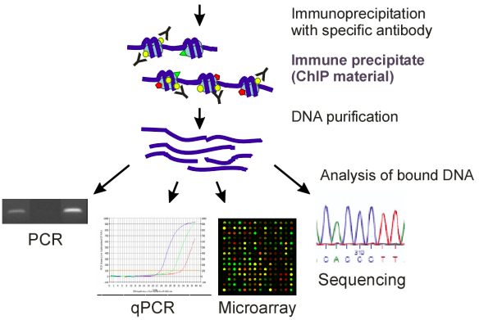
Methods - Chromatin immunoprecipitation (ChIP)
DOI: 10.2741/2733

Slide 13
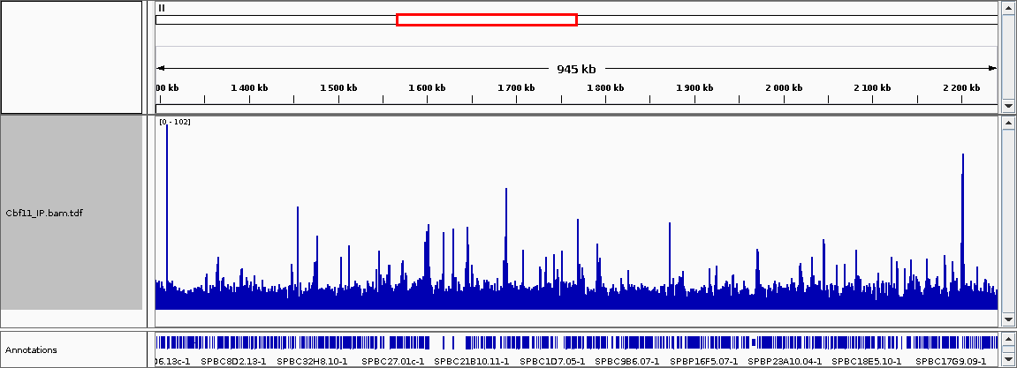
Results - ChIP-seq of Cbf11

Slide 14
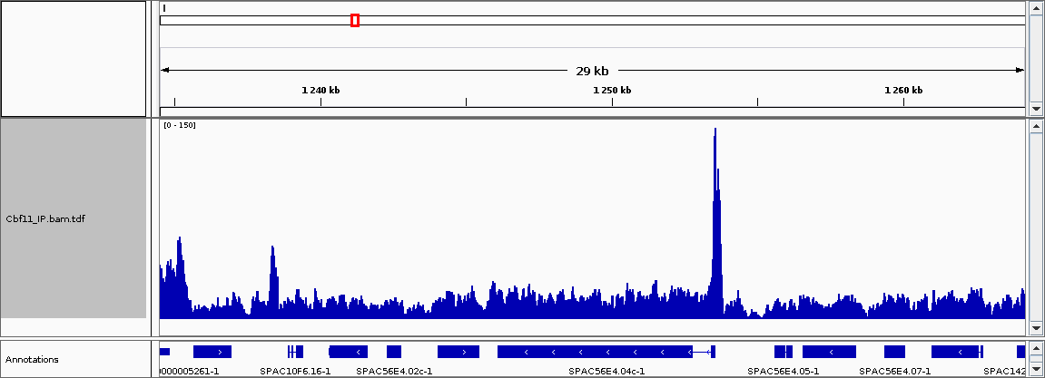
Results - ChIP-seq of Cbf11

Slide 15
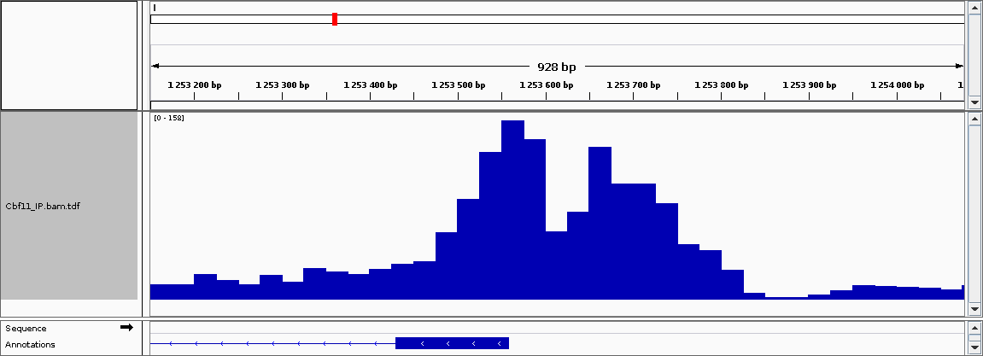
Results - ChIP-seq of Cbf11

Slide 16
Results - ChIP-seq of Cbf11

Slide 17
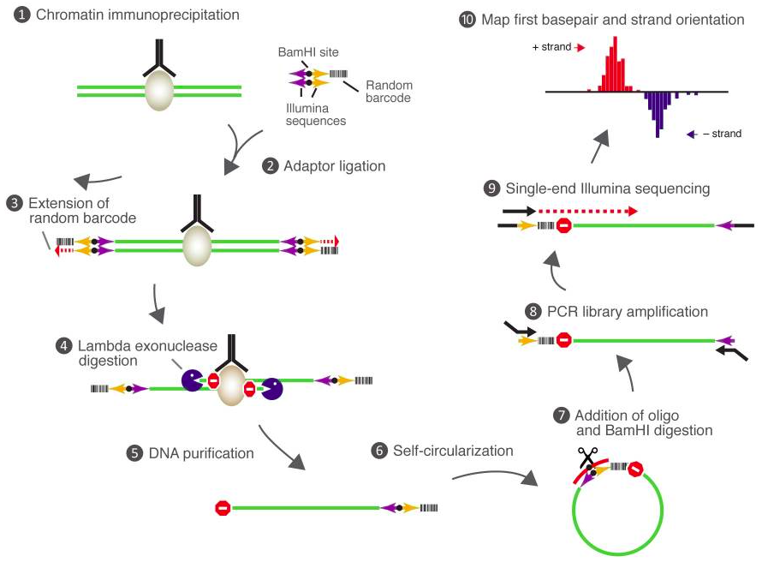
Methods - ChIP-nexus
doi: 10.1038/nbt.3121

Slide 18
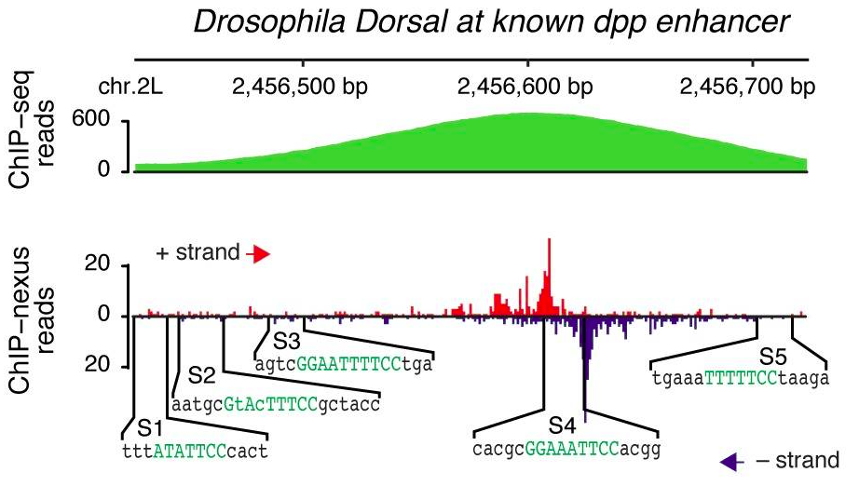
Methods - ChIP-nexus
doi: 10.1038/nbt.3121

Slide 19
Results - ChIP-nexus analysis workflow
1st deduplication & trimming & filtering (clumpify, trimmomatic, nexus barcode)
mapping to S. pombe + S. cerevisiae genomes
(HISAT2, samtools)
read QC
(fastQC)
read QC
(fastQC)
2nd deduplication (nexus barcode, chrom. position)
- target gene ID
- motif ID
- GO enrichment
…
normalized +1 nt coverage tracks & visual QC (deepTools, IGV)
peak calling (Q-nexus ?)

Slide 20
Results - ChIP-nexus analysis workflow
doi: 10.1038/nbt.3121

Slide 21
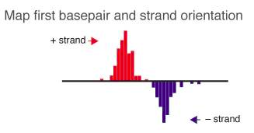
Results - ChIP-nexus analysis workflow
doi: 10.1038/nbt.3121

Slide 22
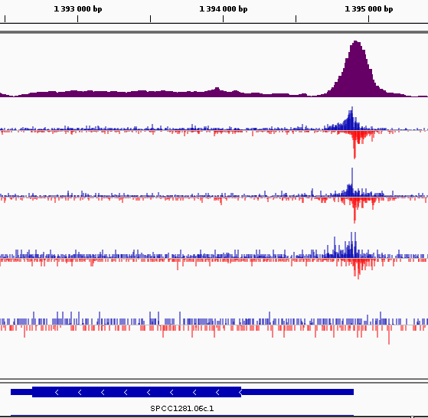
Results - DNA binding profiles
Cbf11
seq
nexus
Cbf11
Mga2

Slide 23
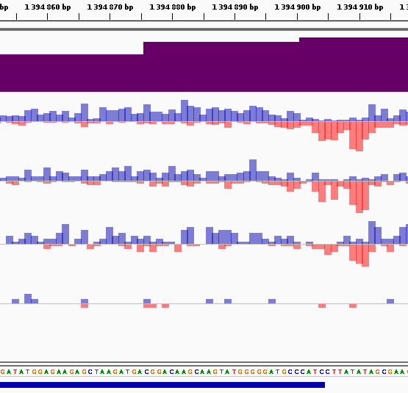
Results - DNA binding profiles
Cbf11
seq
nexus
Cbf11
Mga2

Slide 24
Results - DNA binding profiles
Cbf11
seq
nexus
Cbf11
Mga2
Mga2
Cbf11
Mga2
Cbf11

Slide 25
Conclusions
Mga2
Cbf11
Cbf11
Mga2
?
Cbf11
Mga2

Slide 26
Conclusions
Mga2
Cbf11
a novel TF complex regulating lipid metabolism

Slide 27
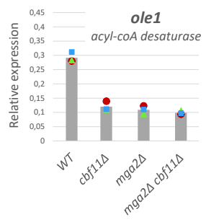
Conclusions
Mga2
Cbf11
a novel TF complex regulating lipid metabolism
Cbf11 = DNA-binding subunit
Mga2 = activatory subunit
ChIP-nexus is useful :-) (but non-standard library prep)

Slide 28
Acknowledgements II
GenoMik, PřF UK Anna Marešová Jarmila Princová Viacheslav Zemlianski Patrik Hohoš Michaela Grulyová Lucie Drahoňovská Adéla Kmochová Kateřina Jelínková
Genomics and Bioinformatics Core Facility, IMG, ASCR Michal Kolář Miluše Hradilová
PRIMUS, GAUK

