Slide 1
GC content of transposons and of their (animal) host genomes
Radka Symonová^{1,2,3,4} , Jan Kubečka², Dominik Matoulek⁴
¹ Technical University of Munich/Freising
² Institute of Hydrobiology, Biology Centre CAS, České Budějovice
³ University of South Bohemia, Faculty of Science, České Budějovice
⁴ University of Hradec Kralove, Faculty of Science, Hradec Králové

Slide 2
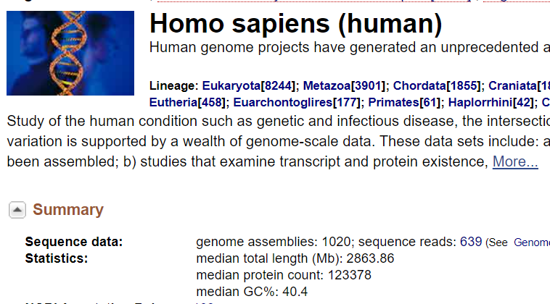
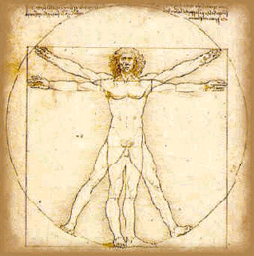
Why is GC% important?
GC% plays an important role in:
Gene density – genes are GC-rich
(Thermo)stability of DNA
Bendability of DNA
DNA replication timing
Exon splicing site recognition
Exon/intron length
Types and proportion of transposons
Actually, AT-rich!

Slide 3
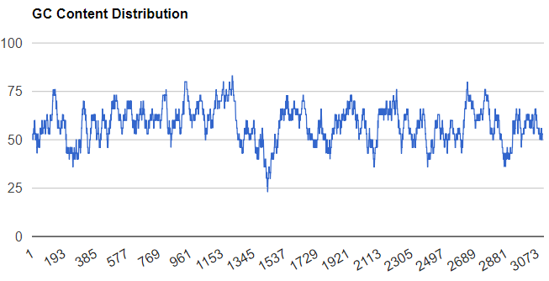
GC% is not equally distributed within genes and in the genome
>ENSLOCT00000000033.1 cds scaffold:LepOcu1:JH591449.1:131083:153586:-1 gene:ENSLOCG00000000026.1 gene_biotype:protein_coding transcript_biotype:protein_coding gene_symbol:kif20bb description:kinesin family member 20B [Source:NCBI gene;Acc:102689298]
GC%
Position (bp)
https://www.biologicscorp.com/tools/GCContent/ sliding window size 30, data from ENSEMBL

Slide 4
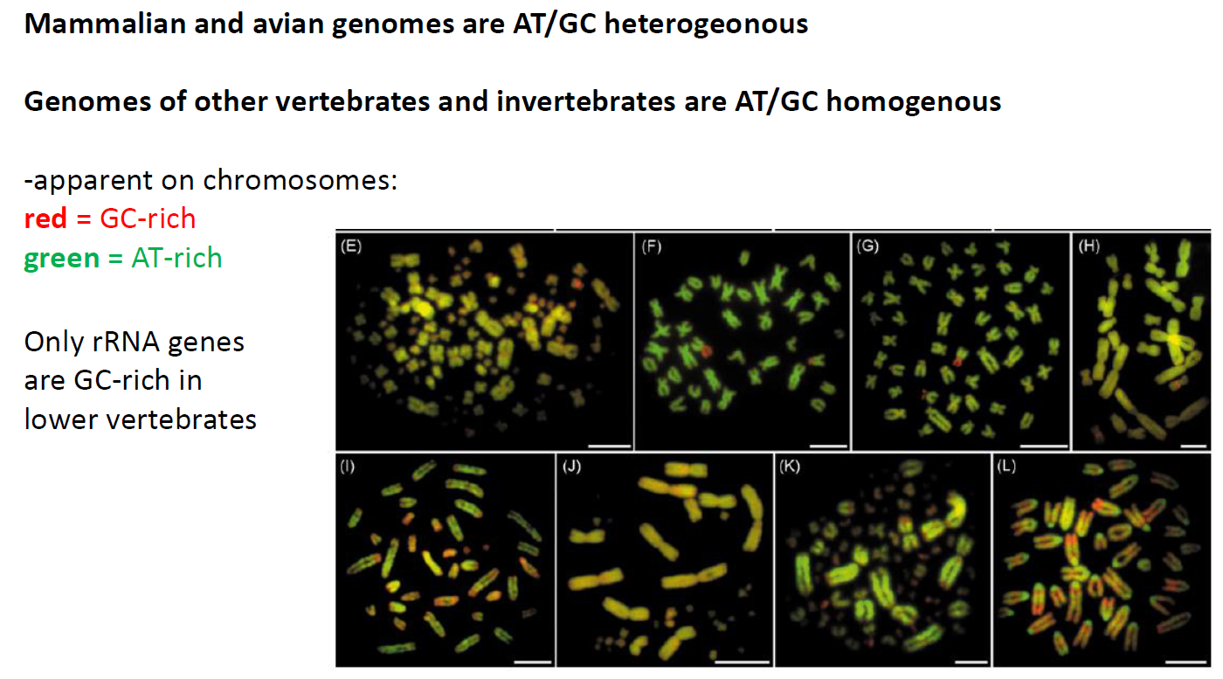
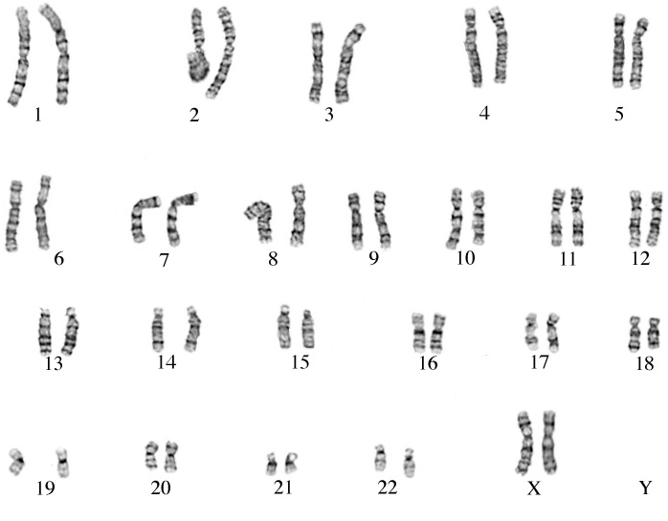
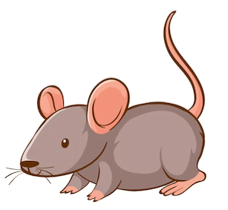
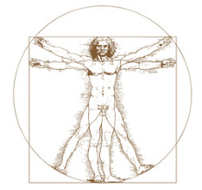
AT/GC heterogeneity
Motivation
Symonová et al., 2016

Slide 5
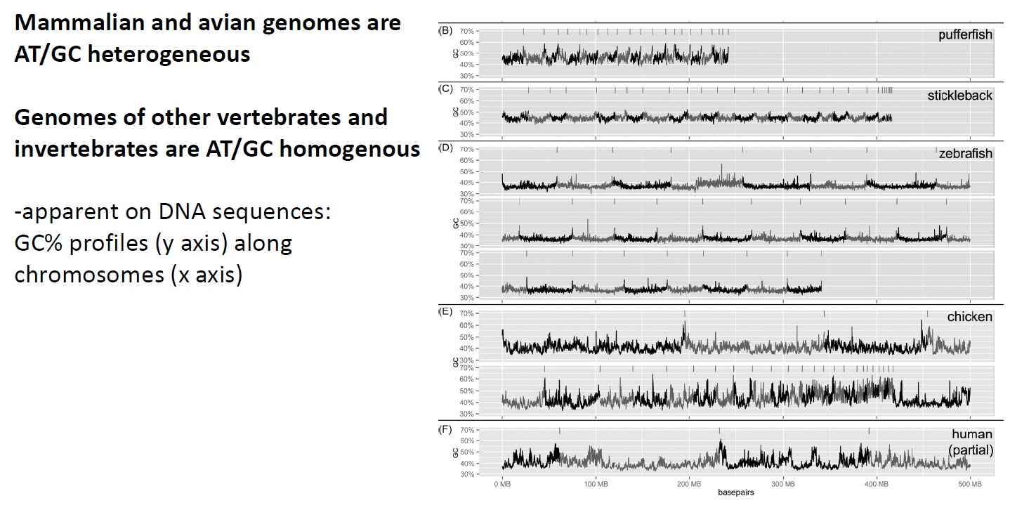
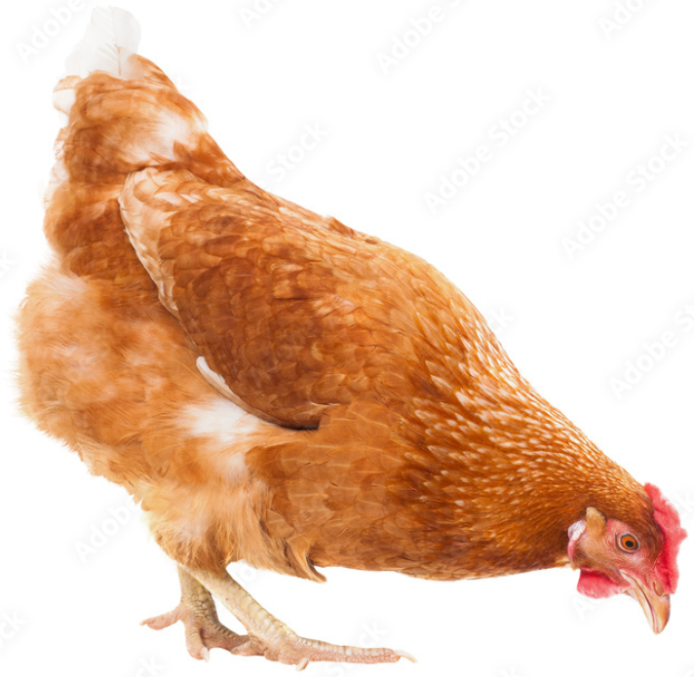
Motivation
AT/GC heterogeneity
Symonová et al., 2016
-genomes assembled to the chromosome level

Slide 6
Symonová et al., 2016
Motivation

Slide 7
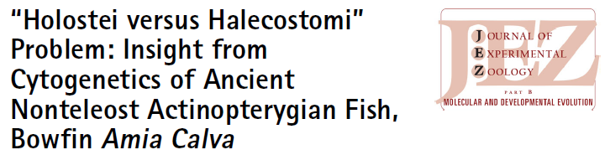
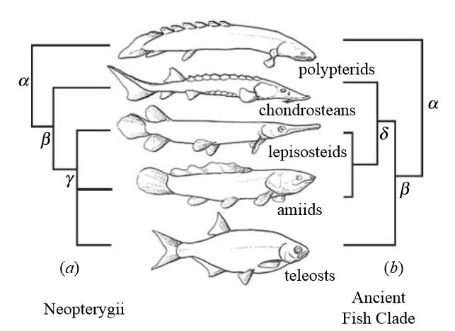
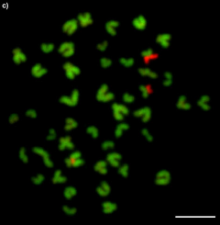
The typical teleost-like AT/GC homogeneity in the closest living relative of gars, the bowfin.
-G-banding not working
Majtanova, Symonova et al., 2017

Slide 8
Summary of the most important attempts to explain the AT/GC heterogeneity in higher vertebrates (proposed already before gars)
Is selection involved or are neutral processes the only culprits?
Thermodynamic stability of DNA – adaptation to homoiothermy through selection (C≡G more stable than A=T)
Compensation for 5-Methyl-Cytosin deamination, resulting in T (5mC less stable → hypermutable)
GC-biased gene conversion – GC% positively correlated with recombination rate
DNA/RNA Bendability – GC% defines optimal physical properties of DNA
- AT-rich DNA less bendable → suppression of gene expression
- GC-rich DNA more bendable → supportive of gene expression
Nucleosome Formation Potential – negatively correlated with GC% → chromatin condensing → gene suppression
DNA Break-Points resulting in mutations
Codon Usage Bias → GC-Bias? Refers to only a tiny fraction of genome
Metabolic hypothesis – GC% correlated with the metabolic rate (corrected according to environmental temperature)

Slide 9
Reasons of the AT/GC heterogeneity in mammals and birds not yet resolved
-one more hypothesis proposed to explain the AT/GC genome organization
Background
2019

Slide 10
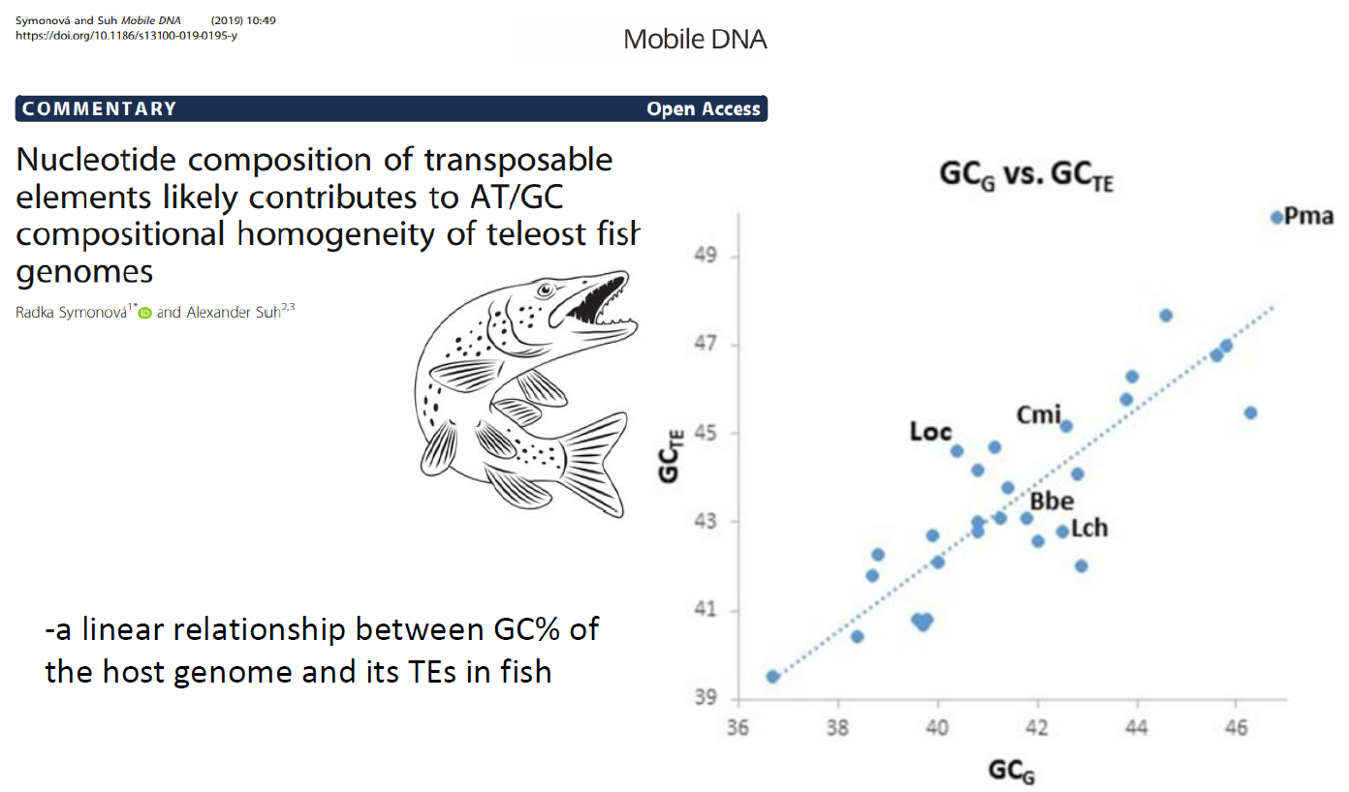
Background
Symonová et Suh, 2019

Slide 11
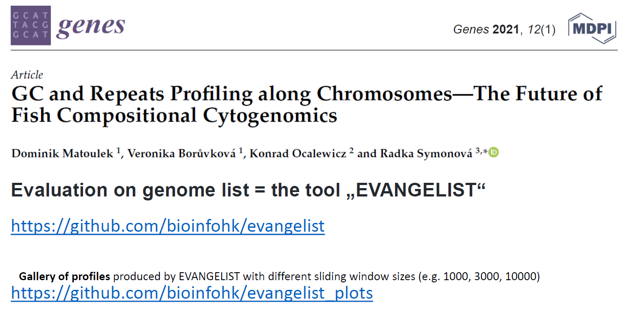
Towards the solution?
.py
(v1.0,
v2.0 in prep)
-virtual karyotyping tool enabling to link genomes and chromosomes
(still largely impossible in fish due to the lack of suitable markers)

Slide 12
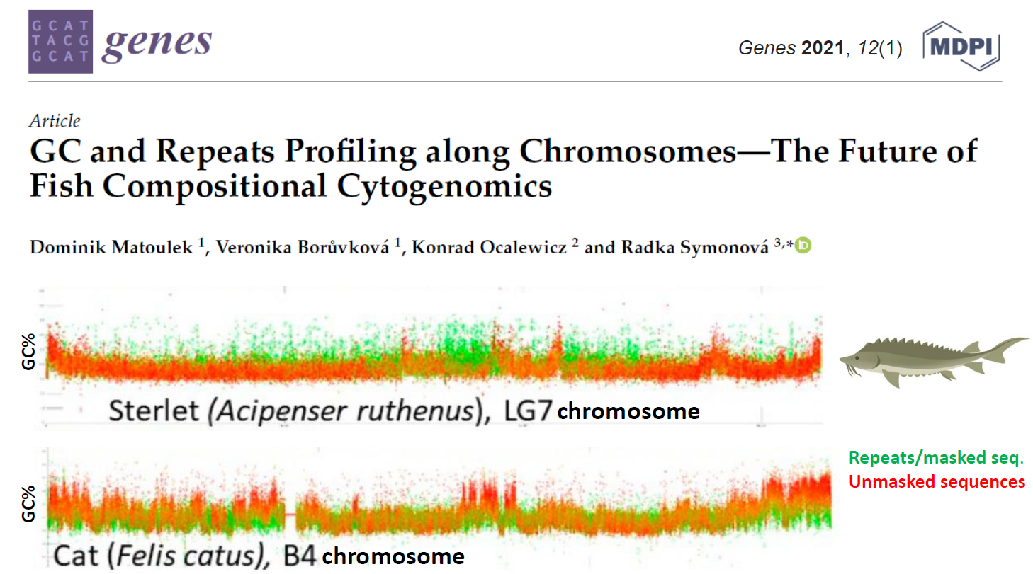
Towards the solution?
Repeats homogenize the GC% in fish (and blur the fluorescent signal)

Slide 13
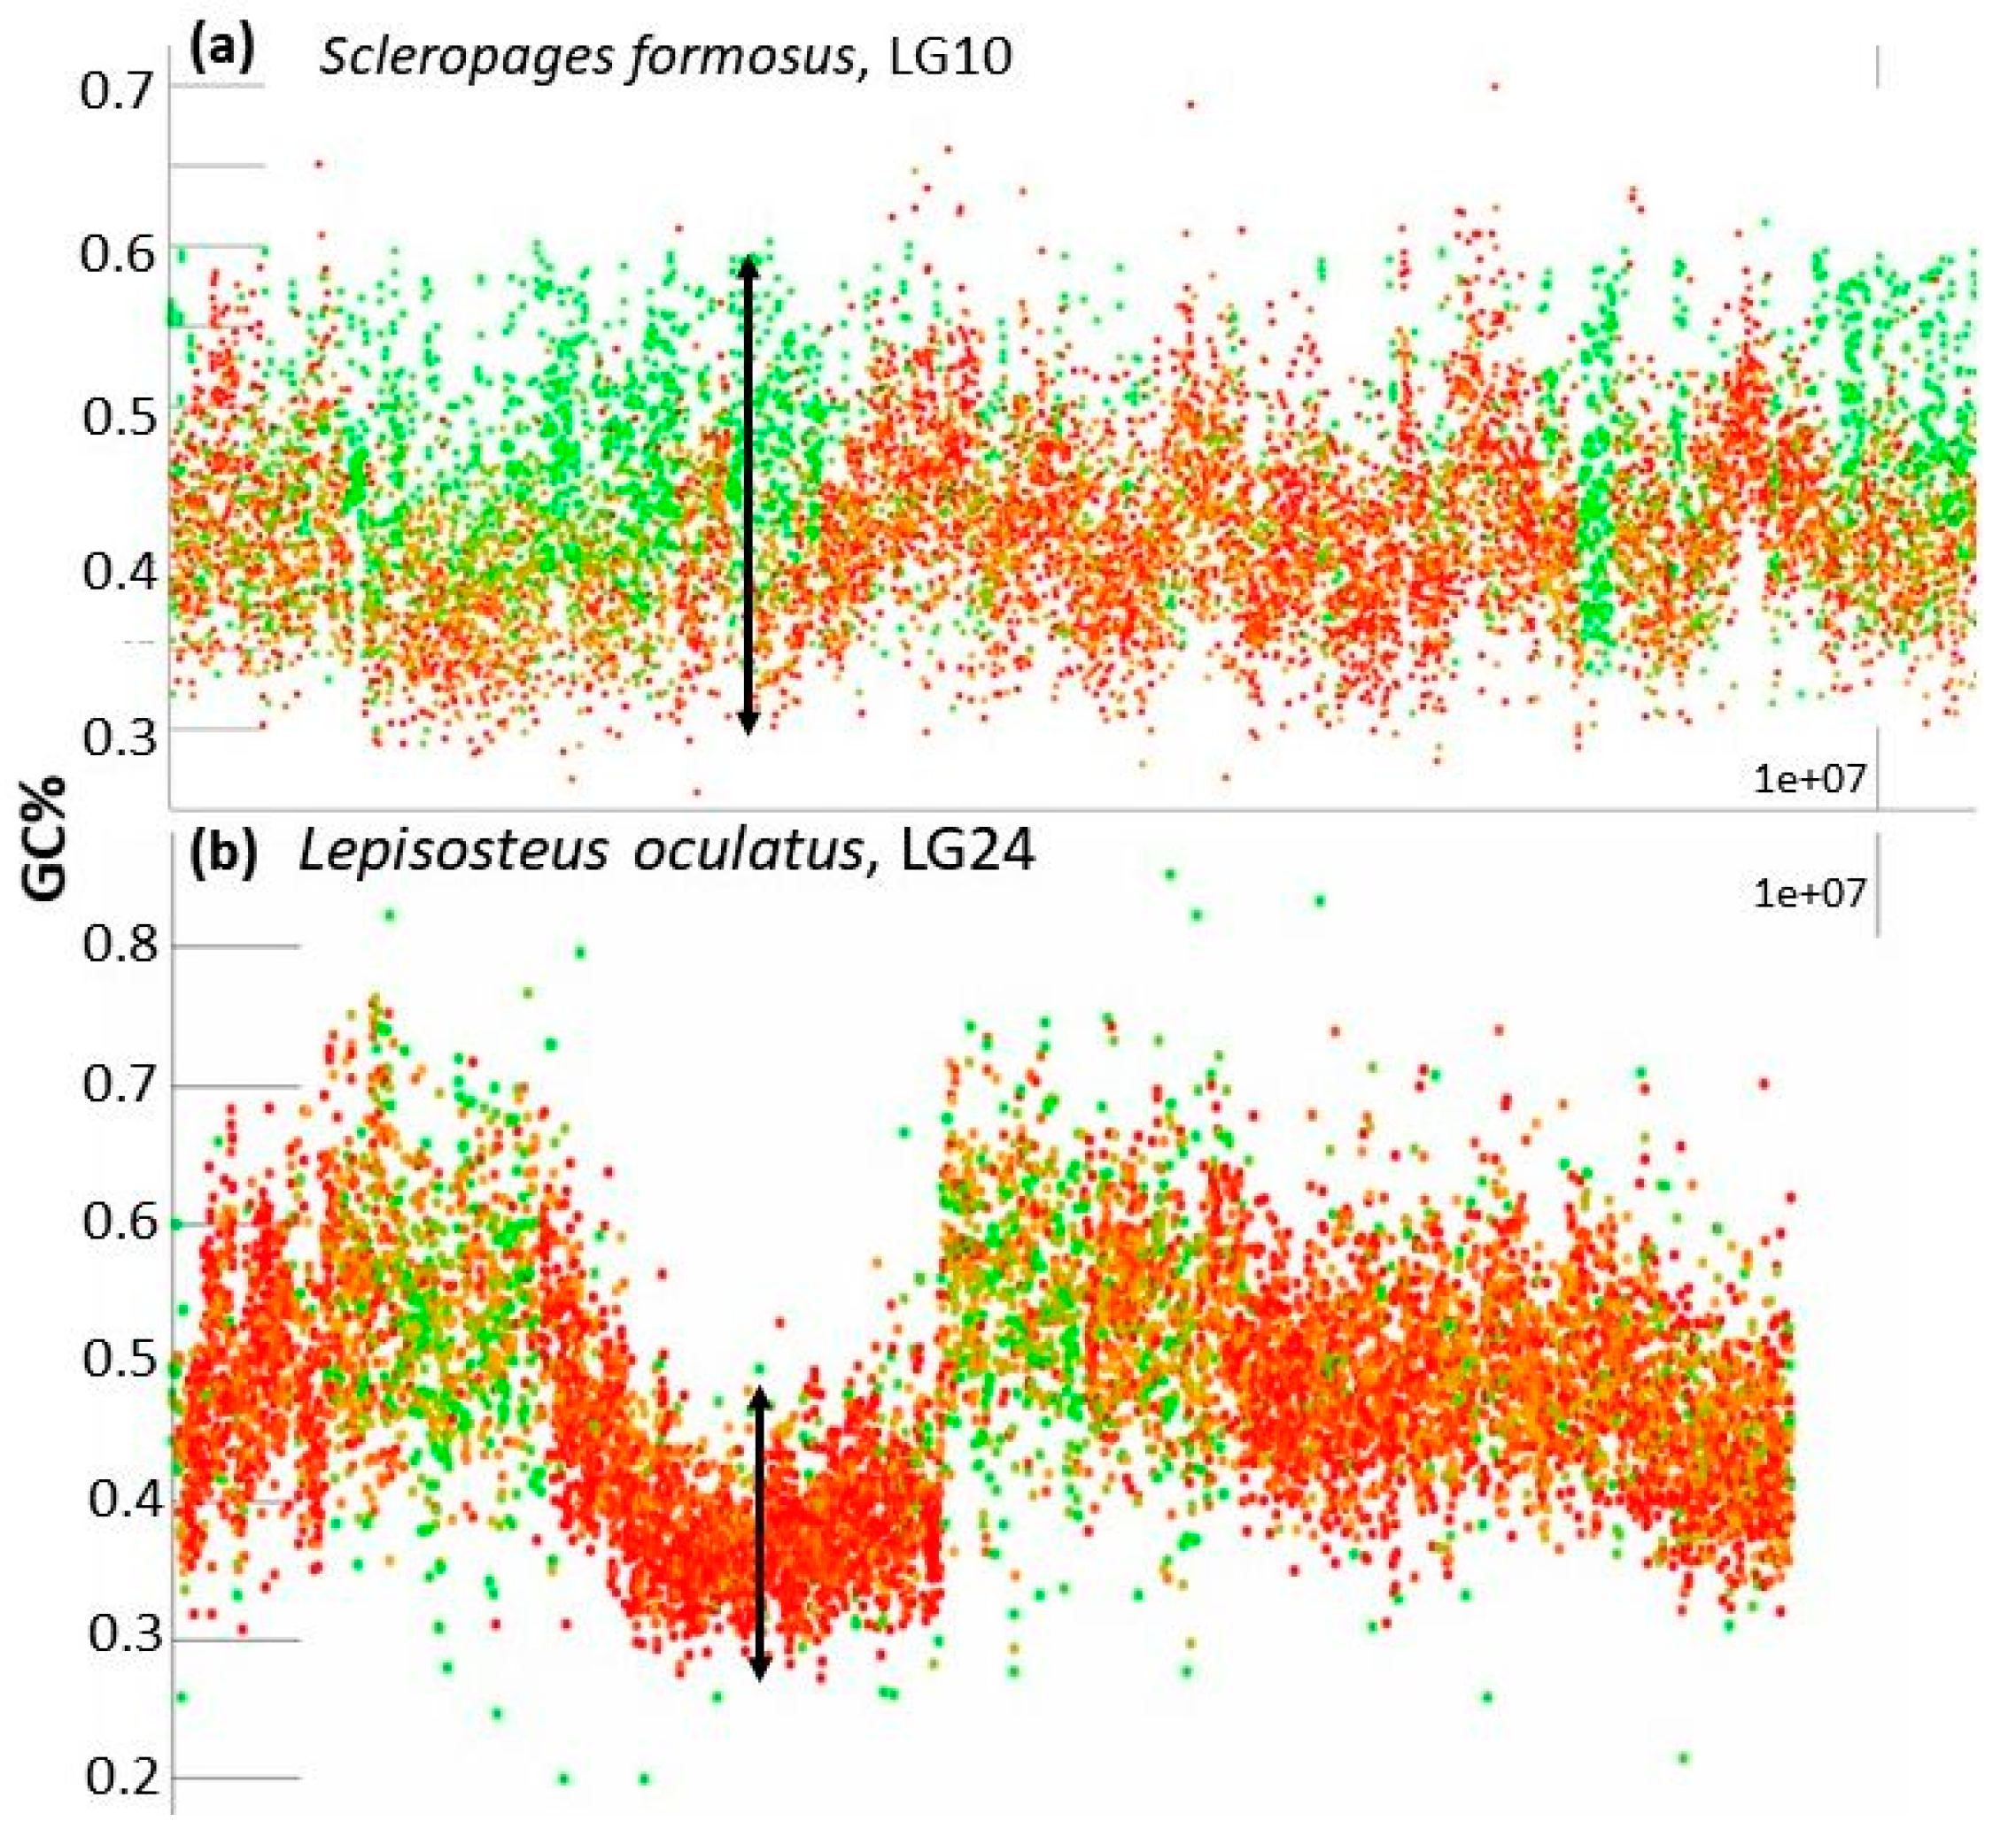
Preliminary results
*Repeats homogenize the GC% in fish
*Gars indeed a more „mammalian“ way
of AT/GC organization
Towards the solution?
→ completely dependent on the genome assembly quality and particularly on the repeat (soft) masking quality
→ still it helps understand the AT/GC organization of chromosomes in vertebrates

Slide 14
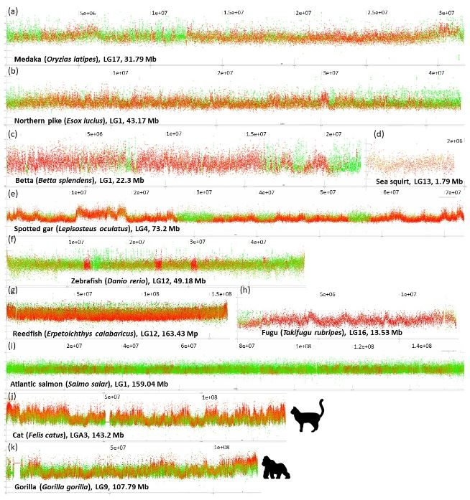
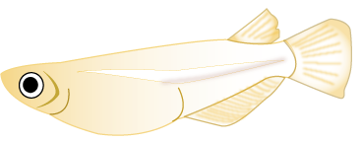
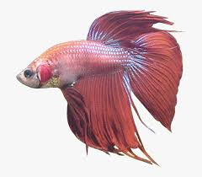
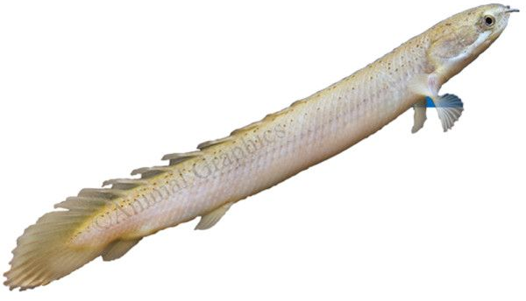
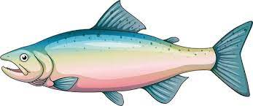
TE% and their
GC% drive the
genome GC organization
→
Towards the solution?
Zebrafish 50 % of AT+ TE
Pufferfish 5-10 % of TE,
GC+ but tiny genome
Salmonids 50-60 % of GC+ TE,
an extreme homogenization, large genomes
GC%

Slide 15
- Full „karyotypes“ available
Everybody welcome to apply, discuss, and cite ☺
radka.symonova@gmail.com

Slide 16
Thank you for your attention
Funding
H2020
The study was supported by the EU within ESIF in frame of Operational Program Research, Development and Education (no. CZ.02.1.01/0.0/0.0/16_025/0007417 administrated by the Ministry of Education, Youth and Sports of the Czech Republic)

