Slide 1
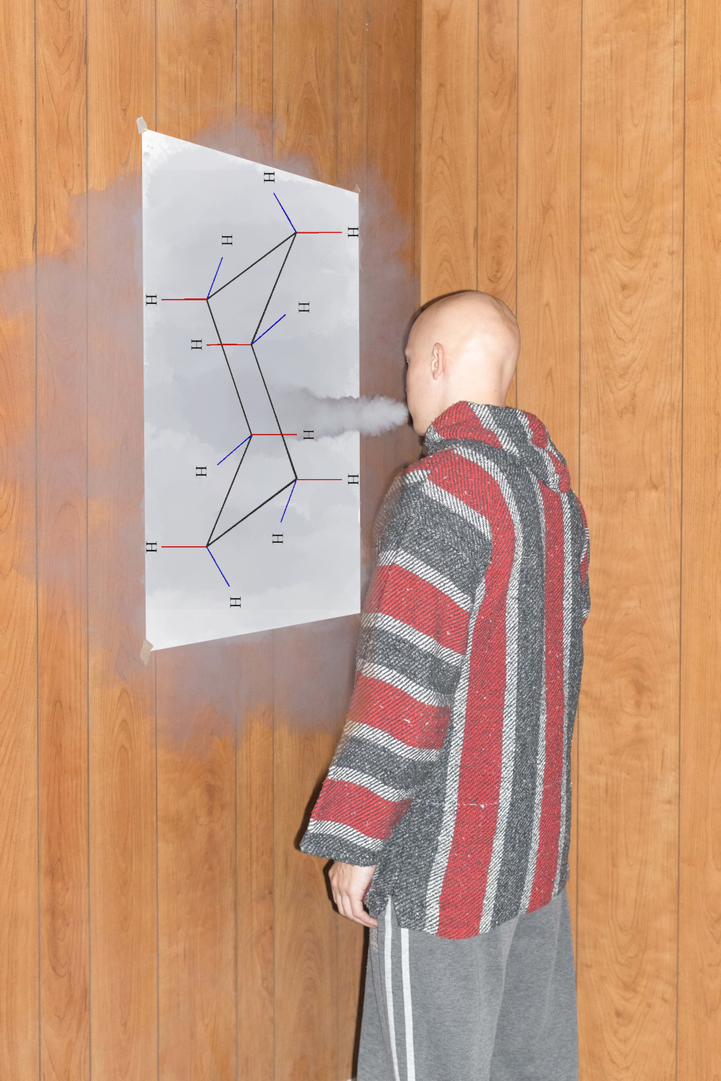

Ligand hallucinations in cofolding methods
Wim Dehaen
ENBIK
Karlov pod Pradědem
9.6.2025

Slide 2
Introduction: Hallucinations in GenAI
Also called "confabulation"
Non-factual but convincing sounding genAI outputs
Unsolved problem
  Finetuning can lead to catastrophic forgetting
  Web search can be manipulated
  RAG suffers from context collapse
Serious impact:
  Misinformation

Slide 3
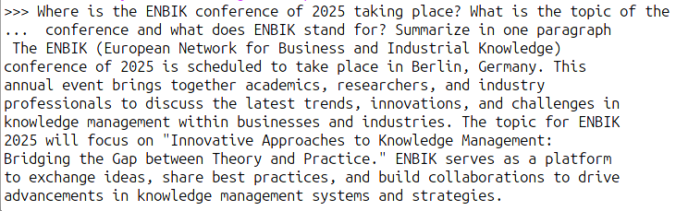
Example LLM hallucination (Mistral 7B)

Slide 4
Introduction: cofolding
Models that predict both the protein 3d structure from the sequence, as well as the placement of the ligand in the protein
One main innovation of AlphaFold3 is cofolding
Before AlphaFold3 precursors existed in Rosetta Fold all atom (RFAA) and non-cofolding ML pose prediction methods such as DiffDock
Ligand placement methods are mostly based on Diffusion

Slide 5
Strengths and weakness of cofolding
Cofolding outperformed traditional docking in several benchmarks
  Polaris SARS CoV2 and Mers-CoV MPro
Serious innovation in protein-ligand modelling after "30 years of stagnation with molecular docking"
Data-driven: performance on OOD data is reduced
AF3 authors report stereochemistry inversions at a rate of 4.4%
Hallucinations of structured segment in intrinsically disordered regions

Slide 6
Ligand hallucinations in cofolding
Ligand hallucination: "When the input and output ligand chemical graph are different after cofolding"
Stereochemistry inversion is only one issue
  But other issues not described well
Planarity of rings:
  e.g. cyclohexane to benzene
Collinearity of atoms:
  e.g. sp hybridized C to sp²

Slide 7
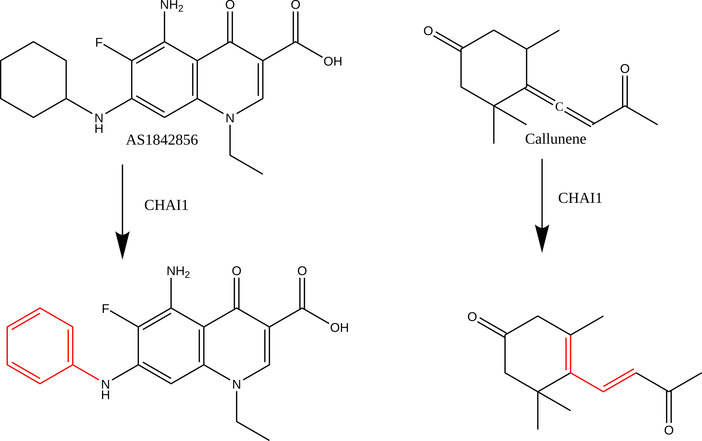
Ligand hallucinations: random discovery

Slide 8
Quantifying ligand hallucination
Construction of a data set of molecules that have planar, non-planar, or collinear atoms
Non-planar:
  Cycloalkanes (n=4,5,6), and related heterocycles
  Even small rings have serious ring puckering
Planar:
  Benzene and various aromatic heterocycles
Collinear:
  Nitrile, alkyne, allene, azide, isocyanate, ...

Slide 9
Data Set
100 molecules:
  50 hand designed molecules with one of the motifs in there
    Collinear molecules
    Planar rings
    Non-planar rings
  50 molecules from DrugBank with one or more of the motifs in there
    Show that this is NOT a fringe problem

Slide 10
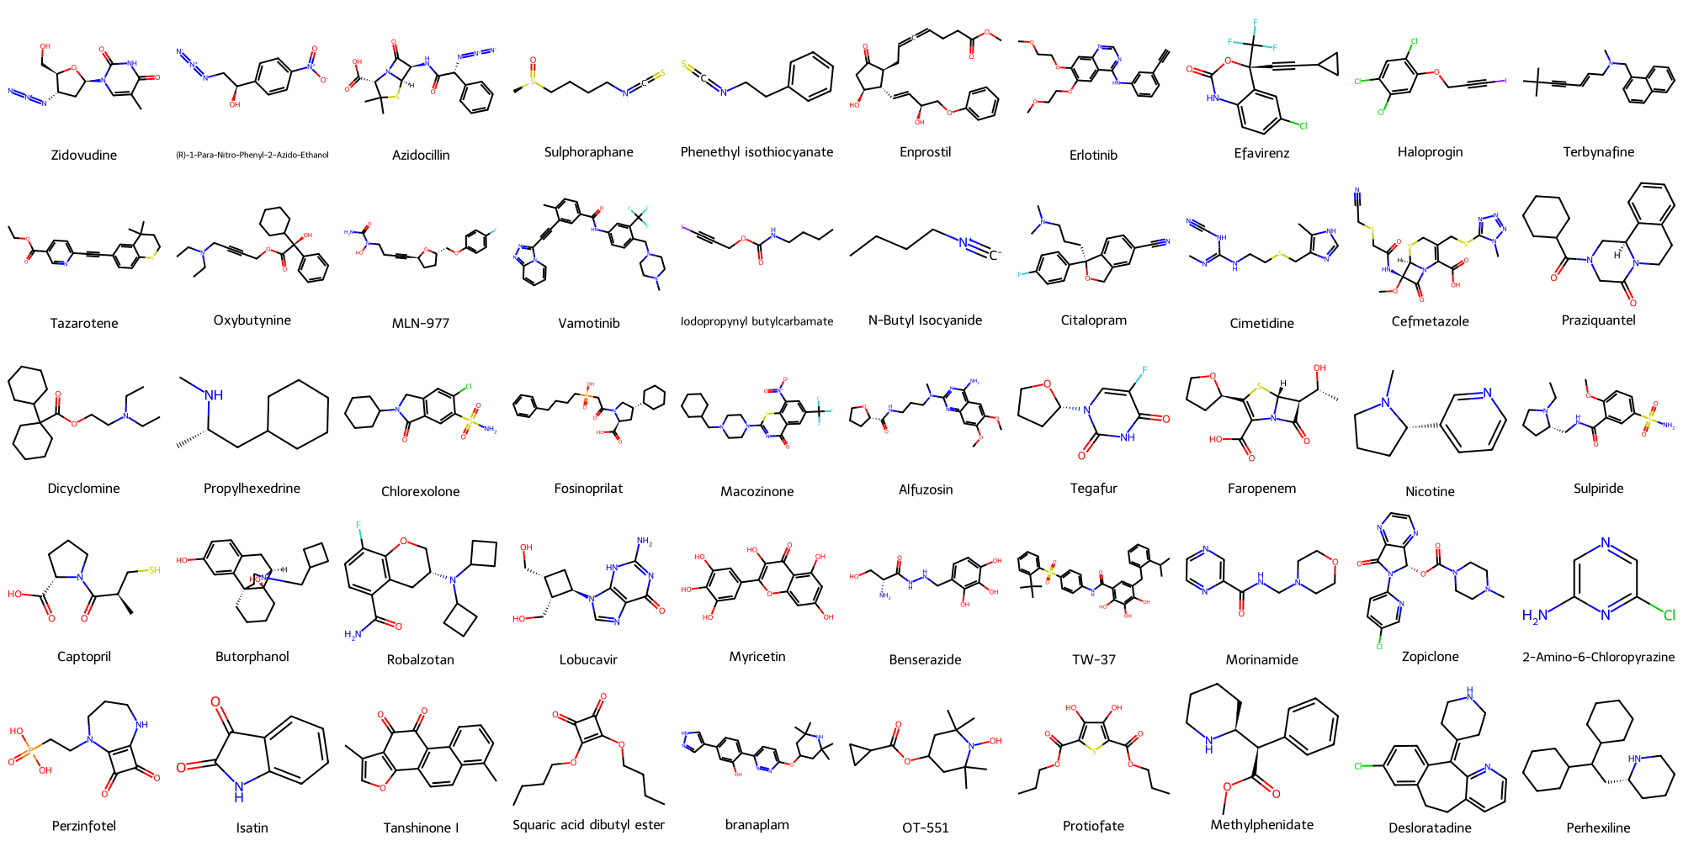

Slide 11
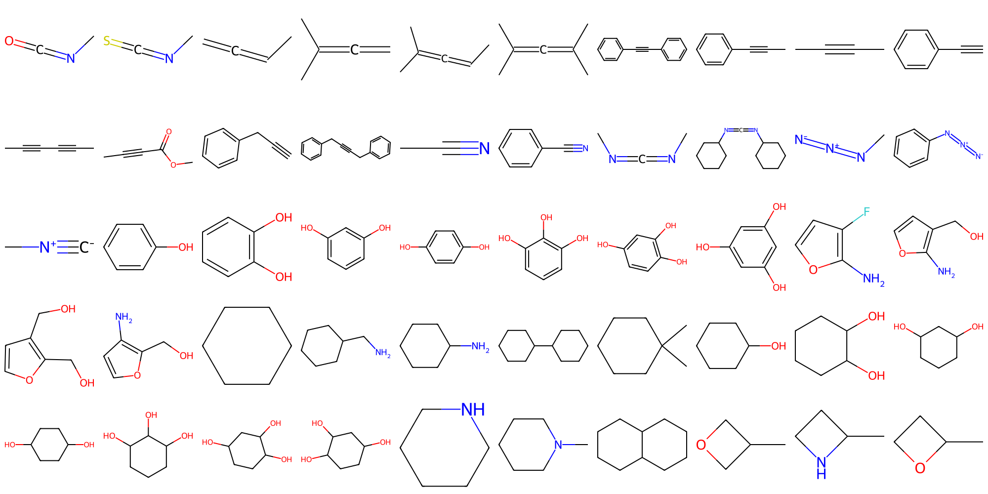

Slide 12
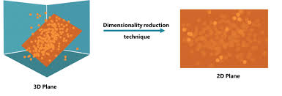
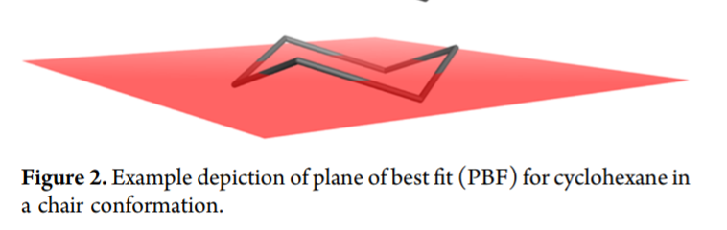
How to score "Planarity" and "Collinearity" of a substructure
Deviation from plane/line of best fit
Used for quantifying planarity of entire molecules before under the name "PBF"
Principle components analysis on atom coordinates can be used, ring per ring and fragment per fragment to find the best fitting plane line
Ratio of explained variance is then a measure for how much the atoms deviate from the plane/line
Source: https://365datascience.com
JCIM 2012 Oct 22;52(10):2516-25.

Slide 13
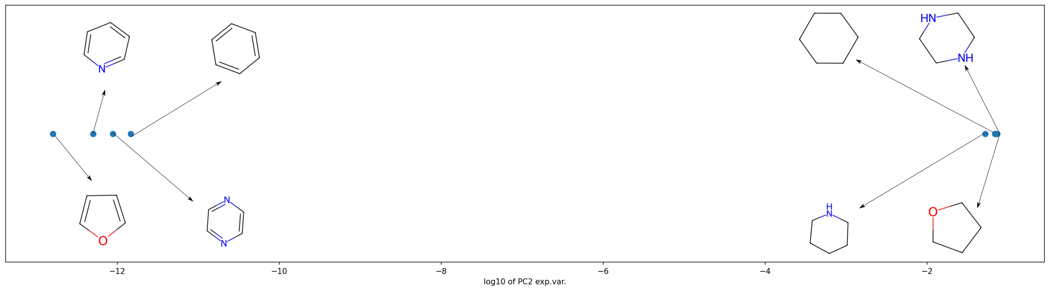
Planar and non-planar molecules are highly distinct
Data shown is for MMFF94 optimized ETKDG conformers.

Slide 14
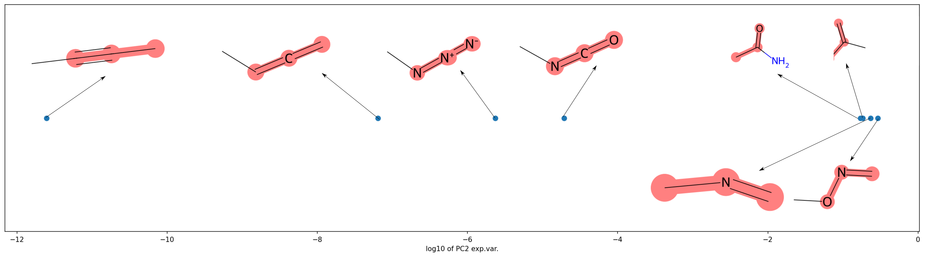
Collinear FGs are highly distinct
Data shown is for MMFF94 optimized ETKDG conformers.

Slide 15
Compared methods
Ground truth:
  ETKDGv3 and MMFF94 rdkit random conformation
ETKDGv3 only
Traditional docking (AutoDock Vina) (ref protein used:)
Boltz1
Protenix
AlphaFold3

Slide 16
Cofolding: is the protein needed?
Cofolding is possible without including a protein
Protein-free cofolding show the same hallucinations
  Comparison was done 1 to 1 using Boltz
Significant computational savings
The data shown is all for protein-free cofolding
Best case scenario without any spatial constraints

Slide 17
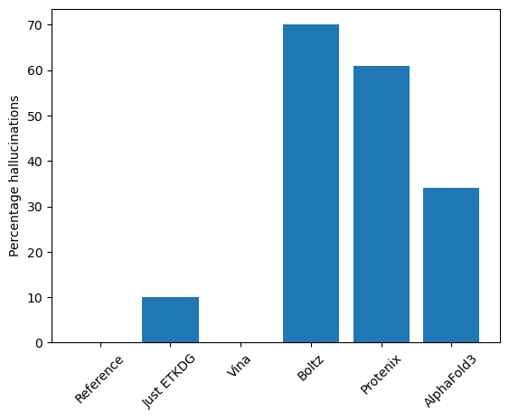
Results: Total

Slide 18
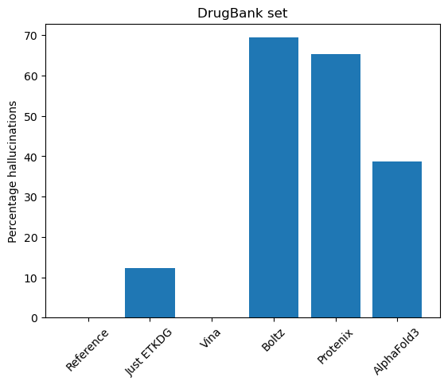
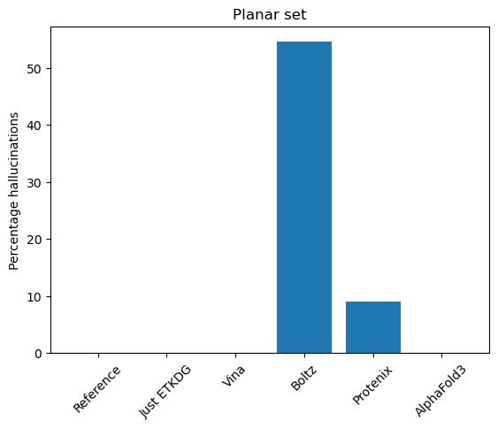
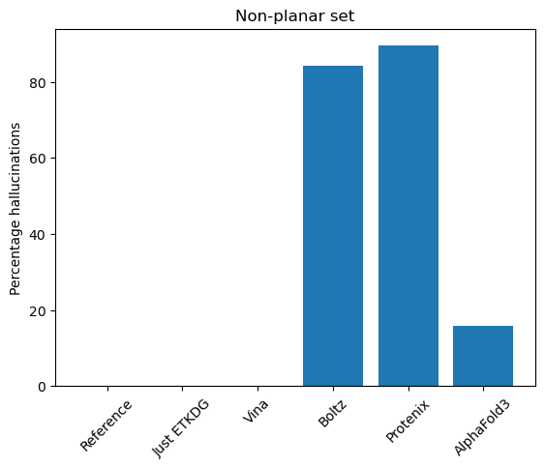
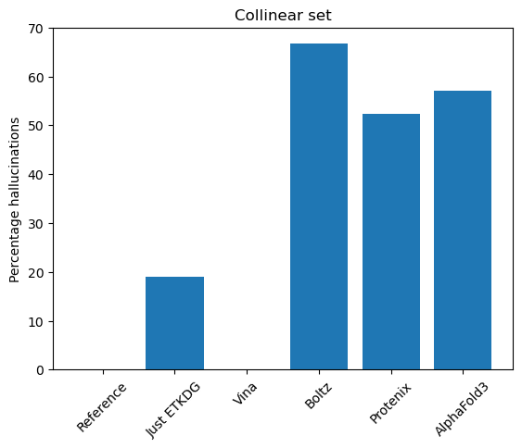
Results: per task

Slide 19
Results
All cofolding methods have serious ligand hallucination issues
Like in other serious benchmarks, AF3 is better than the others
  Particularly for planarities AF3 far much better
Traditional docking performs well
ETKDG has minor issues, mainly collinearity

Slide 20
Cause of and solution to hallucinations
Cofolding methods are usually trained on PDB data with incomplete connectivity and bond degree data
Generative methods do not learn physics of binding
  Because they don't need to
Solution: train models with fully informative molecular graphs
  E,g, databases like PDBBind have a huge problem with this
  Explicit hydrogens should be added before training
Solution 2: increase diversity of training data with artificial data to learn generic chemical spaces better
  E.g. include docking data for close series with scaffold template
Hacky temporary "solution": apply correct bond orders post hoc and perform minimization
  People in the field are actually using this

Slide 21



Open Workflow
This evaluation pipeline and data set are made available as an open source python package
https://www.github.com/dehaenw/LiH
Work in progress (final numbers may change)

Slide 22
Conclusions
GenAI hallucinations ALSO affect cofolding
  Including on the ligand side
Problem is impactful
  Affects many known drugs and many typical substituents and functional groups
Not all cofolding methods are equal
  Even if they are all AF3 "reproductions"
Future work
  Curate final set
  Use QM optimized conformers as real baseline
  Include more cofolding methods (Chai, NeuralPlexer, ...)

Slide 23
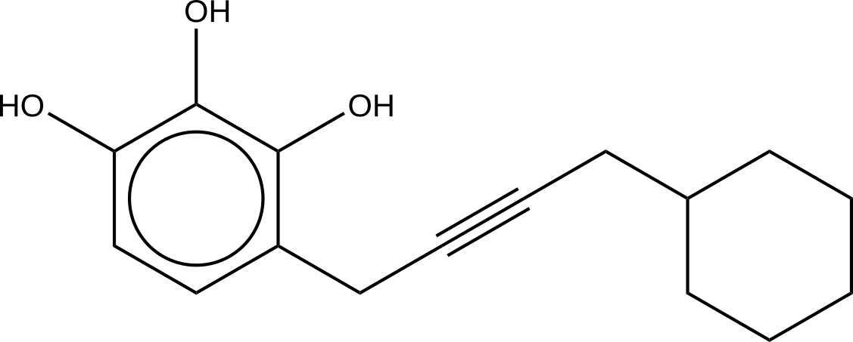
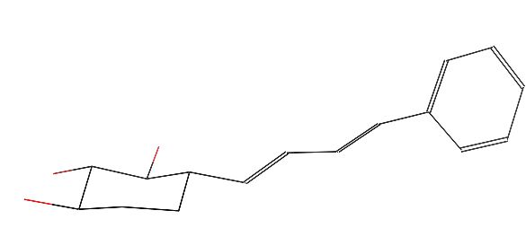
Final egregious example
EVERY carbon in the structure is wrong in the Boltz 3D conformation
Tanimoto similarity (ECFP6_4096) of 0.096 (i.e. completely dissimilar)
Boltz1

Slide 24


Acknowledgement
W.D. was supported by the Ministry of Education, Youth and Sports of the Czech Republic – National Infrastructure for Chemical Biology (CZ-OPENSCREEN, LM2023052) and the project “New Technologies for Translational Research in Pharmaceutical Sciences/NETPHARM”, project ID CZ.02.01.01/00/22_008/0004607, cofunded by the European Union.
Thank you to e-infra FOLDIFY which allowed me to run AlphaFold3
  https://foldify.cloud.e-infra.cz/

