Slide 1


Streamlined workflow for bacterial methylation analysis using nanopore data
#BioSys_BU
Markéta Jakubíčková*, Kateřina Šabatová, Matěj Bezdíček,
Martina Lengerová, Helena Vítková
ENBIK, 11.6.2025

Slide 2

Bacterial typing
?
#BioSys_BU
differentiate between strains within the same bacterial species
essential for epidemiology
phenotype-based methods (historically)
nowadays: genotype-based methods → SEQUENCING
sometimes genotype ≠ phenotype
need additional layer of information → epigenetic modification analysis
    → methylation analysis

Slide 3
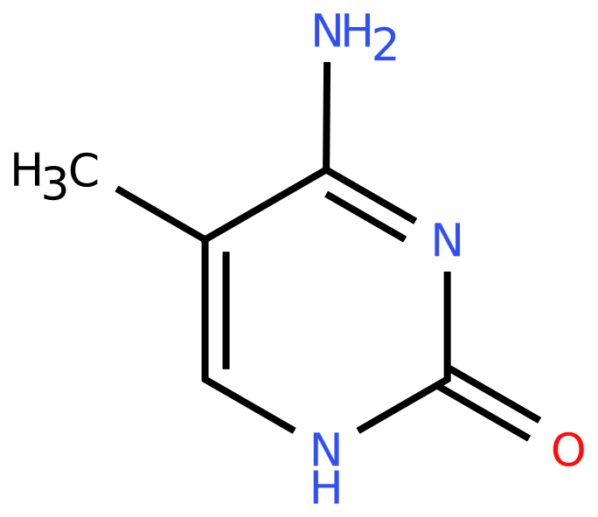
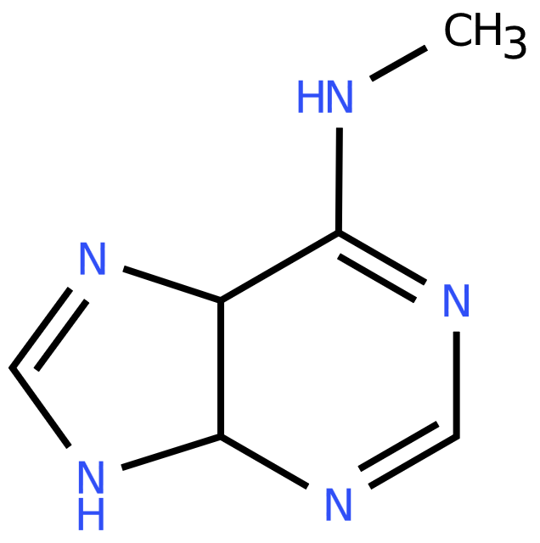
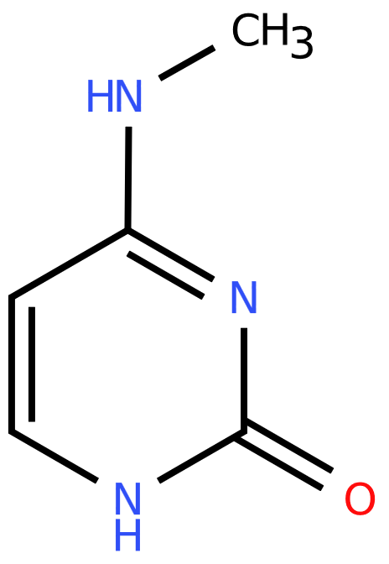
Methylations
#BioSys_BU
chemical modification of DNA
  addition of methyl groups (-CH₃)
types: N⁴-methylcytosine (4mC)
5-methylcytosine (5mC)
N⁶-methyladenine (6mA)
5-hydroxymethylcytosine (5hmC)
catalyzed by DNA methyltransferases
present in all domains of life
5-methylcytosine (5mC)
N⁶-methyladenine (6mA)
N⁴-methylcytosine (4mC)

Slide 4


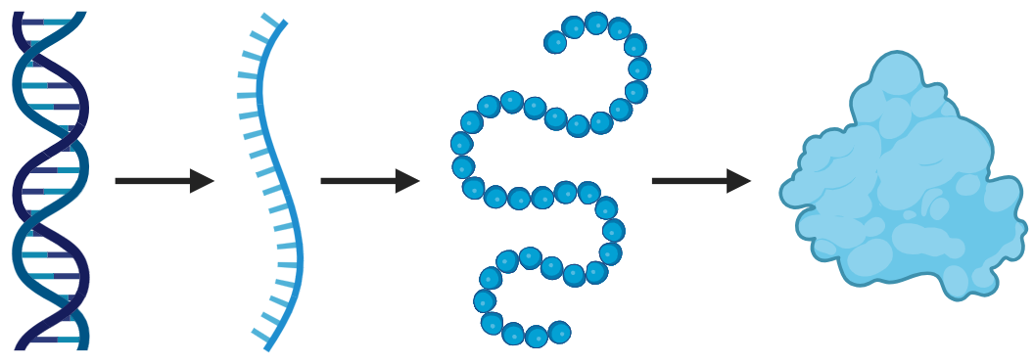
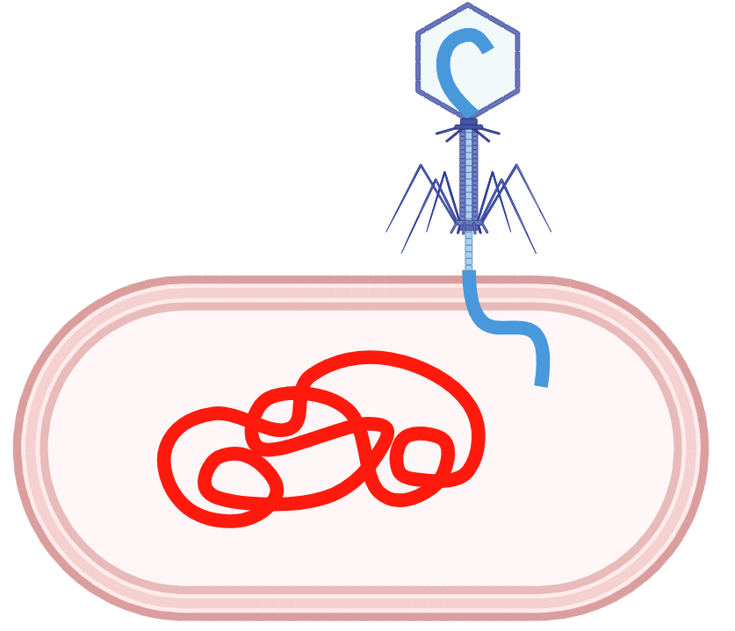

Methylations
#BioSys_BU
Genome stability
and replication
Epigenetic inheritance
DNA methylations
Gene expression regulation
Host defense and
self/non-self discrimination
Phenotypic variation
and adaptation

Slide 5
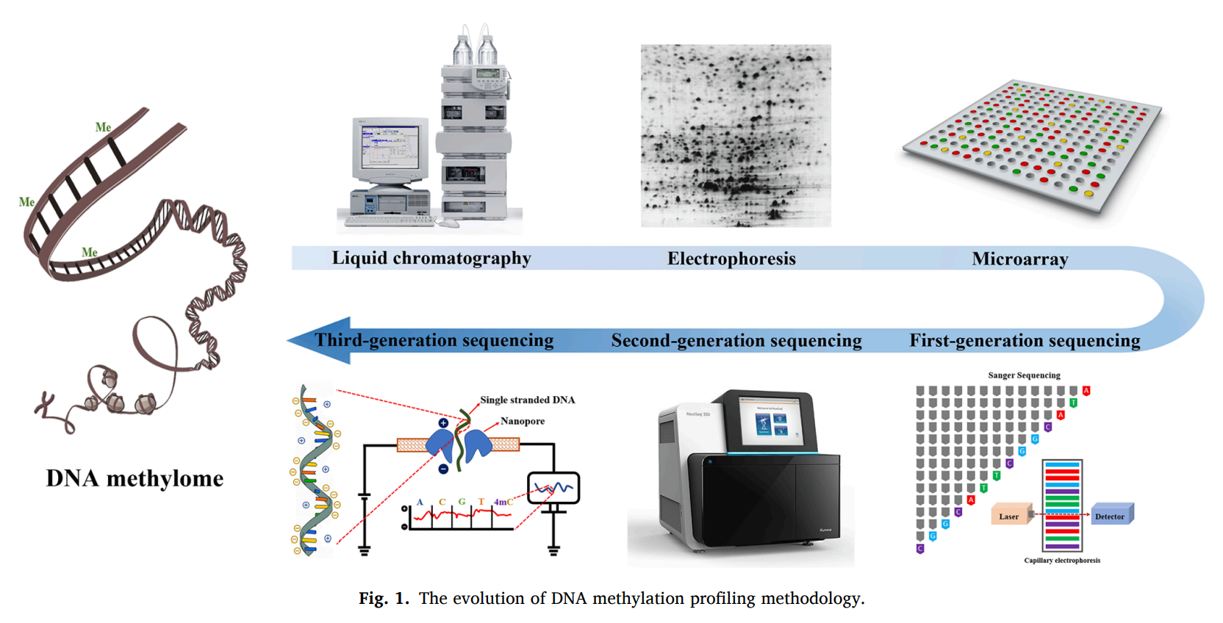
Methylation detection
#BioSys_BU
DOI: 10.1016/j.ymeth.2020.10.002

Slide 6

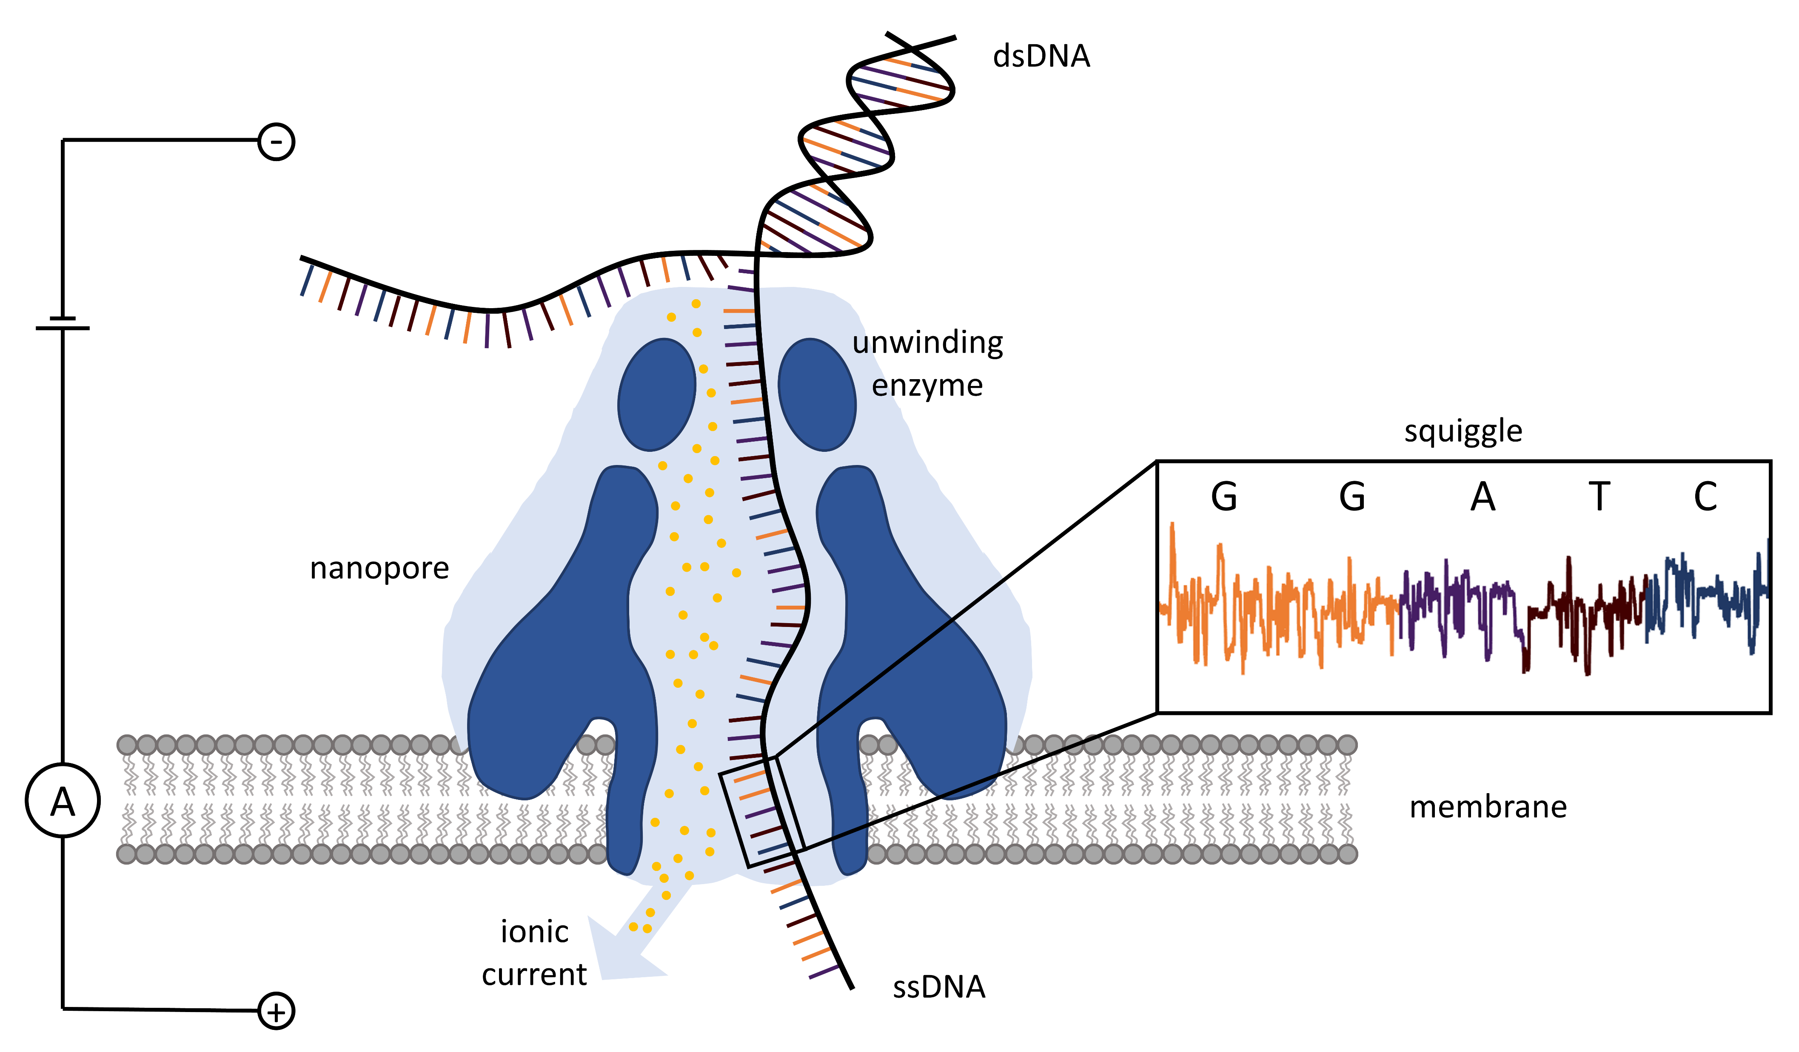
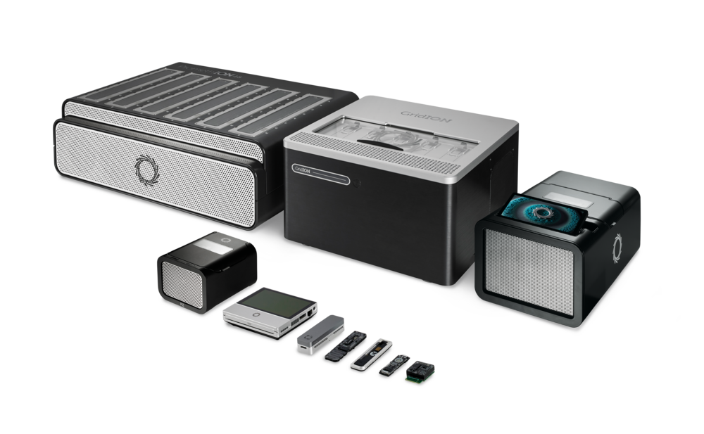
Nanopore sequencing
#BioSys_BU
direct sequencing of native DNA or RNA
long reads (up to 200 kbp)
real-time data analysis
no PCR or chemical treatment
required
sequencers are portable
and scalable

Slide 7
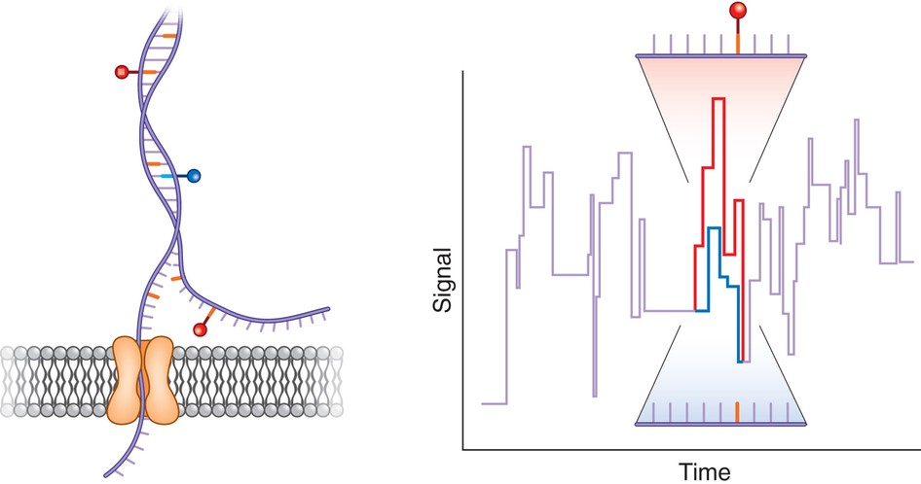
Nanopore sequencing
#BioSys_BU
base modifications change the nanopore signal
→ methylation analysis

Slide 8
Processing challenges
#BioSys_BU
detection possible using ONT tools (Dorado, Modkit)
output: large BedMethyl files (one K. pneumoniae genome – 900 MB)
missing tools for: filtering and quality control
integration with genome annotation
comparison across samples
visualization and reporting
→ new tools and pipelines for methylation analysis are needed
chromosome_contig_1 0 1 a 24 + 0 1 255,0,0 24 0.00 0 24 0 0 1 0 0
chromosome_contig_1 1 2 a 23 + 1 2 255,0,0 23 0.00 0 23 0 0 2 0 0
chromosome_contig_1 2 3 m 25 + 2 3 255,0,0 25 0.00 0 22 3 0 0 0 0

Slide 9
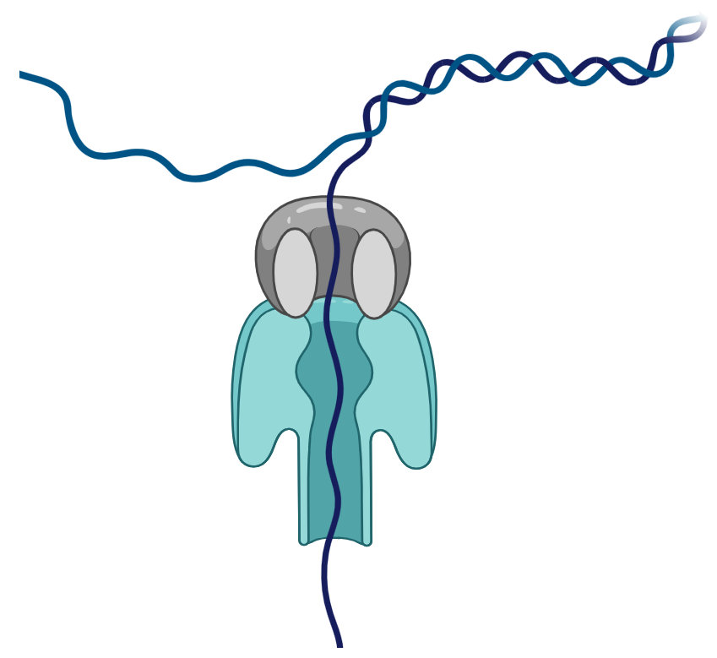
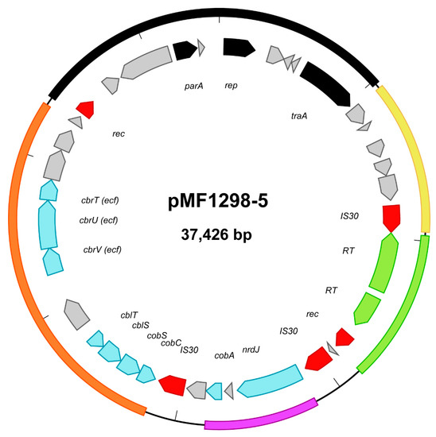

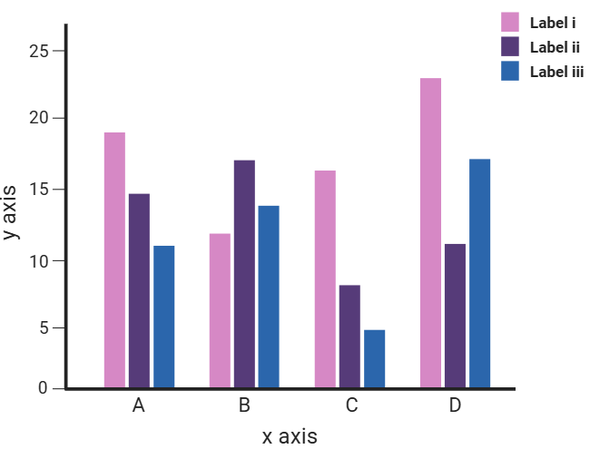


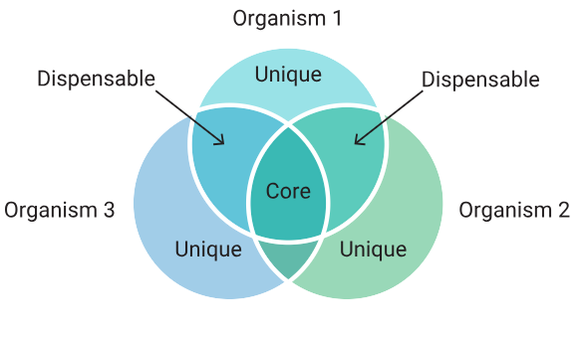
Pipeline
#BioSys_BU
Basecalling & methylation detection
Dorado
Genome assembly
Flye
Pan genome analysis
Roary
Results
evaluation
1
2
3
4
5
6
7
8
Sequencing
ONT P2S
Read preprocessing
Dorado
Genome annotation
DFAST
Methylation site identification
Dorado
Modkit
MethylomeMiner

Slide 10
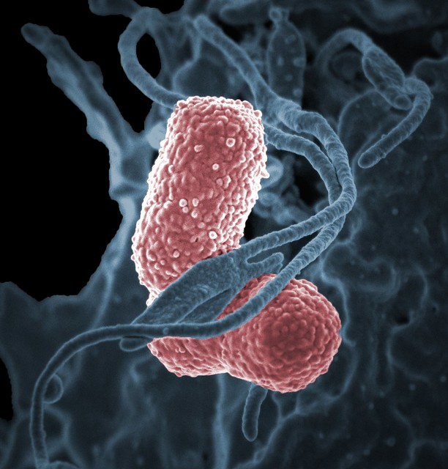
Data
#BioSys_BU
Klebsiella pneumoniae
  opportunistic pathogen → healthcare-associated infections
  major driver of multidrug resistance globally
  20 genomes
    sequenced using ONT PromethION P2S, R10 chemistry
    6 sequence types (2 x ST405, 1 x ST433, 1 x ST391, 1 x ST307, 1 x ST25, 14 x ST13)
    average chromosome size 5,33 Mbp
    from one to three plasmids

Slide 11
Reads processing
#BioSys_BU
basecalling, reads trimming
de novo assembly, annotation, pan genome analysis
sequencing data
assembled references
basecalling with methylation detection, reads trimming
mapping reads to reference sequences
bedMethyl files

Slide 12



MethylomeMiner
#BioSys_BU
Table of methylation in coding regions (*.csv/*.json)
bedMethyl files
bac01.bed
bac02.bed
Pre-processing
filtering based on coverage
selection of genome parts of interest
Analysis of methylations sites in coding and
non-coding regions
…
Table of methylation in non-coding regions (*.csv/*.json)
Genome annotation files
bac01.gff
Statistics for found methylations types
bac02.gbk
…
Methylations in coding regions
Table of methylations of core genes (*.csv/*.json)
Pangenome file
Analysis of methylations
in pangenome
gene_presence_absence.csv
Statistics for methylations of core genome

Slide 13
Results
#BioSys_BU
detection of 4mC, 5mC, 6mA
thresholds:
  coverage ≥ 38 (median)
  methylation probability ≥ 0.9
~56,649 methylation sites per genome
  minimum 1,851 (KP1906)
  maximum 96,422 (KP1267)
not consistent within STs
ST405
ST391
ST307
ST25
ST433
ST13

Slide 14
Results
#BioSys_BU
6mA – predominant DNA modification
4mC – rare
average methylation
sites per genome:
coding vs. noncoding regions:
  each 25th nucleotide methylated in noncoding region
  each 210th nucleotide methylated in coding region
5mC
4mC
6mA
coding
noncoding
Notes:
25th v noncoding, 210th in coding

Slide 15
Results
#BioSys_BU
methylation load per gene
  4mC: one methylation per gene
  5mC: 1 to 5 methylations per gene
  6mA: 1 to 5 methylations per gene
hypermethylated genes
  5mC
    61 methylations: glutamine ABC transporter ATP-binding protein GlnQ (KP1267)
    60 methylations: hypothetical protein (KP1622)
    56 methylations: lipoyl(octanoyl) transferase LipB (KP1821)
    iron ABC transporter permease (KP1829)
  6mA
    58 methylations: hypothetical protein (KP1833)
    57 methylations: ornithine decarboxylase (KP1822)
    56 methylations: lipoyl(octanoyl) transferase LipB (KP1821)

Slide 16
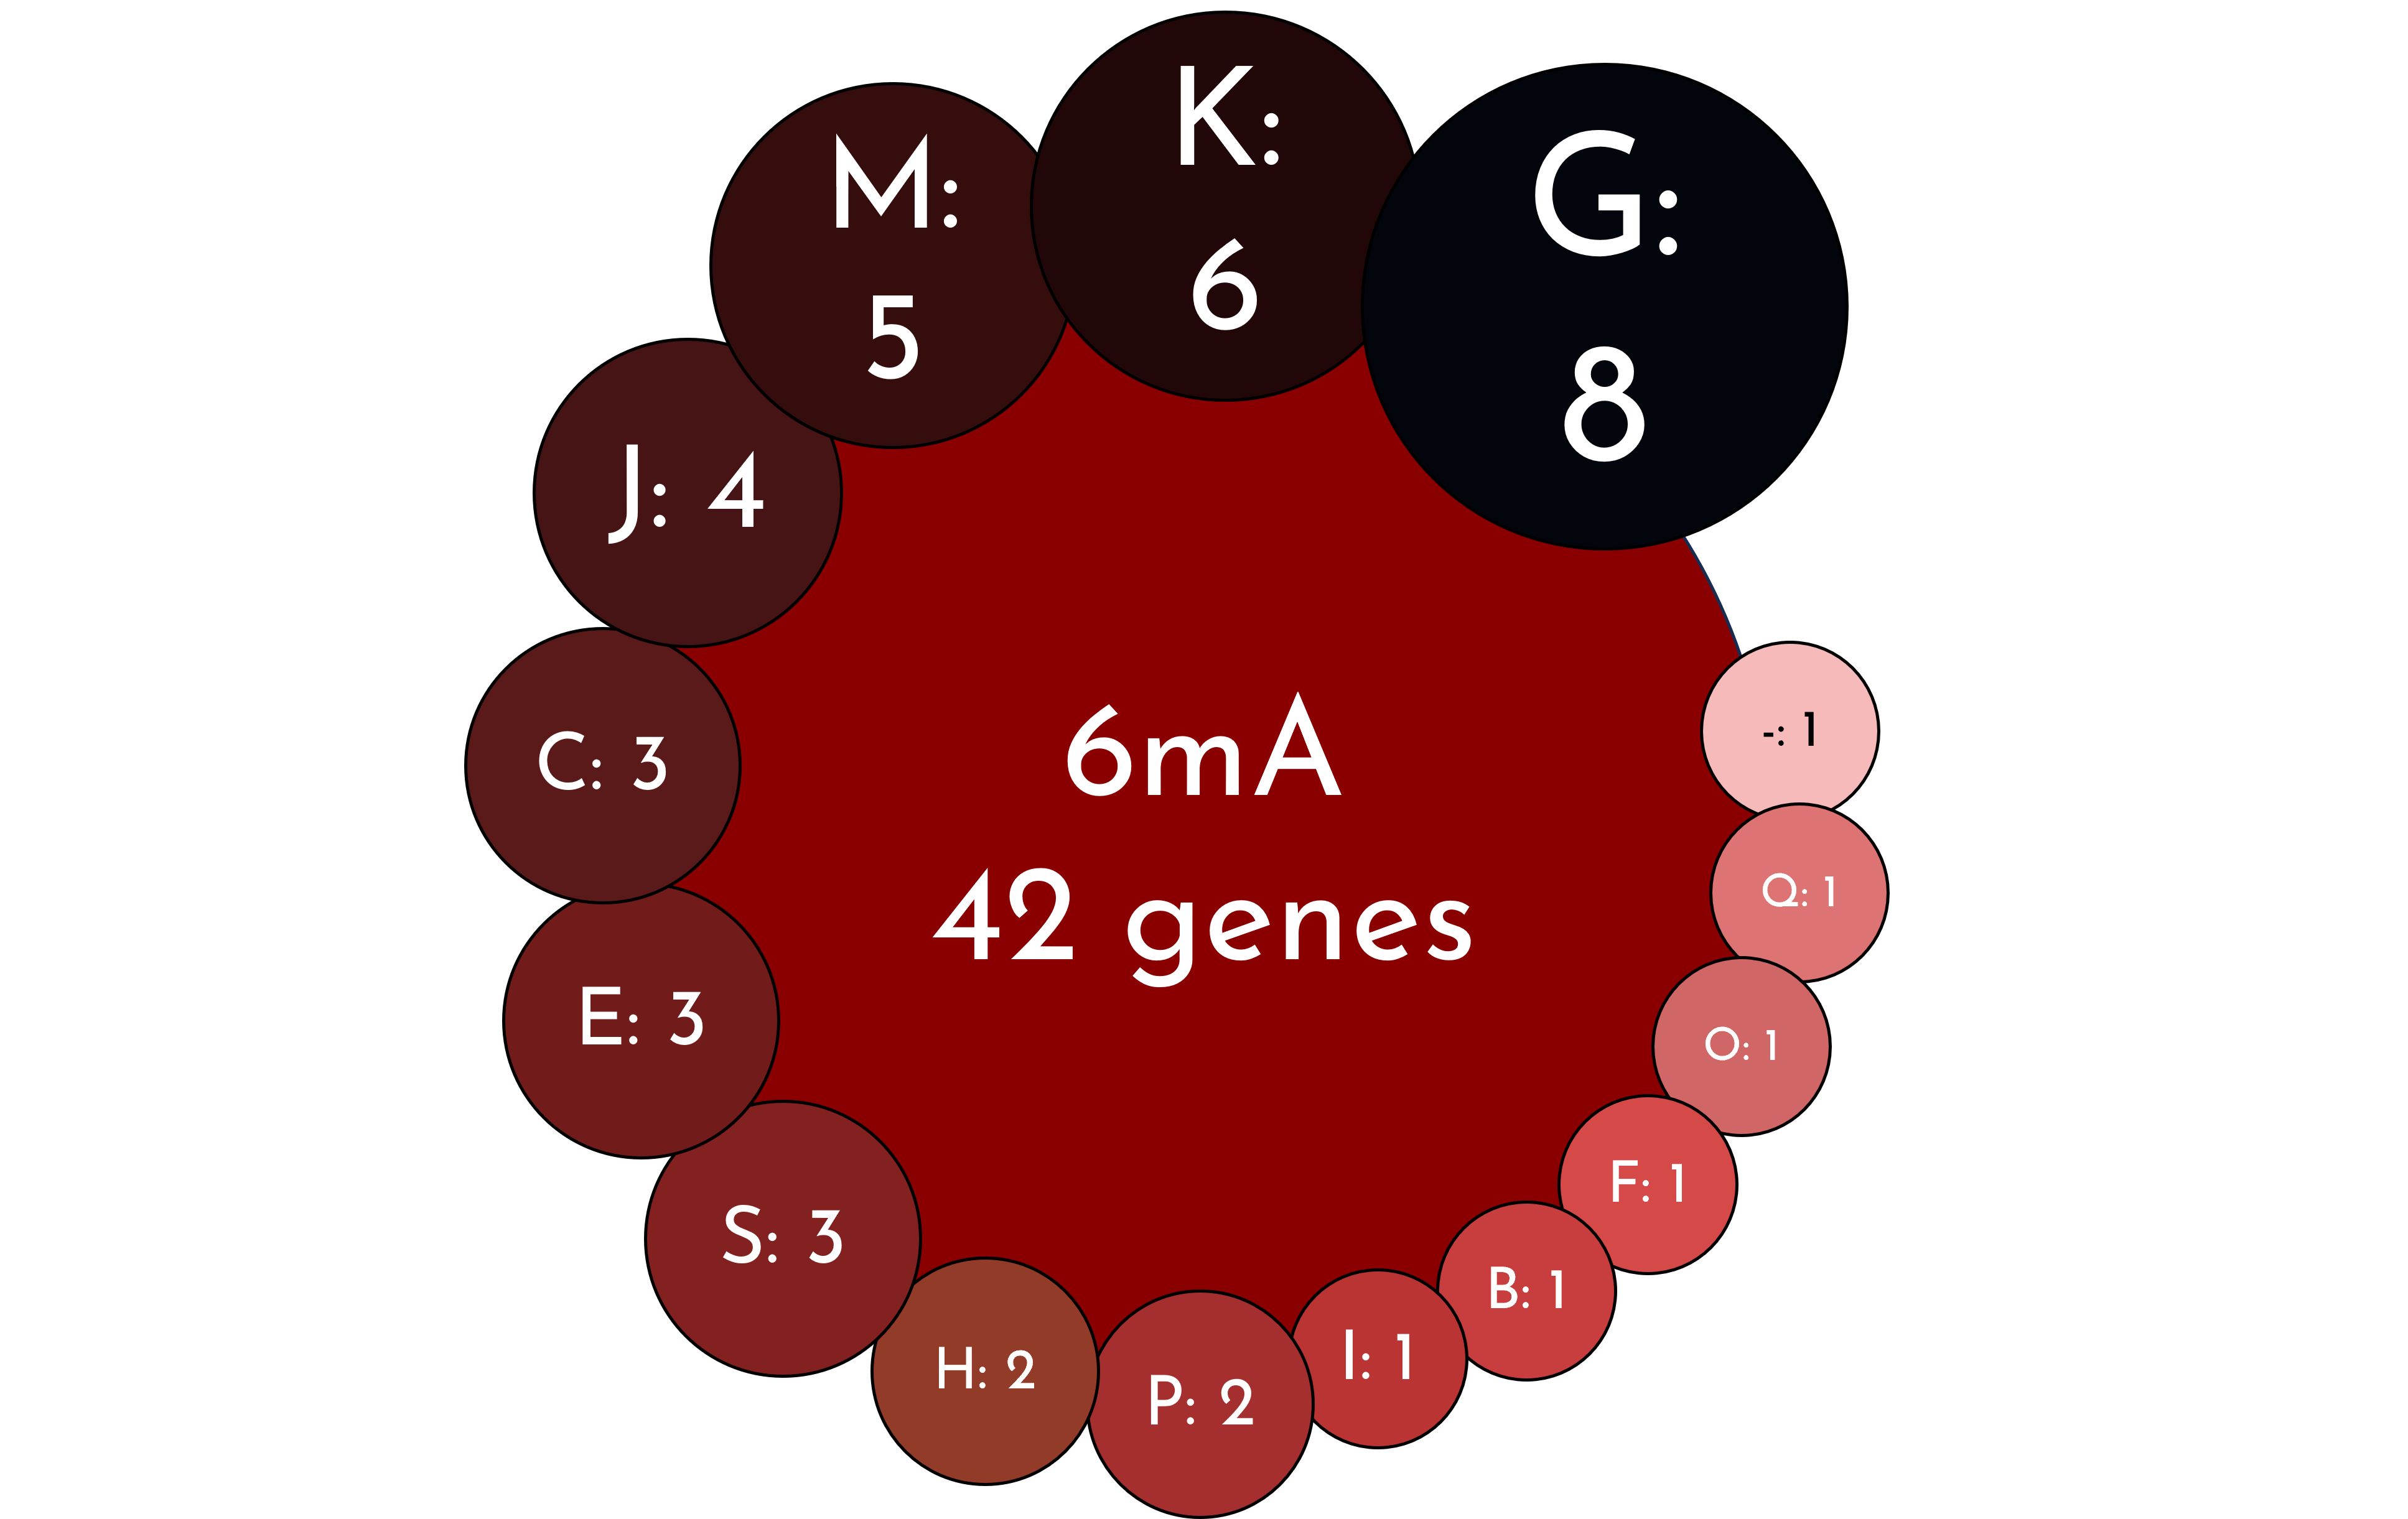
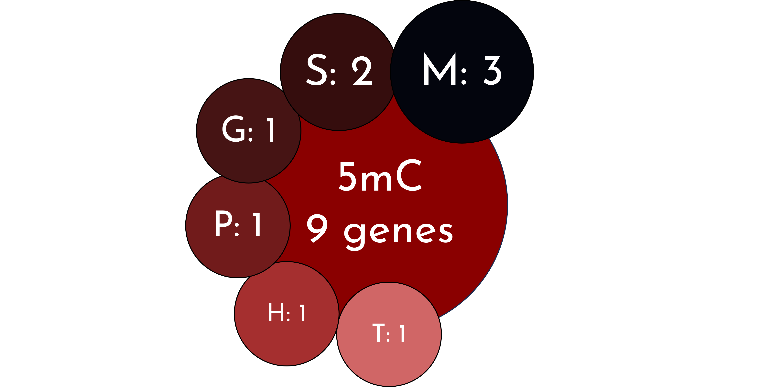
Results
#BioSys_BU
core genome: 4025 genes
core methylome (core genes with the same type of methylation across all strains)
  4mC – 0 genes
  5mC – 9 genes
  6mA – 42 genes
G: Carbohydrate transport and metabolism K: Transcription M: Cell wall/membrane/envelope biogenesis J: Translation, ribosomal structure, and biogenesis C: Energy production and conversion E: Amino acid transport and metabolism S: Function unknown H: Coenzyme transport and metabolism P: Inorganic ion transport and metabolism I: Lipid transport and metabolism B: Chromatin structure and dynamics F: Nucleotide transport and metabolism O: Post-translational modification, protein turnover, chaperones Q: Secondary metabolites biosynthesis -: Unknown function

Slide 17
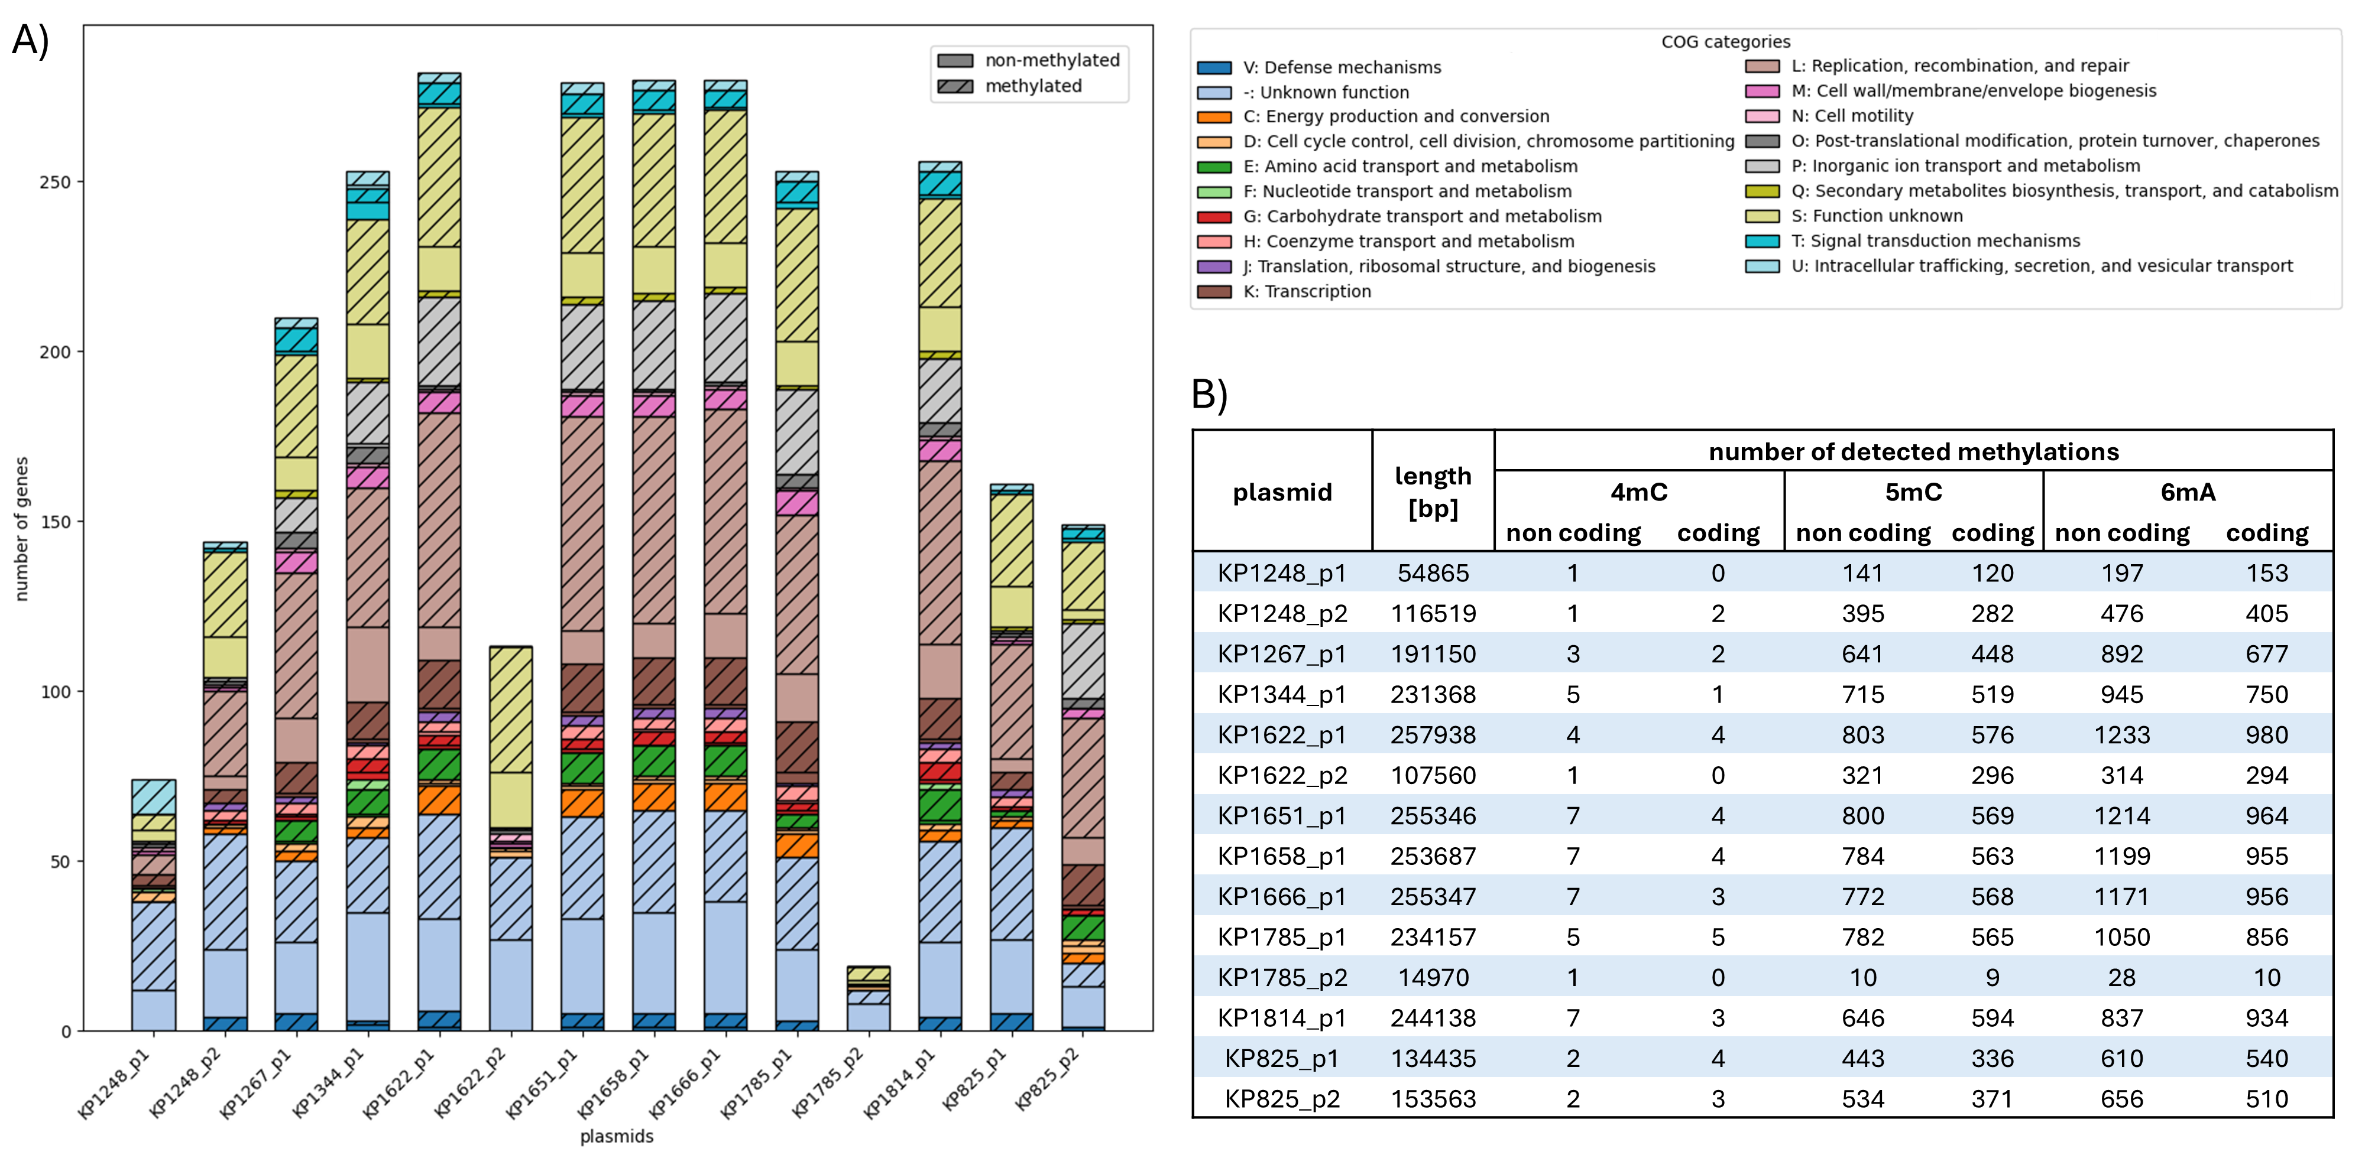
Results
#BioSys_BU

Slide 18

Conclusion
#BioSys_BU
What we did?
  found that methylations occur in bacteria
  proposed pipeline for routine bacterial methylation analysis
  developed in-house tool MethylomeMiner for methylation data processing
    characterization of methylation patterns in populations
    study of regulating gene expression
    bacterial genomes‘ evolution and functional diversity
What next?
  biological interpretation of methylation effects
  correlation with phenotype
  study methylations in resistance and virulence genes
  changes in methylation during freezing and thawing and passaging

Slide 19

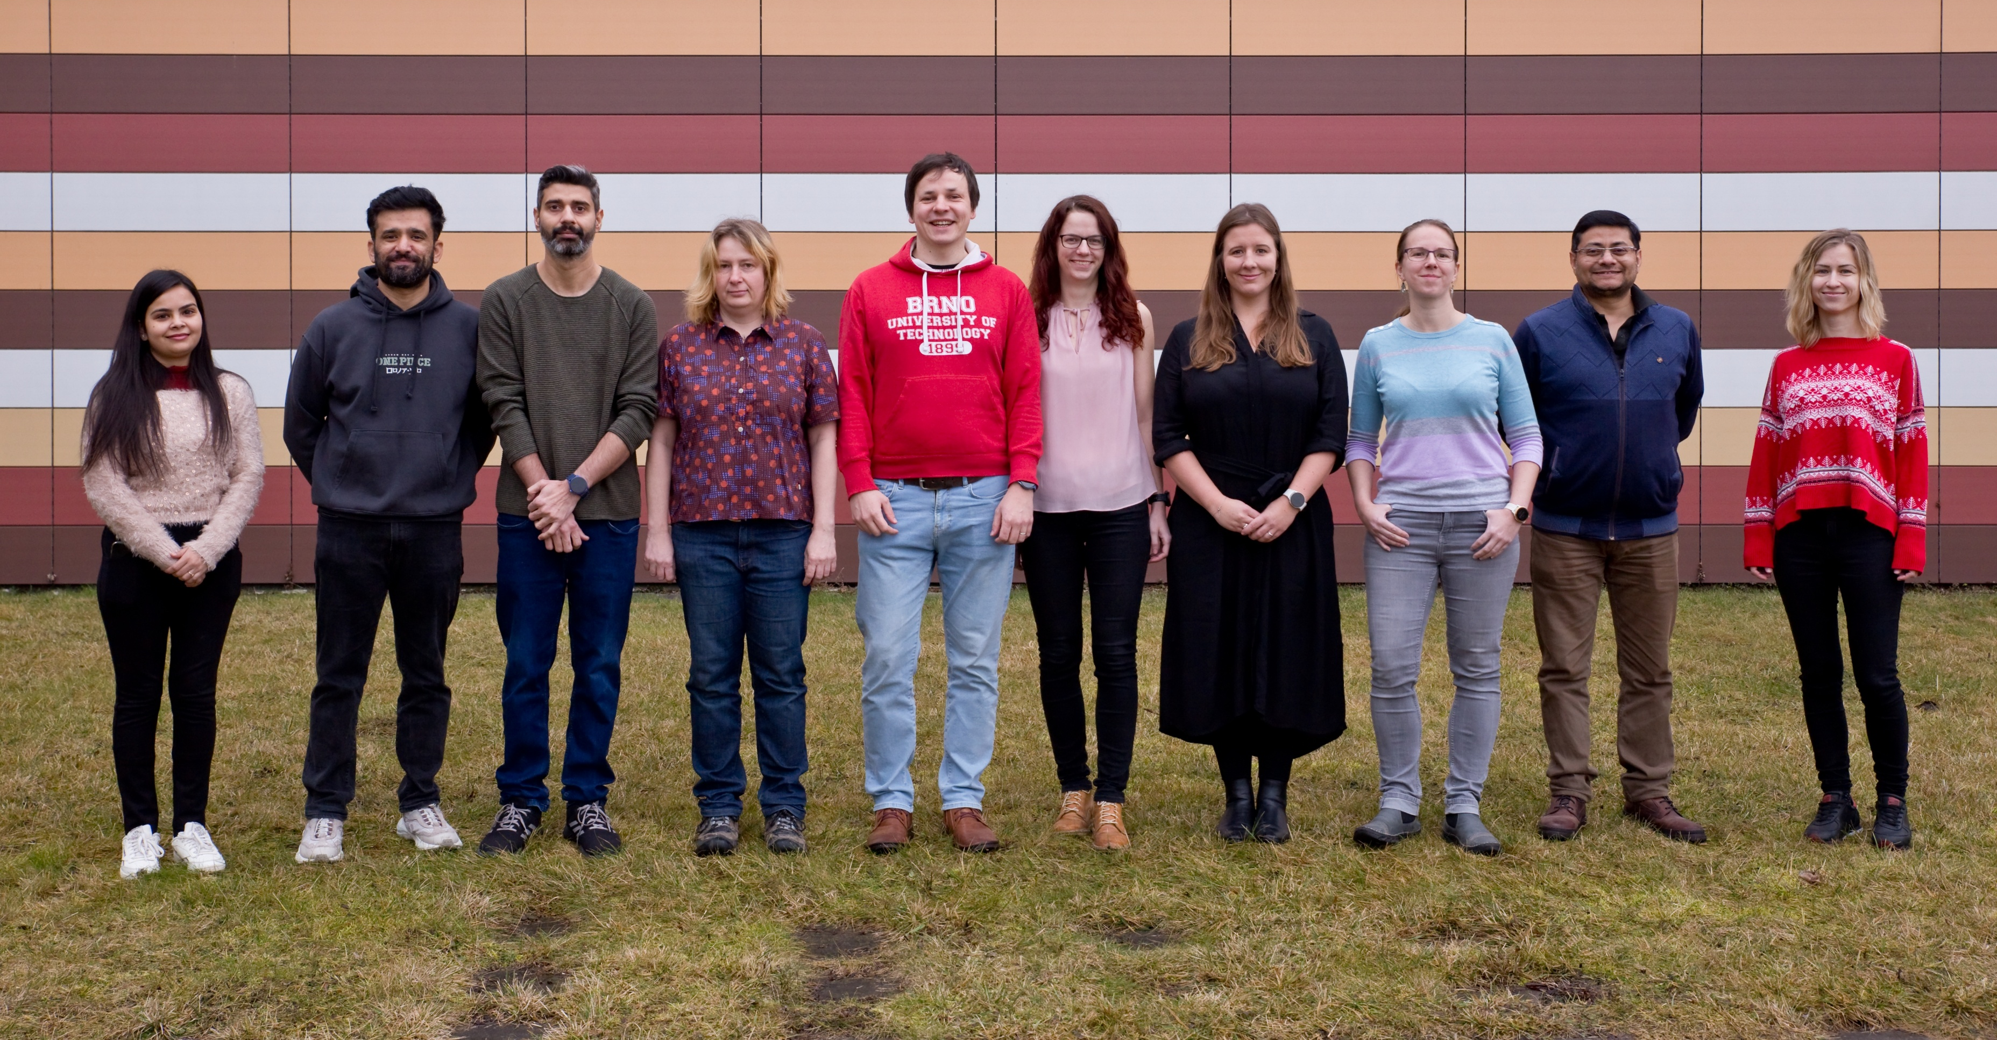


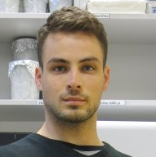

Acknowledgement
#BioSys_BU
Department of Biomedical Engineering, FEEC, BUT
Center of Molecular Biology and Gene Therapy, University Hospital Brno
doc. Mgr. Martina Lengerová, Ph.D.
Mgr. Matěj Bezdíček, Ph.D.

