Slide 1

QM-Based Multiscale Modeling of Insulin–Receptor Interactions and Rational Design of Insulin Analogs
Institute of Organic Chemistry and Biochemistry, Czech Academy of Sciences, Prague
. Y. Yurenko, M. Lepšík
| June 9, 2025

Slide 2
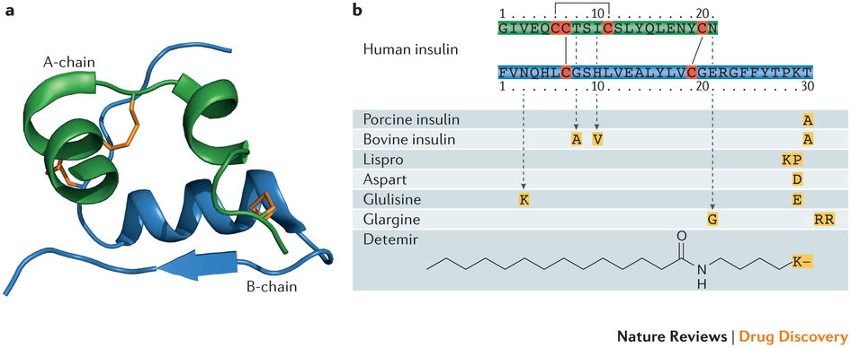
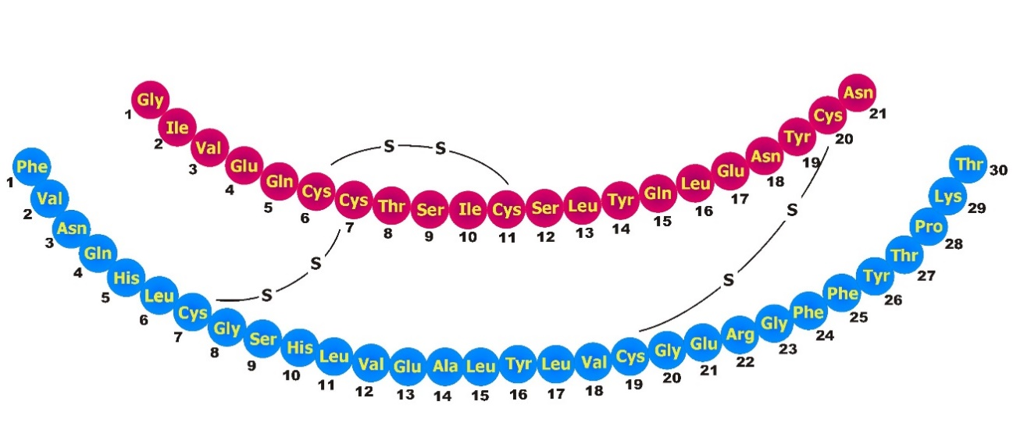
Background
Insulin is a peptide hormone (51 residues, A and B chains) essential for metabolic regulation;
Binds to extracellular domain of insulin receptor (IR), triggering growth and metabolic signaling;
Structural and energetic determinants of this interaction remain incompletely understood.

Slide 3
Motivation
The need for understanding of insulin-IR binding mechanisms, and energetics;
Better treatment of diabetes → computational protocol that can be used for design of insulin analogs.

Slide 4
Aims
Develop a multiscale protocol for the insulin–receptor system
• Quantify residue-level contributions to binding free energy
• Map interaction hotspots at the interface
• Evaluate all natural mutations at key insulin positions
• Benchmark ΔΔG values against experimental data

Slide 5
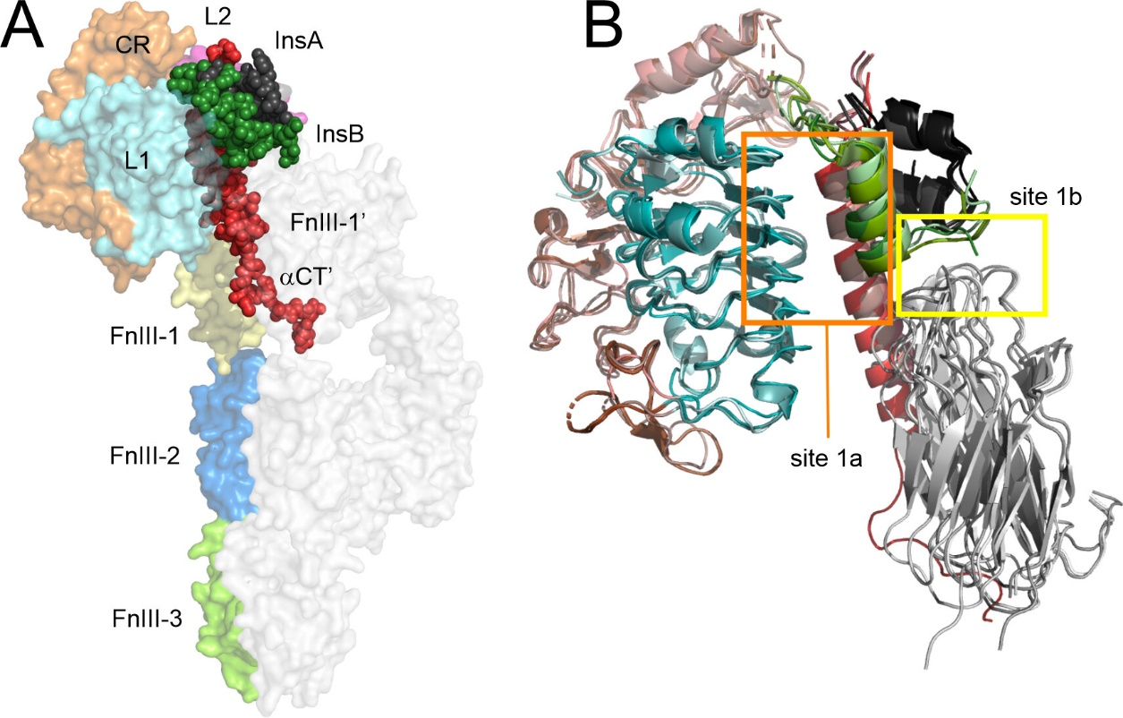
Insulin-IR complexes

Slide 6
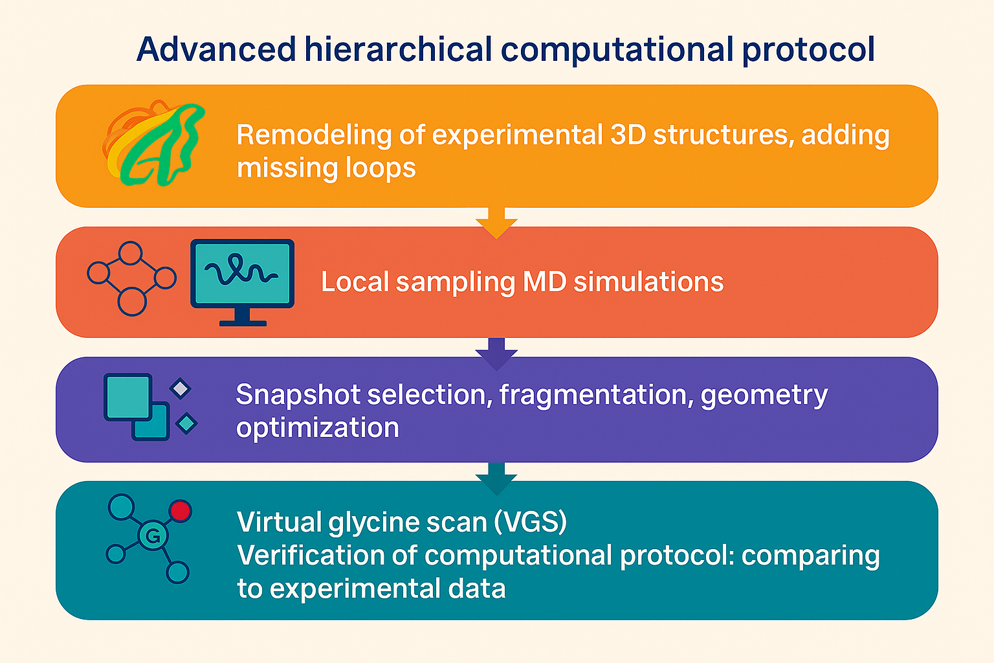
ΔΔG_{int} = -[ΔG_{int} (WT) – ΔG_{int} (Gly)]

Slide 7
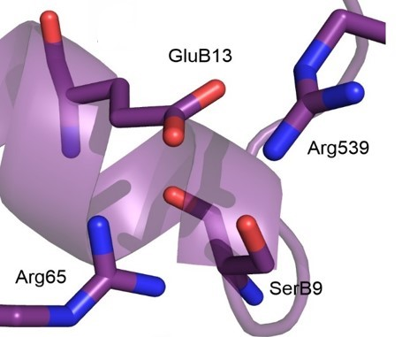
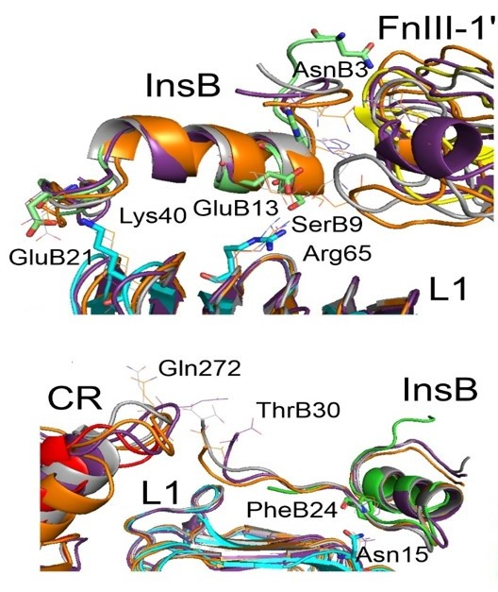
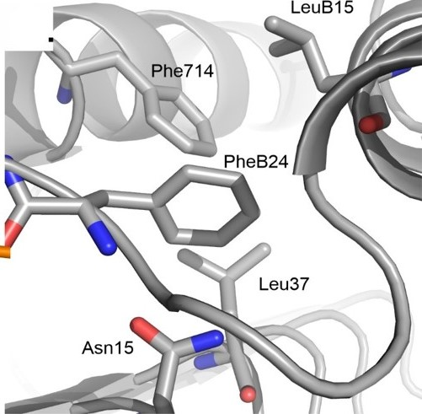
Regions with H-bonding and non-polar contacts

Slide 8
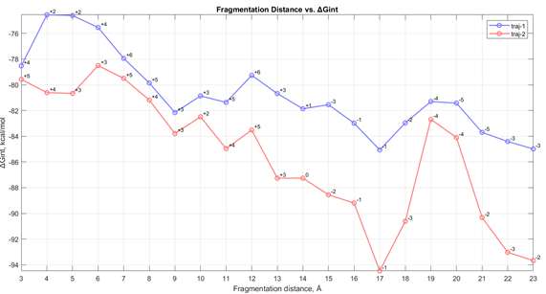
Fragmentation
Poor correlation between MM/GB and SQM/COSMO interaction enegies in insulin-IR complex: MM/GB failure
in describing nonadditive effects!

Slide 9
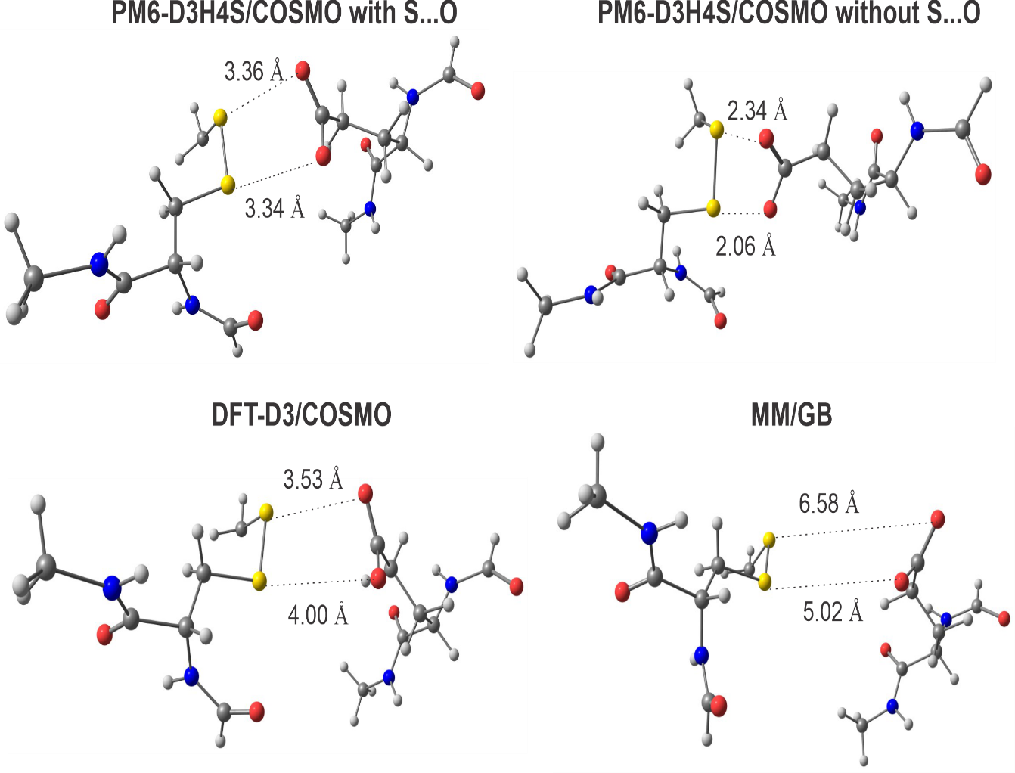
DFT-D3 benchmarking
Poor correlation between MM/GB and SQM/COSMO interaction enegies in insulin-IR complex: MM/GB failure
in describing nonadditive effects!

Slide 10
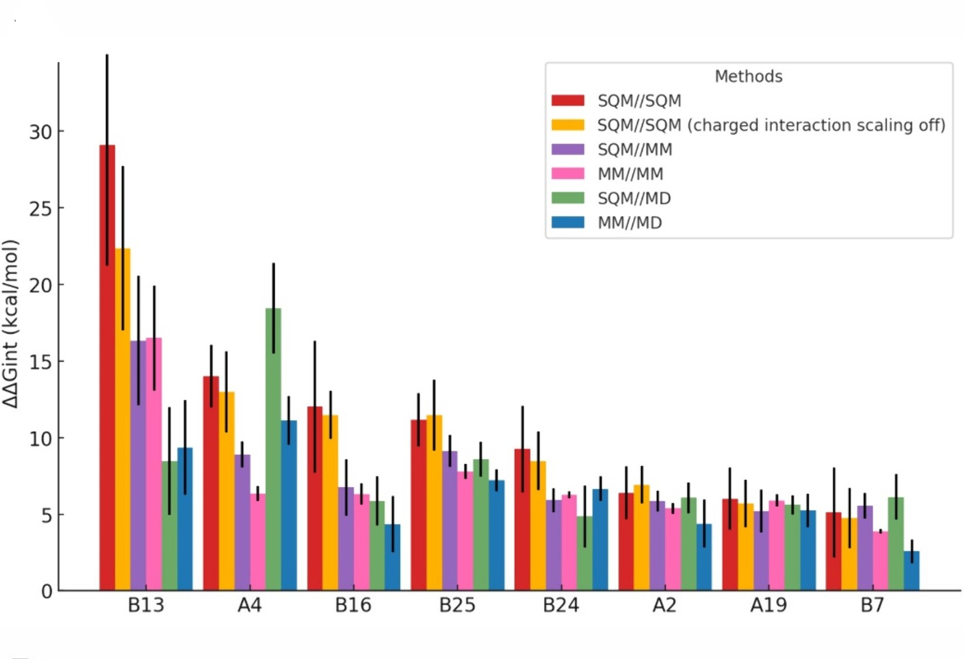
Virtual Glycine Scan (VGS)

Slide 11
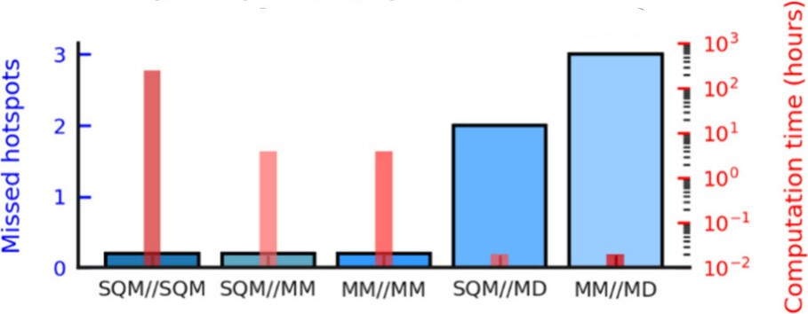
Efficiency in “hotspot” detection vs. timing
Yurenko et al., J. Chem. Inf. Model., 2025, 65, 5690-5705

Slide 12
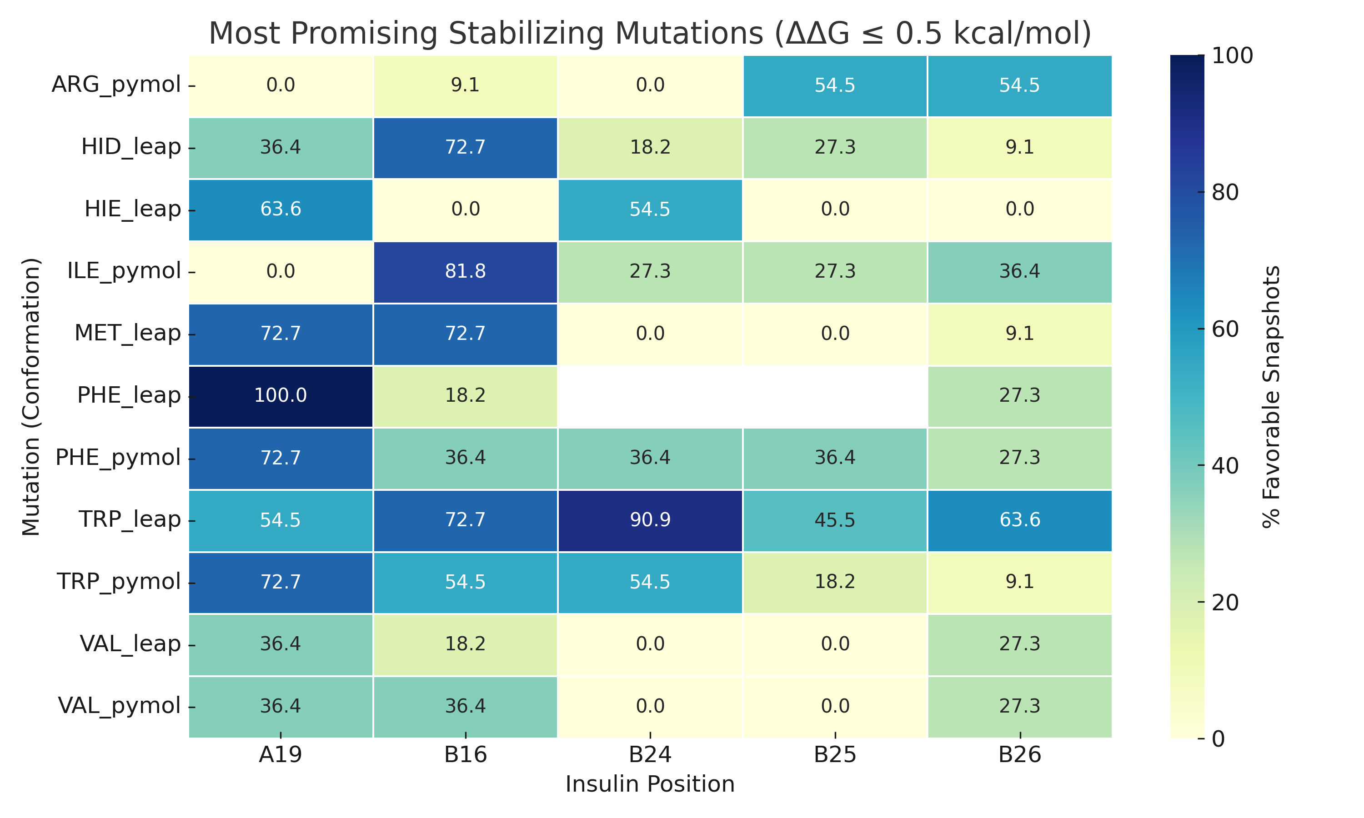
The scanning for insulin mutants

Slide 13
In silico scanning mutagenesis vs. experimental binding affinities
Insulin position | Conformation | Agreement | Disagreement | % Agreement
A19 | LeaP | 27 | 17 | 61.4
 | PyMol | 34 | 10 | 77.3
B16 | LeaP | 21 | 1 | 95.5
 | PyMol | 22 | 0 | 100.0
B24 | LeaP | 61 | 16 | 79.22
 | PyMol | 71 | 6 | 92.2
B25 | LeaP | 59 | 7 | 89.4
 | PyMol | 54 | 12 | 81.8
B26 | LeaP | 85 | 14 | 85.9
 | PyMol | 93 | 6 | 93.9

Slide 14
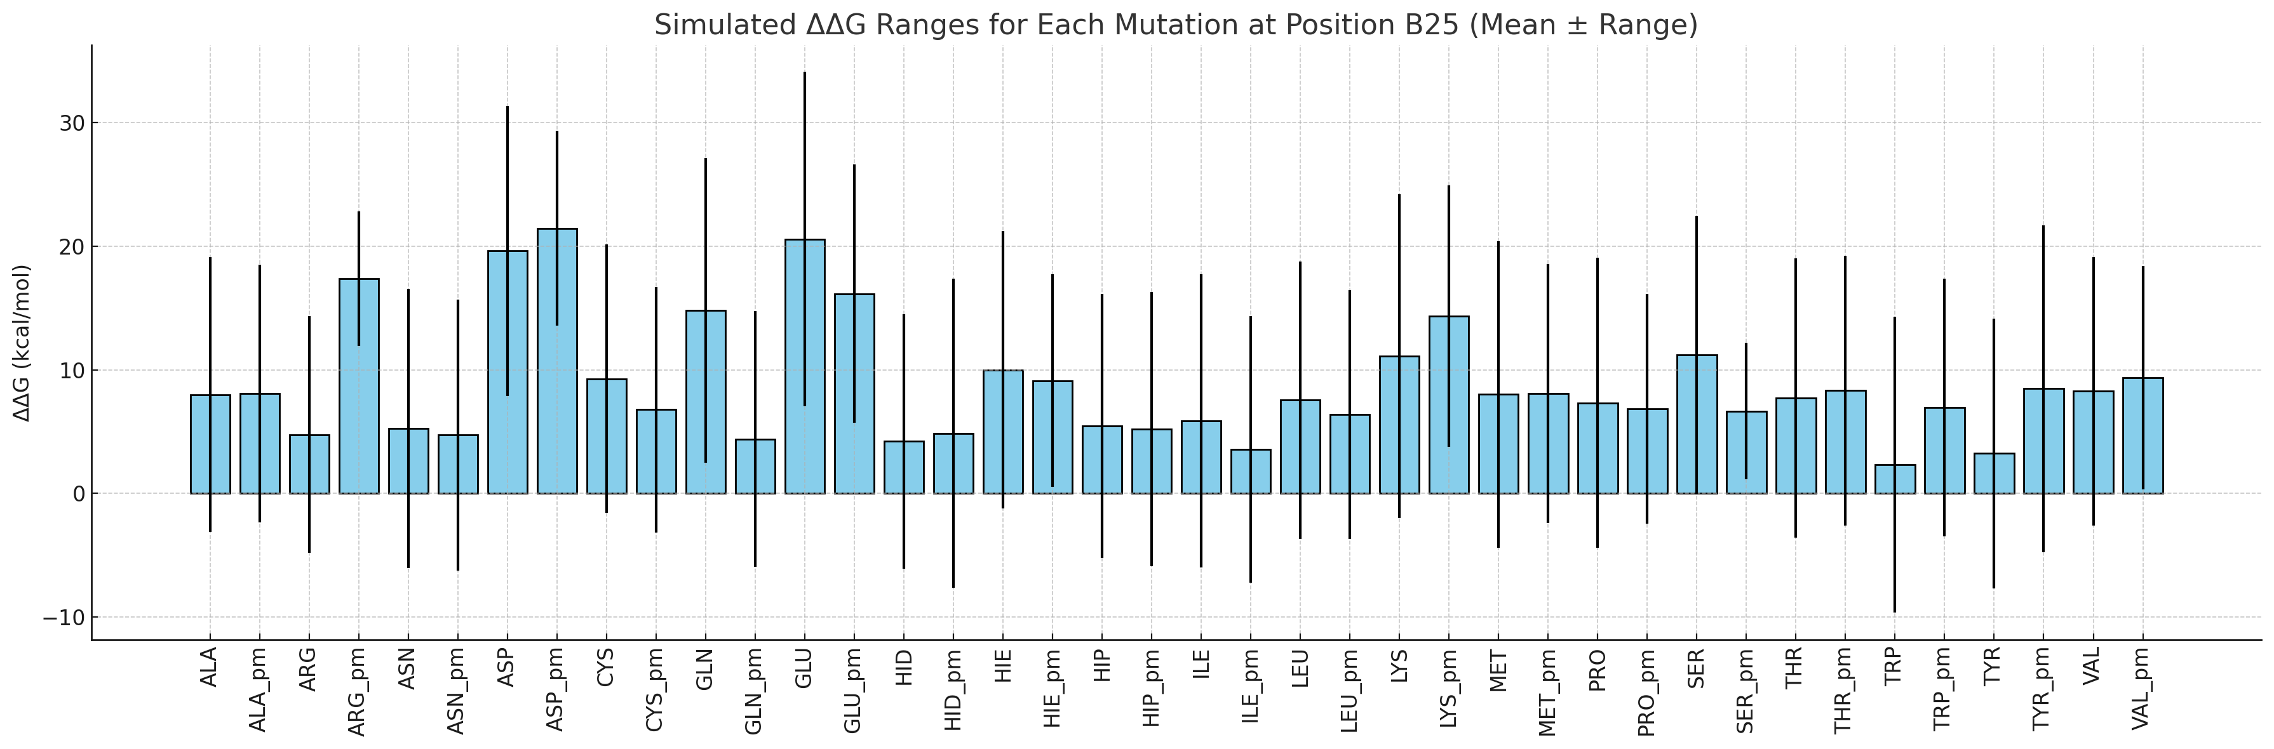
Conformational dependence of modification effects

Slide 15
Limitations of the protocol
Methodological and Sampling Limitations
Limited number of MD snapshots may not capture full conformational ensemble
Rigid receptor model — receptor flexibility not accounted for
Backbone atoms fixed in QM region → possible underestimation of structural adaptation
Snapshot-dependent variability can affect consistency
Computational and Technical Constraints
· Approximate entropy treatment via solvation terms
· Limited solvent modeling (e.g., no explicit water molecules or ions)
· Residue-residue interactions in QM region sensitive to cutoff definitions
· No inclusion of long-range receptor contacts or allosteric effects

Slide 16
Conclusions
A QM-based multiscale protocol was developed to quantify energetic contributions of individual insulin residues to receptor binding.
Mutation scanning across multiple conformations highlights promising stabilizing substitutions.
Good qualitative agreement with experimental binding affinities was achieved for many mutants.
The method captures context-dependent effects but has limitations for flexible or solvent-exposed residues.
This protocol can guide rational design of insulin analogs and be extended to other hormone–receptor systems.

Slide 17
Acknowledgements
Atomistic Understanding of Peptide Hormone Binding to Their Receptors and Mimetics Design via Advanced Computations and Experimental Verification, Czech Science foundation, project 23-06755S
Chemical biology for drugging undruggable targets (ChemBioDrug) European Project № CZ.02.1.01/0.0/0.0/16_019/0000729, Regional Development Fund; OP RDE
Thank you very much!

